Slide 1
Unit 10-JavaScript Functions
Instructor: Brent Presley

Slide 2

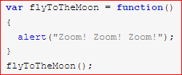

Anonymous functions
Anonymous functions
  this is what our $ function is
  they are given a name by assigning them to a variable
  var calc = function{...}

Slide 3
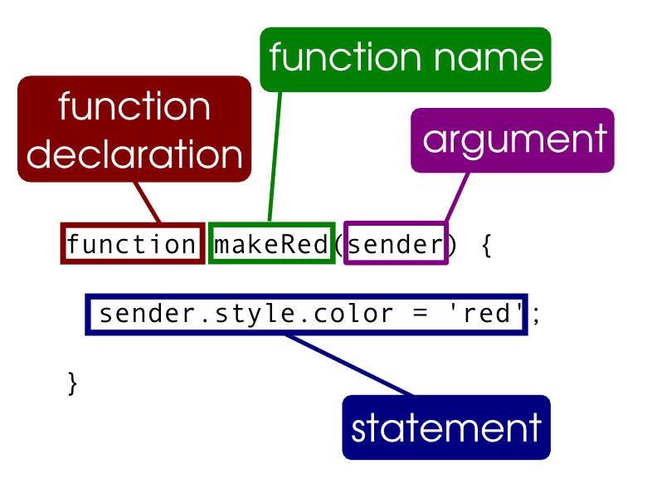
regular functions
Regular functions
  place functions in the .js file anywhere
  may be declared before or after called
  parameters are local variables
  very similar to the manner you would use a # method

Slide 4
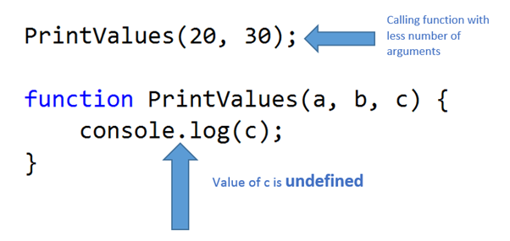
optional parameters
all parameters are really optional
  some programmers use no parameters
  if you know parameters are required, you should pass them in the parameter list
JS stores the arguments sent to a function in the predefined arguments object
the parameters are what are included in the function declaration and arguments are what is provided in the function call

Slide 5
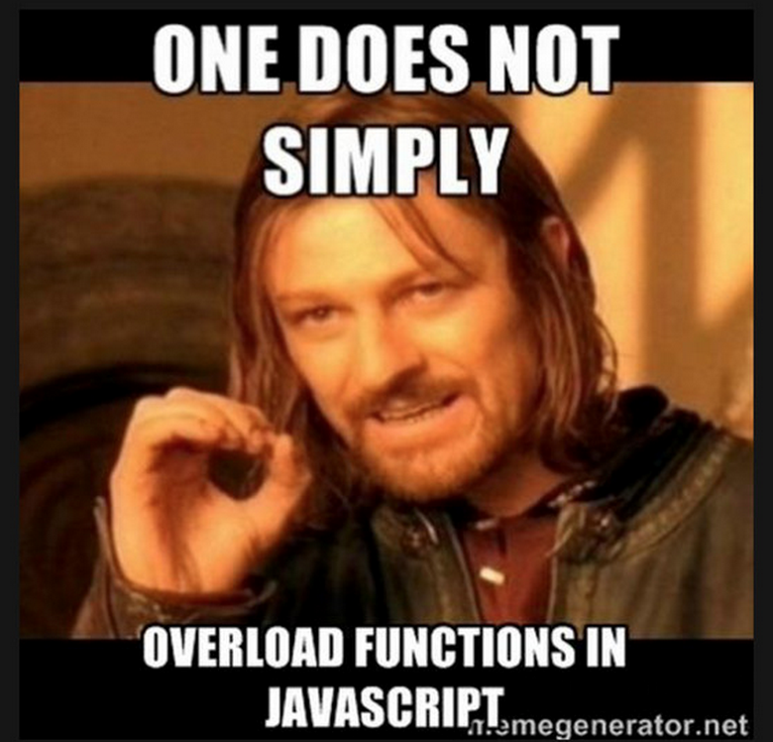
optional parameters vs overload
Most languages will overload a method by giving different parameter lists
  sort(int i1, int i2)
  sort(int i1, int i2, int i3)
  sort(string s1, string s2)
however, JavaScript has optional parameters & cannot be overloaded
  if not passed in, JavaScript will set them to undefined

Slide 6
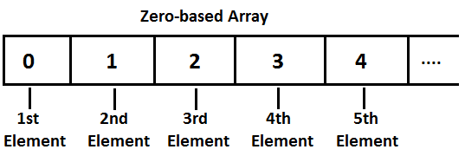
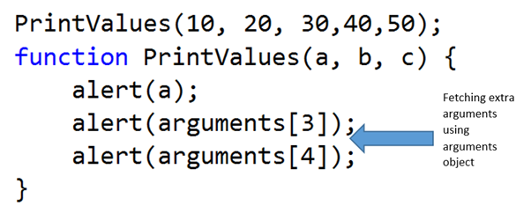
the arguments array
arguments is an array of all the objects sent to the function
arguments.length returns how many arguments there were
arguments[i] provides access to the individual arguments (replace i with a 0-based counter/index)

Slide 7
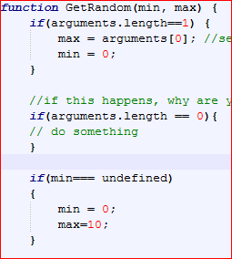
determine if an optional parameter is missing
Check if arguments.length is less than the number of arguments you expect
(alternative)
if(paramName===undefined)

Slide 8
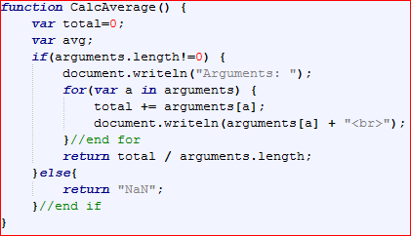
avg function
functions with variable numbers of parameters
  write an average function that allows any number of arguments.

Slide 9

function return values
Functions can optionally return a value
return returnValue;
If a function call expects a return value and none is provided an error will most likely occur
If the function does not return a value, you may still include the return; statement, but it is optional.
Structured programming has historically dictated that a function should only have one return statement. However, this is no longer the expectation, but if you are using multiple return statements, do it carefully.
http://stackoverflow.com/questions/36707/should-a-function-have-only-one-return-statement

Slide 10
calling a function
calling a function that doesn't return a value
  funcName(argumentlist);
  the argument list is optional if the function doesn't have parameters or if all parameters are optional
calling a function that does return a value
  myVariable = funcName(argumentlist);
  or
  document.writeln("square rt is " + sqrt(myVariable));
  //the function return value is used immediately, but not stored

Slide 11
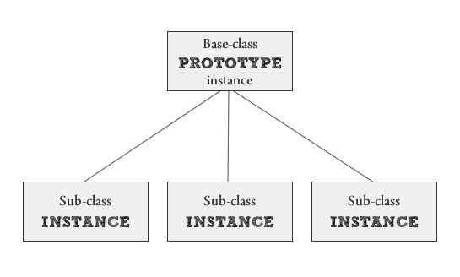
Adding a method to a class
Remember, in most languages a method is simply a function embedded in a class
The built-in JavaScript classes have many predefined methods
However, you may want to define a new method and assign it to a class (a prototype class)
defining a method for a built-in class is done using anonymous functions

Slide 12
object methods
create an object method:
access the object method
you will describe fullName() as a method of the person object, and fullName as a property

Slide 13
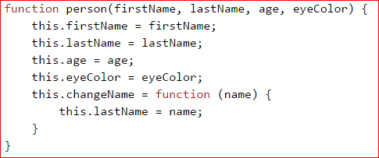
object method example
changeName is the method here
  to access: myName.changeName("Alan");

Slide 14
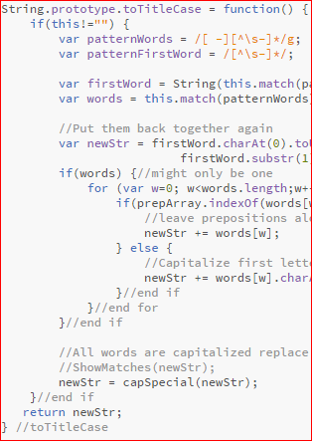
open JStools
look at titlecase.js
  view source, note prototype modification
Defining a method for a built-in class is done using anonymous functions

Slide 15
Replace ClassName with the name of the class you’re adding to (Date, String, Math, etc.)
prototype is a required keyword
Replace methodName with the name of your choice
As with functions, the parameter list is optional
As with functions, the return value is optional, but many methods include one
Note the similarities between method declarations and function declarations

Slide 16
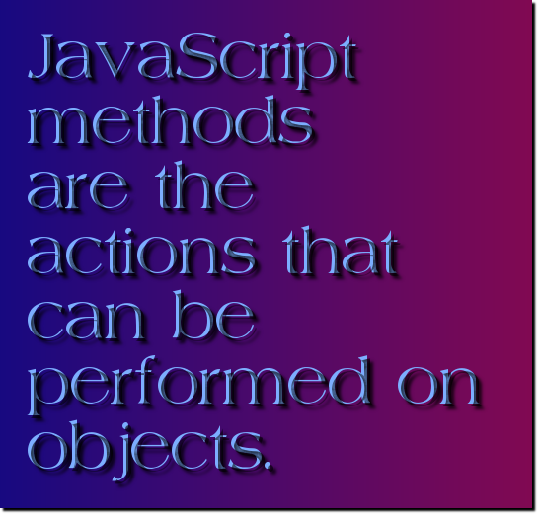
calling/invoking the method
Unlike functions, methods must be invoked by first referencing the object you wish to apply the method to.
result = objName.methodName(argList);
betterString = myString.toTitleCase();
The result variable assignment is not used when the method doesn’t return a value.
The argList is optional based on the requirements of the method

Slide 17
In the example,
myString is a String variable (an instance of the String class
TitleCase is the name of a method defined using the prototype technique described above (it requires no arguments)
TitleCase does return a value which is stored in another String variable named betterString

Slide 18
importing functions
Functions are often stored in JavaScript libraries
Files containing nothing but JavaScript function(s), with js extension
To import a library, making its functions available:
javascript is a folder within your website containing JavaScript libraries
  scripts is also used as the folder name
Note the end script </script> tag is required even though no JavaScript is included between the tags

Slide 19

global variables
Global variables are variables defined outside of a function.
These variables can be referenced by any function and any code not in a function
Code can read or change the variable
Use global variables sparingly

Slide 20

local variables
Local variables are variables defined inside a function
Include parameters
Only accessible inside that function
Generally considered better programming practice to pass data needed by a function as a parameter instead of declaring globally

Slide 21
Assignment unit 9
JavaScript Functions
  lab the rest of today, as well as Thursday
  Due one week from today

Slide 22
demo
Create a function to display the string variable using a global string variable
Discuss why global variable not needed here.
Write calcAverage function that calculates the average of a global array.
Declare array in html page JavaScript
Display contents of array and average in html page

