Slide 1
Unit 8 –JavaScript Basics
Instructor: Brent Presley

Slide 3
Assigned Reading
pages 50-75
224-227
250-271
276-309

Slide 4
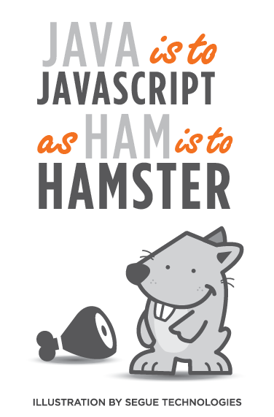
JavaScript overview
java - not like java
script- implies it's not a full language
used mostly in browsers
gets a bad reputation
functional language

Slide 5
JavaScript overview
java - not like java
script- implies it's not a full language
used mostly in browsers
gets a bad reputation
functional language
reference
  https://www.youtube.com/watch?v=v2ifWcnQs6M&list=PL62E185BB8577B63D&index=1

Slide 6
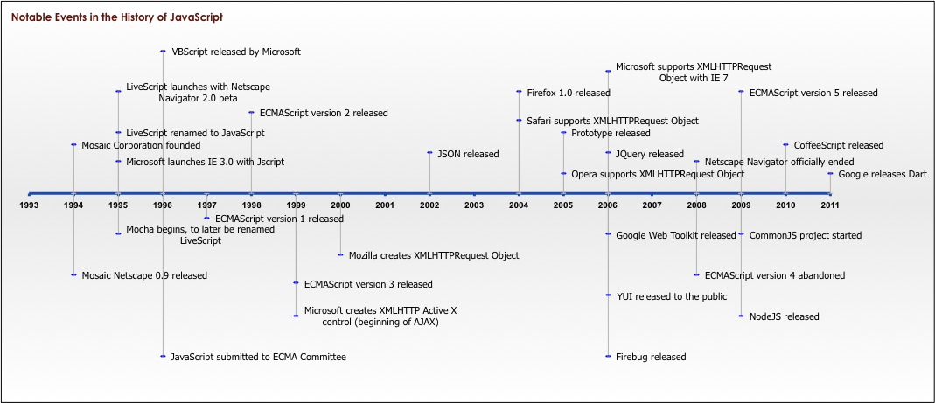
history of JavaScript - Douglas Crockford-Yahoo
https://www.youtube.com/watch?v=t7_5-XYrkqg
above image
  http://cevichejs.com/images/1-javascript/JavaScriptTimeline.jpg

Slide 7
JavaScript overview
it is a real language
small, but sophisticated
not a subset of java

Slide 8

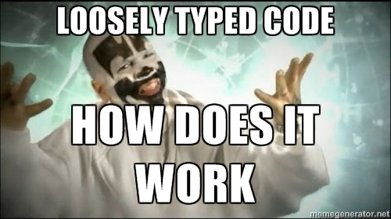
JavaScript overview
load and go delivery
  delivered to the execution site as source code
  was intended to be imbedded into text pages, so it was originally delivered as text
loosely typed
  current desire- strongly typed so the compiler can check the type
objects as general containers

Slide 9

objects as containers
Objects as general containers
  items can be added to the object at any time
  unification of objects and hash tables..
Hash table = data structure that can map keys to values

Slide 10

prototypal inheritance
prototypal inheritance (not class inheritance)
  objects inherit from other objects
  there are no classes

Slide 11
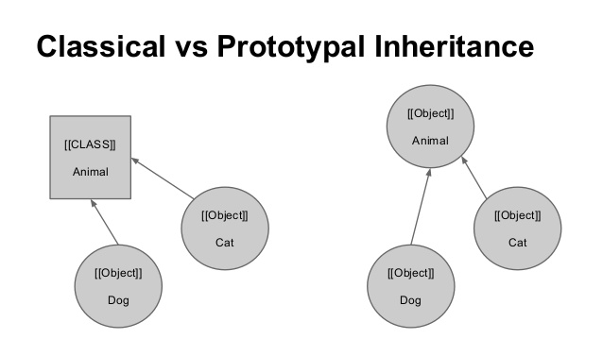
prototype
A prototype is an internal object from which other objects inherit properties.
Its main purpose is to allow multiple instances of an object to share a common property.
Thus, object properties which are defined using the prototype object are inherited by all instances which reference it

Slide 12
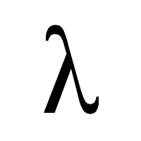

lamda and global variables
lamda
  use of functions as first class objects
    an anonymous function
linkage through global variables
  due to load and go, global namespaces causes issues

Slide 13
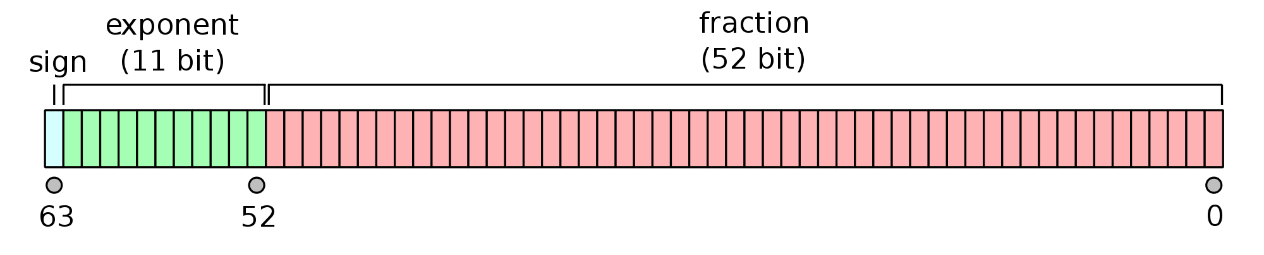
numbers
only one number type
  no integers
64 bit floating point
  aka "double"
does not map well to common understanding of arithmetic
  .1 + .2 = 0.30000000000000004
  be careful when dealing with money

Slide 14


Nan
special number called "Not a Number"
  although it is actually a number
result of undefined or erroneous operations
Toxic: any arithmetic operation with NaN as an input will have NaN as an output
NaN is not equal to anything, including itself

Slide 15

Number function
Number(value)
  Number("889") will give 889
  Number("999 84") will give NaN
converts the value into a number
it produces NaN if it has a problem - string cannot be converted to a number
similar to + prefix operator

Slide 16
parseInt
parse(value, 10)
converts the value into a number
it stops at the first non-digit character
the radix (10) should be required
  parseInt("08") === 0
  parseInt("08", 10) ==8
Radix = the number of values for a single digit. The Base.
10= base 10
2 = base 2
16 = hexidecimal
8 = octal

Slide 17
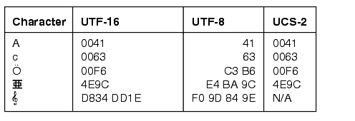
Strings
sequence of 0 or more 16-bit chars
  UCS-2 not quite UTF-16
    http://www.differencebetween.net/technology/software-technology/difference-between-ucs-2-and-utf-16/

Slide 18

Strings
no separate character type
  characters are represented as strings with length of 1
strings are immutable - cannot be modified once a string is created
similar strings are equal (==)
string literals can use 'single' or "double" quotes

Slide 19

String length
all strings have a length property
  string.length
  the length property determines the number of 16 bit characters in a string
    not the same thing as the number of unicode characters

Slide 20
String function
var x1 = Boolean(0);
var x2 = Boolean(1);
var x3 = new Date();
var x4 = "12345";
var x5 = 12345;
var res =
String(x1) + "<br>" +
String(x2) + "<br>" +
String(x3) + "<br>" +
String(x4) + "<br>" +
String(x5);
string function
  String(value)
  convert value to string
false
true
Mon Oct 26 2015 17:44:22 GMT-0500 (Central Daylight Time)
12345
12345

Slide 21
string methods
charAt
concat
indexOf
lastIndexOf
replace
search
substring
toUpperCase

Slide 22

booleans
true
false
function
  returns true if truthy
  returns false if falsy
  similar to !! prefix operator

Slide 23

undefined
a value that isn't even that
the default value for variables and parameters
the value of missing members in objects
  variables that are not initialized
can be defined with a value of undefined

Slide 24

falsy values
false
null
undefined
"" (empty string)
0
NaN
all other values (including all objects) are truthy
beware of....
  "0" string and "false" string which are truthy

Slide 25
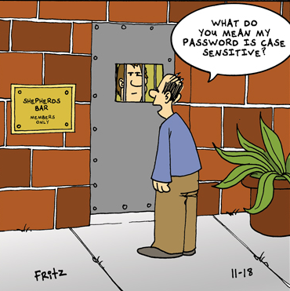
case sensitivity
case sensitive
all keywords are lower case
everything else in the language is objects

Slide 26
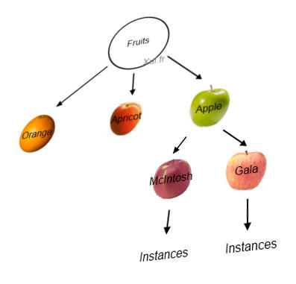
dynamic objects
unification of object and hashtable
new Object() produces an empty container of name/value pairs
a name can be any string, a value can be any value except undefined
members can be accessed with dot notation or subscript notation
no hash nature is visible (no hash codes or rehash methods)

Slide 27
loosely typed
any of these types can be stored in a variable, or passed as a parameter to any function
the language is not "untyped"

Slide 28
C
JavaScript is syntactically C family language
  many similarities to C#
it differs from C mainly in it's type system
  allows functions to be values

Slide 29
identifiers
starts with a letter or _ or $
followed by a zero or more letters, digits _ or $
by convention- all variables, parameters, members, and function names start with lower case
  constructors start with upper case
Initial _ should be reserved for implementations
$ should be reserved for machines
  program generators, macro processors
  ajax seems to use them extensively

Slide 30
JavaScript reserved words
some are reserved, but not currently used
http://javascript.about.com/library/blreserved.htm

Slide 31
calculations
  Mathematical operators
    + - / * %
      % is modulus operator
      No integer division
        Unlike Java (int / int → int), all division in JavaScript results in a Double
        Use parseInt to simulate integer division because there are no types so you cant cast them
        intResult = parseInt(var1 / var2); (no rounding)
        Or use Math.floor (round down)
        Math.ceil (round up)
        Math.round (round to certain number of decimal places)

Slide 32
calculations
    ++ --
      var++; is the same as var = var + 1;
      var--; is the same as var = var – 1;
      DO NOT embed in other statements (except for loops)
    += -= *= /=
      Same as C#
    String operator
    + for concatenation

Slide 33
Order of precedence
! ++ -- - (unary)
* / %
+ -
< <= > >=
== !=
&&
||
?: - inline if statement
= += -= *= /=

Slide 34
Math functions
  Note that JavaScript doesn’t include an exponentiation operator (^ in VB 2³ → 2 ^3)
  JavaScript (like C#) does include a built in Math class that includes many methods.
  total = Math.pow(2, 3); //2³
  newValue = Math.random();

Slide 35
operators
arithmetic
  + - * / %
comparison
  == != < > <= >=
logical
  && || !
bitwise
  & | ^ >> >>> <<
ternary
  ?:

Slide 36
+
used for addition and concatenation
  if both are numbers,
    then add them
  else
    convert them both to strings
    concatenate them
  '$' + 8 + 9 = '$89'
  Many mistakes from this type of problem

Slide 37
+
unary operator can convert strings to numbers
  +"42" = 42
also
  Number("42") = 42
  parseInt("42", 10) =
  +"3" + (+"4") = 7

Slide 38
/
division of two integers can produce a non-integer result
  10/3 = 3.33333333333335
Floating division reference
  http://floating-point-gui.de/basic/
  http://docs.oracle.com/cd/E19957-01/806-3568/ncg_goldberg.html

Slide 39
floating point division
programmers are often confused on what causes floating point accuracy problems so we are going to discuss this now
When you convert .1 or 1/10 to base 2 (binary) you get a repeating pattern after the decimal point, just like trying to represent 1/3 in base 10. The value is not exact, and therefore you can't do exact math with it using normal floating point methods.

Slide 40
floating point division
pizza example-- 1/10 or 1/3 of a pizza
  cut a pizza exactly in half to get fractions
    easy.... 1/2, 1/4, 1/8
    difficult.... 1/3, 1/5, 1/10
A more complete discussion of this issue
http://stackoverflow.com/questions/588004/is-floating-point-math-broken

Slide 41
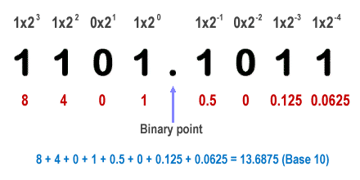
Floating point programming problem
Floating point and the problem with decimal
https://www.youtube.com/watch?v=KMcUWgIAu1c

Slide 42
== and !=
equal and not equal
these operators can do type coercion
better to use === and !== which do not do type coercion

Slide 43
type coercion
Type coercion means that when the operands of an operator are different types, one of them will be converted to an "equivalent" value of the other operand's type. for ex:
boolean == integer
  the boolean operand will be converted to an integer: false becomes 0, true becomes 1. Then the two values are compared.
However, if you use the non-converting comparison operator ===, no such conversion occurs.

Slide 44
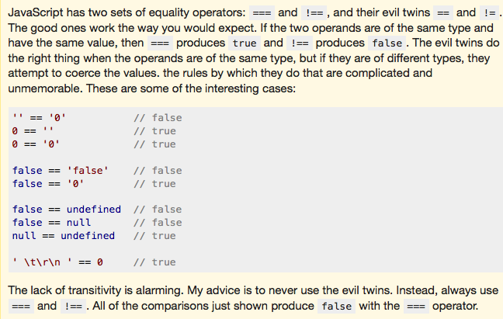
difference between == and ===

Slide 45
&&
the guard operator, aka logical and
if the first operand is truthy
  then result is second operand
  else result is first operand
can be used to avoid null references
  if(a) {
    return a.member;}
  else{ return a;}
return a &&a.member;

Slide 46
||
the default operator, aka logical or
if first operand is truthy
  then result is first operand
  else result is second operand
can be used to fill in default values
  var last =input || nr_items;
  (if input is truthy, then last is input, otherwise set last to nr_items)

Slide 47
!
prefix logical not operator
if the operand is truthy, the result is false.
  otherwise the result is true
!! produces booleans

Slide 48
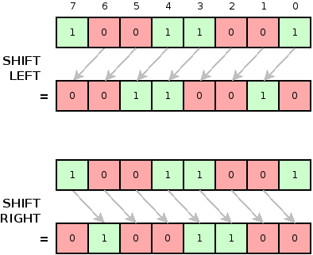
bitwise operators
& | ^ >> >>> <<
bitwise operators convert the operand to a 32 bit signed integer, and turn the result back into a 64 bit floating point
https://developer.mozilla.org/en-US/docs/Web/JavaScript/Reference/Operators/Bitwise_Operators

Slide 49
break statement
statements can have labels
break statements can refer to those labels
  can break out of middle of the nested loops and move to the bottom
loop: for(;;) {
  ----
  if(…) {
  break loop;
  }
  ----
  }

Slide 50
for statement
iterate through all the elements of an array
for(var I=0 I< array.length I+=1)
I is the index of the current member
array[i] is the current element

Slide 51
for statement with objects
iterate through all of the members of an object
for(var name in object){
  if (object.hasOwnProperty(name)){
  …..
  name is the key of the current member
  object[name] is the current value
  }
}

Slide 52
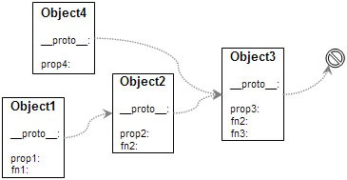
for statement with objects
also goes through the keys from all the objects this inherits from, so that is why we have to check hasOwnProperty

Slide 53
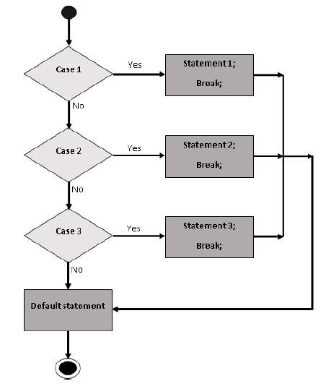
switch statement
multiway branch
switch value can be a string
case value can be expressions

Slide 54
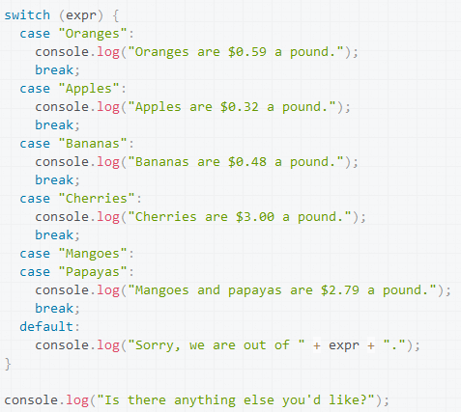
switch example

Slide 55

throw statement
thows a user- defined exception. Execution stops and control is passed to the first catch block in the call stack
throw new Error(reason);
throw{
  name: exceptionName,
  message: reason
};

Slide 56
try - catch- finally statement
try{ … }
catch (e) {
switch (e.name) {
case 'Error':
…
break;
default:
throw e;
}
}
Because we have no classes, there is only one catch clause.
You wont have one per exception class. Determine what type of exception and if it is to be handled or thrown on

Slide 57
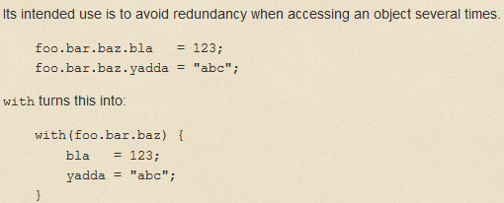
with statement
has been deprecated, but you may see it in old code. Example of it's use

Slide 58

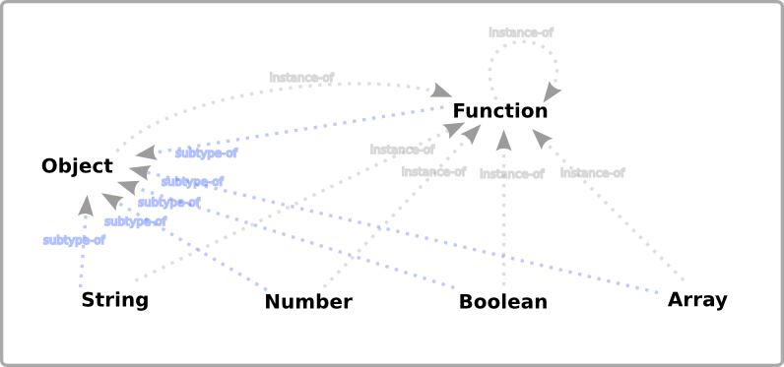
Declaring variables
var variableName; //Variable description
JavaScript variables are automatically typed
  Type based on data stored in variable
  Type can change as code executes (not a good idea)
    Can be number, then text, then number in the same execution

Slide 59

Declaring variables
Naming rules (also apply to function names)
  Letters, digits, underscore, $
  Can’t start with a digit
Note: Not including var creates a global variable (not usually what you want)
  Not good programming practice
  Can cause unexpected errors

Slide 60
Use of var to declare variables
var x is the same as just x... kind of
  In global scope they are the same
  In a function var will create a local variable.
    If no “var” it will look up the scope chain until it finds the variable or hits the global scope… not finding it, the property will be created
Stackoverflow discussion
http://stackoverflow.com/questions/1470488/what-is-the-function-of-the-var-keyword-and-when-to-use-it-or-omit-it

Slide 61
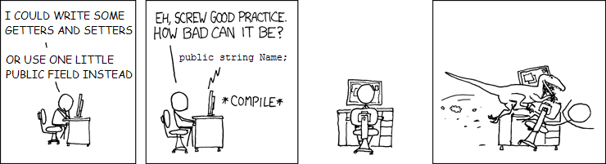
global variables

Slide 62
how one var ruined our launch
http://blog.safeshepherd.com/23/how-one-missing-var-ruined-our-launch/

Slide 63
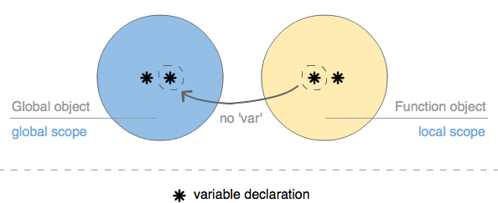
var
var set to undefined if not initialized
scope diagram

Slide 64
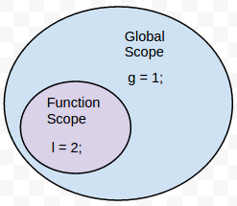
scope
{blocks} do not have scope
only functions have scope
vars defined in a function are not visible outside of the function
there is only function scope
if variable is declared more than once, there is no error

Slide 65

return statement
return expression;
or
return;
if there is no expression, the return value is undefined
except for constructors, whose default value is this

Slide 66

objects
can inherit from other objects
an object is an unordered collection of name/value pairs
names are strings
values are any type, including other objects
good for representing records and tree
every object is a little database

Slide 67

object literals
objects are wrapped in {}
names can be names or strings
values can be expressions
: separates names and values
, separates pairs
object literals can be used anywhere a value can appear

Slide 68

object literal example
Key | Value
"name" | "William Gates"
"goto" | "Jail"
"grade" | "A"
"level" | 3
think of the object creating this table...
in this case "goto" is a key word- so not ok

Slide 69
creating object with a maker function
function maker(name, where, grade, level) {
var it = {}; //making a new empty obj
it.name = name;
it['goto'] = where;
it.grade = grade;
it.level = level;
return it;
}
myObject = maker("William Gates", 'Jail', 'A', 3);

Slide 70

object literals
uses anonymous object in place of previous function
can use an object literal anyplace that you'd expect a value

Slide 71
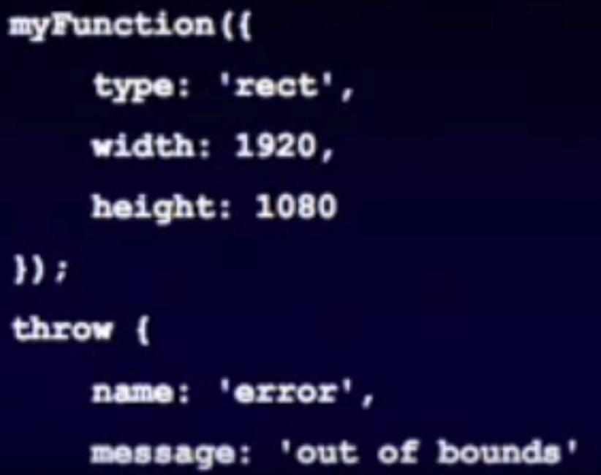
object literals
myFunction does not know if this is parameter is predefined, or if I just defined it.
we can create the error dynamically

Slide 72
object augmentation
new members can be added to any object by simple assignment
there is no need to define a new class
myObject[name] = value;
myObject.format.colorModel = 'YcgCb';
Do you see potential problems with this?

Slide 73
linkage
objects can be created with a secret link to another object (inheritance in js)
if an attempt to access a name fails, the secret linked object will be used (look to the parent)
the secret link is not used when storing. New members are only added to the primary object

Slide 74
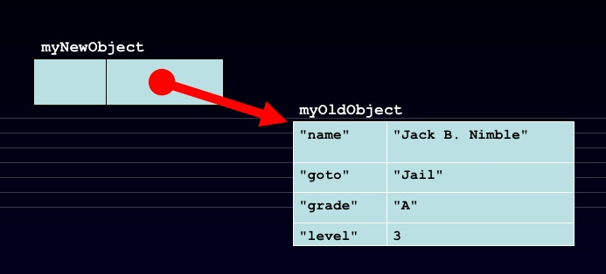
creating a linked object
var myNewObject = object(myOldObject);
new object has a pointer to old object

Slide 75
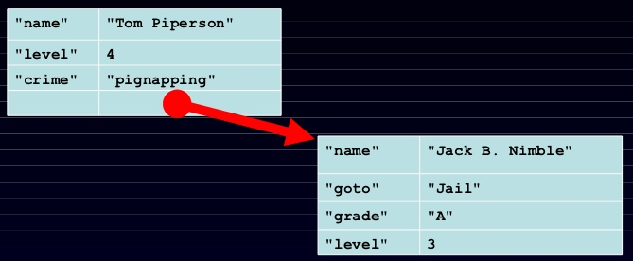
adding to the new object
myNewObject.name = "Tom Piperson";
myNewObject.level +=1;
myNewObject.crime = 'pignapping';

Slide 76
linkage impact
1 was added to level in this object to give 4.
  since it had no level, the value was pulled from linked object

Slide 77
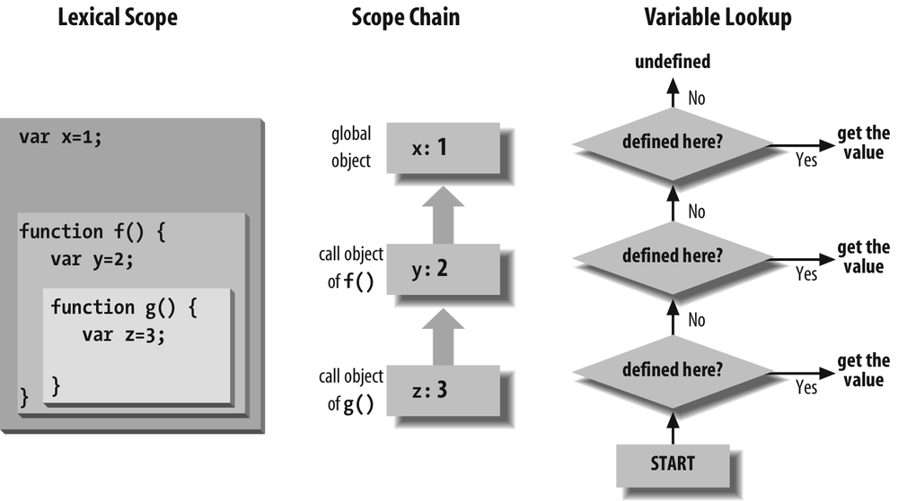
impact of deletion
what happens if you delete level in the new object?
the value is not deleted, but appears to morph to a new value
Deleting new object does not eliminate the pointer or the data in the old object

Slide 78
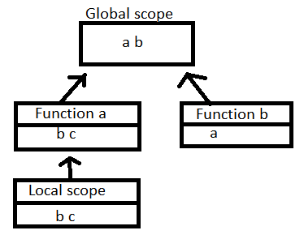
impact of deletion
what happens if you delete level in the new object?
the value is not deleted, but appears to morph to a new value
Deleting new object does not eliminate the pointer or the data in the old object

Slide 79
inheritance
linkage provides simple inheritance
an object can inherit from an older object

Slide 80
prototypal inheritance
some languages have classes, methods, constructors, and modules
  JavaScripts functions do the work of all of these
instead of classical inheritance, JavaScript has Prototypal Inheritance
it accomplishes the same things, but differently
it offers greater expressive power

Slide 81
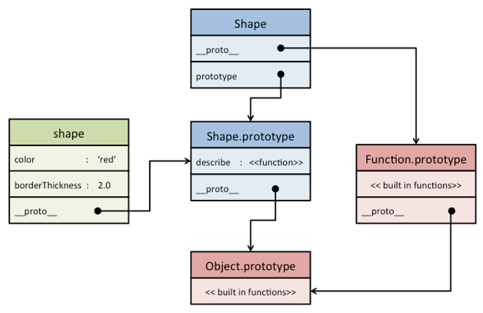
prototype inheritance

Slide 82
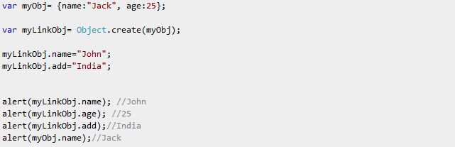
prototype inheritance example
myLinkobj inherits the properties from myObj

Slide 83
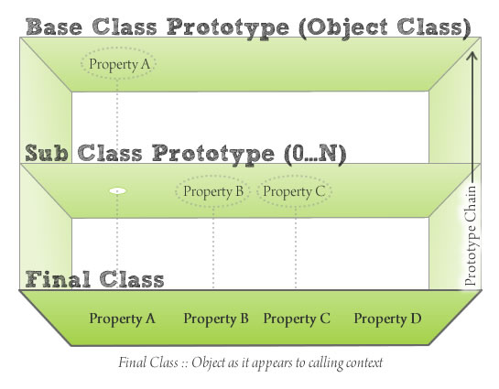
prototype inheritance
Instead of organizing objects into rigid classes, new objects can be made that are similar to existing objects, and then customized.
Object customization is a lot less work than making a class, and less overhead, too.
The other key is functions

Slide 84
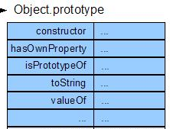
object methods
All objects are linked directly or indirectly to Object.prototype (last link in the chain)
All objects inherit some basic methods.
  hasOwnProperty(name) is useful
    Is the name a true member of this object?
No copy method
No equals method

Slide 85

make a new object
All three of these expressions have exactly the same result:
new Object()
{}
object(Object.prototype)
{} is the preferred form

Slide 86
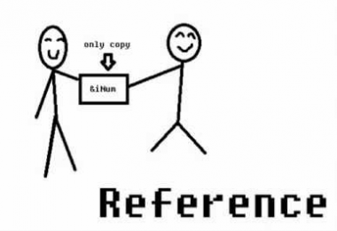
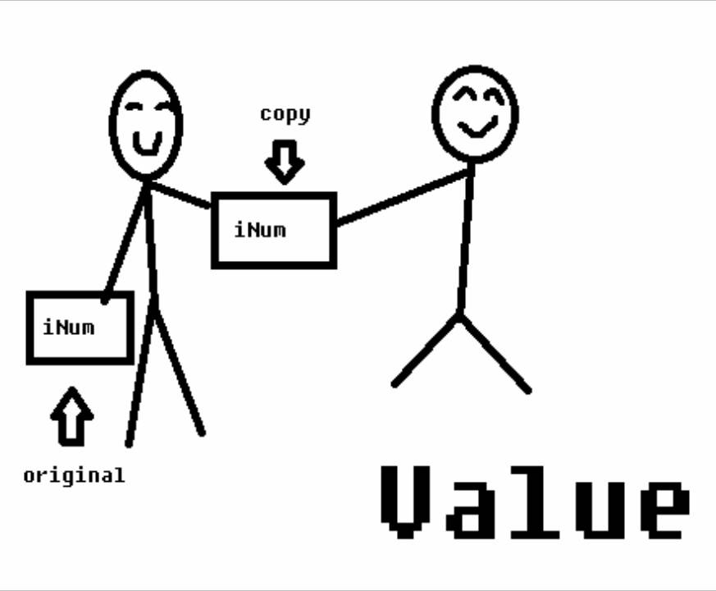
reference
objects can be passed as arguments to functions, and can be returned by functions
  objects are passed by reference
  objects are not passed by value
the === operator compares object references, NOTvalues
  true only if both operands are the same object

Slide 87

pass by value vs reference
If I have a url and give it to you, you have access to the website, we can both seee it in real time and edit it. These changes are seen by both of us. This is pass by reference.
if I print out a page of the url and give you the printout you only have access to the copy. No matter what you do to the copy it does not effect the original Even if you destroy it you have not destroyed the original, only the copy. This is pass by value.

Slide 88
delete
members can be removed from an object the delete operator
delete myObject[name];
changes the value to undefined

Slide 89
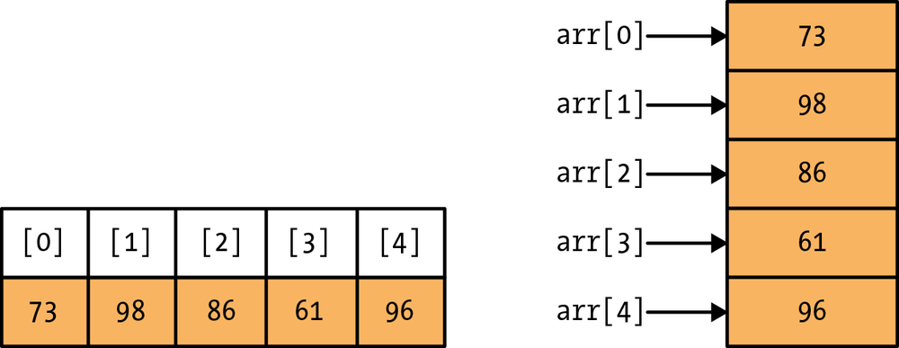
arrays
Array inherits from Object.
Indexes are converted to strings and used as names for retrieving values.
Very efficient for sparse arrays.
Not very efficient in most other cases.
One advantage: No need to provide a length or type when creating an array.
  also no need for type

Slide 90
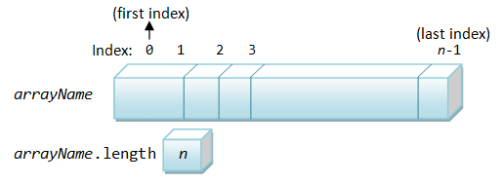
length
Arrays, unlike objects, have a special length member.
It is always 1 larger than the highest integer subscript.
It allows use of the traditional for statement.
for (i = 0; i < a.length; i += 1) { ... }

Slide 91
array literals
An array literal uses []
It can contain any number of expressions, separated by commas
myList = ['oats', 'peas', 'beans'];
New items can be appended
myList[myList.length] = 'barley';
The dot notation should not be used with arrays.
[] is preferred to new Array().

Slide 92
array methods
concat
join
pop
pushslice
sort
splice

Slide 93
deleting elements
delete array[number]
Removes the element, but leaves a hole in the numbering.
array.splice(number, 1)
• Removes the element and renumbers all the following elements

Slide 94
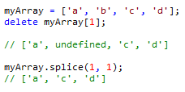
deleting elements
creates undefined locations, unless you splice

Slide 95
arrays vs objects
arrays and objects are very similar, and the code may work if you use the 'wrong' one
use objects when the names are arbitrary strings
arrays when the names are sequential integers

Slide 96
Distinguishing arrays
value.constructor === Array
value instanceof Array
Neither of these work when the value comes from a different frame

Slide 97

Arrays and inheritance
Don’t use arrays as prototypes
  The object produced this way does not have array nature. It will inherit the array’s values and methods, but not it’s length
You can augment an individual array
  Assign a method to it, or functions
  This works because arrays are objects
You can augment ALL arrays
  Assign methods to Array.prototype

Slide 98
functions
Functions are first-class objects
  Can be passed, returned, and stored just like any other value
  Inherits from object. Can be a container of name/value pairs. Can have methods.
Functions can be passed, returned, and stored just like any other value
Functions can inherit from Object and can store name/value pairs

Slide 99
Function operator
The function operator takes an optional name, a parameter list, and a block of statements, and returns a function object.
function name(parameters) {
statements
}
A function can appear anywhere that an expression can appear
Assign functions to variables, pass functions to other functions, store them to objects, return them from functions

Slide 100
lamda
What JavaScript calls function, other languages call lamda.
It is a source of enormous expressive power
Unlike most power-constructs, it is secure.
  Can constrain scopes

Slide 101
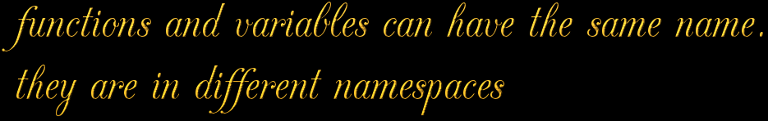
Function statement
The function statement is just a short-hand for a var statement with a function value.
function foo() {}
Expands to…
var foo= function foo() {};

Slide 102
Inner functions
Functions do not all have to be defined at the top level ( or left edge)
They can be defined inside of other functions
It does raise scope questions.
  What does the function know, and when does it know it?

Slide 103
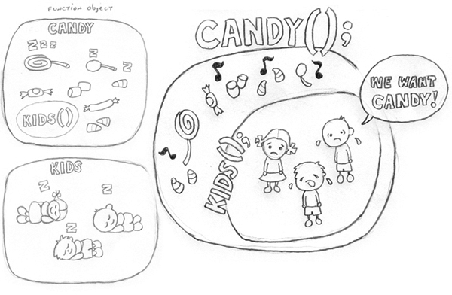
scope
An inner function has access to the variables and parameters of the functions that it is contained within
This is known as Static Scoping or Lexical Scoping

Slide 104
closure
The scope that an inner function enjoys continues even after the parent functions have returned.
This is called closure
What does this mean?

Slide 105
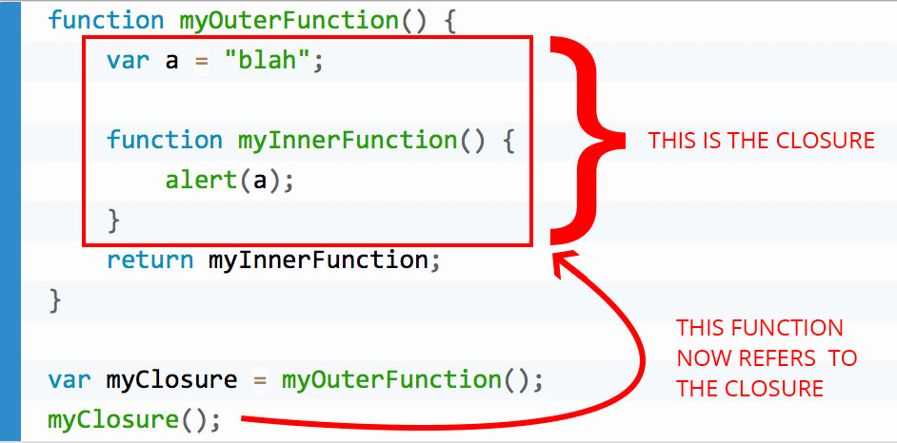
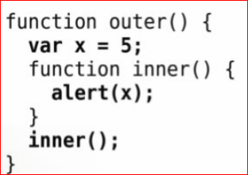
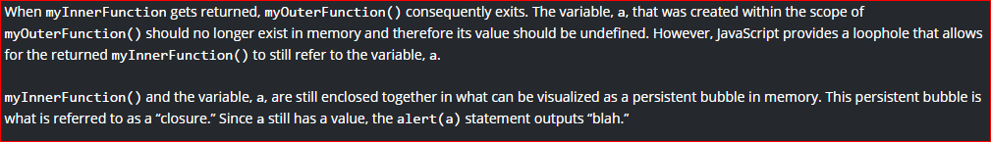
example
Access to variables after the scope would seem to have ended.

Slide 106
example
Invoking inner here will give you 5
  despite the fact that the scope of inner has ended, you still have access to x
essentially... inner tracks the state of the code at the time it was invoked, and you have access to that state

Slide 107
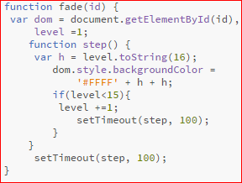
example
Ajax application- change the color from yellow to white.
After the parent closes..100 ms later, it calls the value of the parent level

Slide 108
function objects
functions are objects, so they can have name/value pairs
this can serve the same purpose as static members in other languages

Slide 109
methods
since functions are values, functions can be stored in objects
a function in an object is called a method

Slide 110
invocation
if a function is called with too many arguments, the extra arguments are ignored
if a function is called with too few arguments, the missing values will be undefined
there is not implicit type checking on the arguments

Slide 111
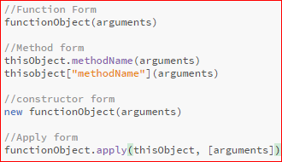
invocation
there are 4 ways to call a function
  Function form
  Method form
  Constructor form
  Apply form

Slide 112
method form
thisObject.methodName(arguments)
when a function is called in the method form, this is set to thisObject, the object containing the function.
this allows the methods to have a reference to the object of interest.
allows for re-use of the functions.

Slide 113
function form
functionObject(arguments)
when a function is called in the function form, this is set to the global object
  that is not very useful
  it makes it harder to write helper functions within a method because the helper function does not get access to the outer this.
  var that = this; // use that to get around this problem

Slide 114
constructor form
new functionObject(arguments)
when a function is called with the new operator, a new object is created and assigned to this.
if there is not an explicit return value, then this will be returned.

Slide 115

this
this is an extra parameter. Its value depends on the calling form
this gives methods access to their objects
this is bound at invocation time

Slide 116
arguments
when a function is invoked, in addition to its parameters, it also gets a special parameter called arguments.
it contains all the arguments from the invocation
it is an array -like object (no access to array methods)
delivers every argument that was passed
arguments.length is the number of arguments passed

Slide 117
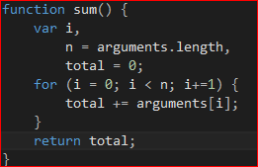
using arguments
Pass in some numbers, then they are summed up
Provides a convenient way to write a function with a variable number of parameters

Slide 118
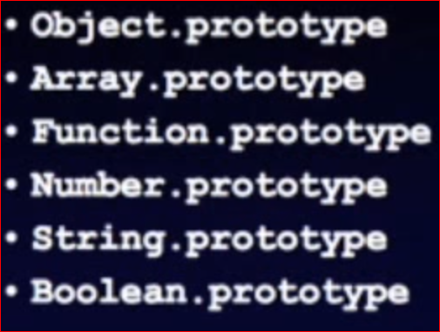
Augmenting built in prototypes
Can Extend built in types
Can extend all of them at once by augmenting object.prototype
Could add to Array.prototype

Slide 119

Trim example
JavaScript does not have a trim method
  Gets rid of whitespace in a string
However, you can add one to the String.prototype

Slide 120
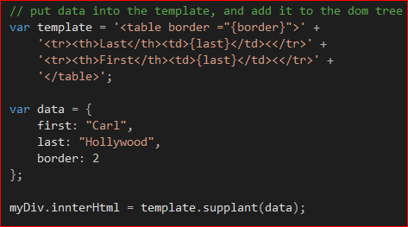
supplant
Suppose you want to do some client-side html generation.
A supplant method is one way to do this.
Want to insert the data into the template.

Slide 121
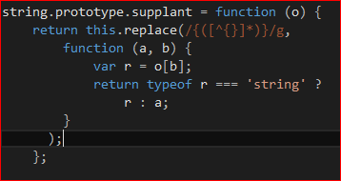
supplant
Update the String prototype to add a supplant method.
Pass into the replace function another function which tells it how to do the substitution.
Has access through closure to the object that is passed into supplant
You can’t extend string in java or c# like you are doing here in JavaScript

Slide 122
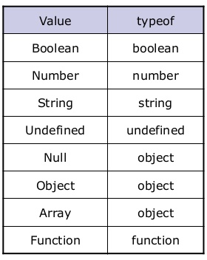
Typeof operator
The typeof prefix operator returns a string identifying the type of a value.
Array is not helpful
Also the null should not return object
  This is a bug

Slide 123
eval
Gives you access to the JavaScript compiler and interpreter
eval(string)
Compiles and executes a string and returns a result
It is what the browser uses to convert strings into actions
It is often misused, try not to use it except when using JSON

Slide 124
Function
new function(parameters, body)
  Used by the browser
The Function constructor takes zero or more parameter name strings, and a body string, and uses JavaScript compiler to produce a function object
It should be used to compile fresh source from a server
It is closely related to eval. Also avoid if you can.

Slide 125
Built in type wrappers
C# has int and Integer, two incompatible types which can both carry the same value with differing levels of efficiency and convenience
  Int = primitive
  Integer = object
JavaScript copied this, but it has little advantage.
Creates an object which wraps a string value.
Not the same as a string value.
  new Boolean(), new String(), new Number()
You are used to seeing this type of thing in C#, but you won’t want to use it in JavaScript.
new Boolean(false) value is false….. but the expression is truthy.

Slide 126
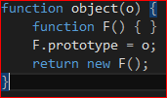
Object function
JavaScript has no Object function
Prototypal language, but they did not make a way to do this conveniently.
Use this function to do so.

Slide 127
augmentation
Can directly modify individual objects to give them just the characteristics we want
We can do this without having to create classes
We can then use our new object as the prototype for lots of new objects, each of which can also be augmented

Slide 128
Global object
The object that dare not speak it’s own name
  In other words, there is no pointer to this global object
It’s the container for all global variables and all built in objects
Sometimes this points to it.
  Var global = this;
On browsers, window is the global object
  Windows assigned to the global object a window member whose value is the global object

Slide 129
Global variables are evil
Functions within applications can clobber each other
Cooperating applications can clobber each other
Use of the global namespace must be minimized

Slide 130
Implied global
Any var that is not properly declared is assumed to be global by default
This makes it easy for people who do not know or care about encapsulation to be productive, but it makes the applications less reliable
JSLint is a tool which helps identify implied globals and other weaknesses
http://www.JSLint.com

Slide 131
namespace
Every object is a separate namespace
Use an object to organize your variables and functions
Pick your own object and put your functions all in there
Namespaces can inherit since they are just objects

Slide 132
Script interaction
Script loading
  Scripts are loaded in the header, or from external files
  Once loaded, they all become part of one space
  They can interact, could have collisions
Can be very difficult to debug

Slide 133
encapsulate
Function scope can create encapsulation
Use an anonymous function to wrap your application
Encapsulation is the packing of data and functions into a single component. The features of encapsulation are supported using classes in most object-oriented programming languages, although other alternatives also exist.

Slide 134
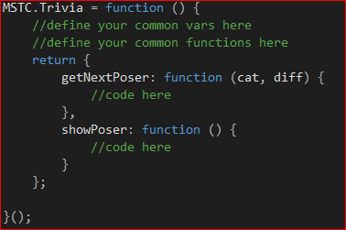
Example of encapsulating to prevent global variables - triva
  Return an object, then invoke the function
  Assign the result of calling this function to Trivia.
  Due to closure, the private variables are bound to this function and cannot be in the global space

Slide 135
Thinking about types
Trading type-safety for being dynamic
JavaScript has no cast operator
Reflection is easy, and usually unnecessary
Why have inheritance in a language?
  automatic casting (no casting in JS, however)
  Code re-use
Trading brittleness of language for flexibility

Slide 136
date
The date function is based on the Java’s Date class

Slide 137
regexp
Regular expression pattern matcher
Patterns are enclosed in slashes
Example: a pattern that matches regular expressions
Bizarre notation, difficult to read

Slide 138
Semicolon insertion
When the compiler sees an error, it attempts to replace a nearby linefeed with a semicolon and try again
Can mask errors
Always use the full, correct forms, including semicolons
Was an attempt to make it easier for beginners.

Slide 139
Line ending
Break a line after a punctuation
Do not break after a name, string, number, or ) ] ++ --
Defense against copy/paste errors

Slide 140

comma
Avoid tricky expressions using comma operators
Do not use extra commas in array literals
Browsers will give different lengths for these

Slide 141

Required blocks
The second example is more easily corrupted.

Slide 142
Forbidden blocks
Blocks do not have scope in JavaScript
Blocks should only be used with structured statements
  Function
  If
  Switch
  While
  For
  Do
  try

Slide 143
variables
Define all variables at the beginning of the function
JavaScript does not have block scope, so there is not advantage in declaring variables at the place of their first use

Slide 144
Expression statements
Any expression can be used as a statement. That can mask errors
Only expression statements and invocation expressions should be used as statements
Good
  foo();
Bad
  foo && foo(); //better to use an if rather than the &&

Slide 145
Assignment expressions
Do not use assignment expressions in the condition parts of if, while, or for
It is more likely that
  if(a=b) {…}
Was intended to be
  If(a==b) {…}

Slide 146
== and !=
Be aware that they do type coercion
Bad
  If(a== null) {…}
Good
  If(a=== null) {…}
  If(!a) {…}
Appears to do this
Actually does this

Slide 147
labels
Use labels only on these statements
  Do
  For
  Switch
  While
Never use JavaScript: as a label

Slide 148
JSLint
Can help to improve robustness and portability of your programs
Enforces style rules
Can spot some errors that are very difficult to find debugging
Provides some strong typing safety checks
www.JSLint.com

Slide 153


Adding JavaScript to a web page
Embedded JavaScript
Imported JavaScript
Can use both on the same page
Can import multiple files
  Note: JavaScript inserted directly in the body (instead of head) cannot be set as a breakpoint in Firebug.

Slide 154
https://www.youtube.com/watch?v=v2ifWcnQs6M&list=PL62E185BB8577B63D&index=1
1:00

Slide 155
Primary principles
JavaScript is case sensitive
Built-in functions must be capitalized correctly
Variable names must be capitalized correctly
  myVar myvar are three different variable names
  Not a good idea to have different variables with same name but different capitalization
  All JavaScript statements end in a semicolon (";")
Multi-statement blocks (loop contents, if contents) are surrounded by {curly brackets}

Slide 156
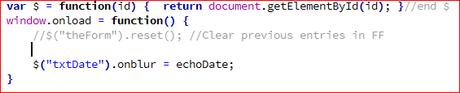

JavaScript comments
Inline comments use //
Multi-line comment

Slide 157
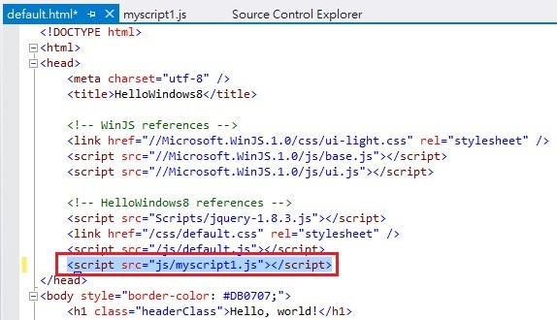
imbedding javascript files
relative path reference
can imbed multiple files
be careful that they play well together

Slide 158
window.onload and onsubmit
events that can the the key for JavaScript to run
will require you have form tags surrounding the form

Slide 159
Date class
  JavaScript doesn’t have a primitive data type for
  It does have a built-in Date class
    When you declare a Date variable, you typically instantiate it using new
You can delay the instantiation until later in the program
Var today = new Date();
      This command creates a variable and immediately initializes it to the current date and time (automatic when you instantiate with nothing in the ( ) )

Slide 160
date
  To declare a date initialized to a date of your choice
  var myDate = new Date("12/25/2010");
    There are other ways as well, look in references
Common Date Methods
  W3schools JavaScript date reference
http://www.w3schools.com/jsref/jsref_obj_date.asp

Slide 161
date methods
toDateString( )
  Returns a string in ddd mmm dd yyyy format
  2011-10-17 returns Oct 16, 2011???
toUTCString( )
  Seems to convert all date entries properly
getFullYear( )
  Returns the 4-digit year
getMonth( )
  Returns the month index number (0-based)
  Add 1 to get the actual month number
getDate ( )
  Returns the day of the month (1-31)

Slide 162
example of date handling
UTC (Coordinated Universal Time) has no Daylight Saving changes and you use a kind of abstract time. In most practical applications there is no problem.
var dt = new Date( Date.UTC(2012, 9, 21, 8, 5, 12));
alert( (dt.getUTCMonth()+1) + '/' + dt.getUTCDate() + '/' + dt.getUTCFullYear() + " " + dt.getUTCHours()+ ':' + dt.getUTCMinutes() + ':' + dt.getUTCSeconds() );

Slide 163
JavaScript Date Handling
if you use toDateString(), the browser will automatically adjust your date to GMT
if you don't specify a time, the browser assumes that the time is 0:00 (midnight)
use toUTCString() for consistency
  utc = coordinated universal time
use the format function from the tools

Slide 164
import the javascript tools library files
choose the relative path and file name inside a script tag
add isDate.js to the file & look at it
  tries to turn the string into a date
    fail: invalid date, or NaN
    otherwise, a valid date

Slide 165
import the javascript tools library files
Add DateFormat.js & look at it
  once a JavaScript error occurs... all JavaScript on the page stops and the page loads
  demo by creating an error in the date string.format
Advantage of having small individual javascript files, rather than putting them all in one large file

Slide 166
date
To add days to a Date:
  myDate.setDate(myDate.getDate() + 15);
    Note there is no myDate =
  setDate() sets the date in place, you don’t assign it back to the variable again.
Using a setter to set content without an assignment

Slide 167
Custom date formats
To create custom date formats:
  Import DateFormat.js
myDate.format("mmmm d, yyyy");

Slide 168
JavaScript date tutorial
https://www.youtube.com/watch?v=0vmzt94aupQ

Slide 169
Date display in different browsers
Depending on how you enter information in a textbox… returns are different for different browsers
  chart on next slide

Slide 170


Slide 171
Prompt function
  myVar = prompt("Message","Default value");.
    Allows user to enter one line of text and stores it in the designated variable.
    If user clicks Cancel, prompt returns null (JavaScript reserved word)
    If user clicks OK without entering text, prompt returns empty string
    isNaN returns false for both empty string and null
parseInt however returns NaN for both

Slide 172
Confirm function
Displays a dialog box with your question and OK, Cancel buttons
  response = confirm("Yes or No question here");
response is a Boolean variable, true if the user clicks the OK button, false otherwise

Slide 173
output
alert("message");
  Displays a message box with the designated message
document.writeln("text");
  Actually adds HTML to the document.
  JavaScript that contains this command is typically embedded in the body tag (not in the head tag)
    If in head tag, text is inserted before all body text
  To add a second line to the alert, concatenate '\n'(carriage return)
  To add a second line using document.writeln, output a <br>

Slide 174
output warning
Note: document.writeln commands issued after the page as fully loaded will erase the original contents of the page.

Slide 175
Form input
Most input is done using a form. JavaScript then extracts data from the form fields and uses it for processing
Retrieving form field data
  First, you need to define a pointer to the field whose data you want
  document.getElementById(id)

Slide 176
Form input
document.getElementById(id)
  document refers to the current web page
  getElementById (note the capitalization)
    generates a pointer to the object whose ID (not name) (string) is designated in the parameter (id in the example)

Slide 177
Form input
Getting a pointer is done so often, Murach simplifies the process even more by creating a function.
var $ = function(id) {
return document.getElementById(id);
} //end $
Or
var $ = function(id) {return document.getElementById(id); }//end $

Slide 178
Form input
This defines a function that expects one parameter (id).
  Remember, variables and parameters are untyped in JavaScript, so you don’t designate the parameter type, just its name.
The function’s name is simply $
The function returns a pointer to the object designated by id, so the following would be a call to the function:

Slide 179
Form input
ptrName = $("txtName");
$("txtName") gets a pointer to the object whose ID is txtName
That pointer is then assigned to a variable (ptrName);
I'd recommend defining this function first, before all other JavaScript

Slide 180
pointer
  Then, using the pointer, you can extract the value in the text box.
  myVar = ptrName.value;
  You can combine the definition of the pointer with the text extraction:
  myVar = $("txtName").value;
    If you are only using the pointer once (typical), this is OK
If you are using the pointer more than once, define the pointer first, then extract its value.
  You can also modify the text of a form object to create output
  $("txtName").value = "new text";

Slide 181
Converting inputs to numbers
Inputs that come from text boxes are considered Strings by JavaScript
  prompt inputs are also considered Strings
  Need to be converted to numbers before they can be processed numerically.
  parseInt analyzes the string until it comes upon a character that is not recognizable as part of an integer. E.g. 123Student is parsed as 123
  There is also a parseFloat

Slide 182
Converting inputs to numbers
gpa = parseFloat($("txtGPA").value);
credits = parseInt($("txtCredits").value);
Parse basically means to process, one character at a time and then analyze (convert)

Slide 183
Update form
Use evalForm.html
Test using window.onsubmit function
Enter a number in name box.
Demo how Parse functions parse until they hit a character they don’t like.
Enter a date in the name box.
Note how 2012-10-20 format subtracts a day

Slide 184
Convert text to date
  To convert a text box input to a date:
  birthdate = new Date($("txtBirthDate"));
    Instantiates a new Date and immediately sets its value to the date string entered
    Acceptable formats
      10/17/2011
        2-digit year = 1900
      2011-10-17 (GMT: might be off by a day)
      Oct 17, 2011
      October 17, 2011
      2011 Oct 17

Slide 185
Relational operators
  < <= > >=
  == (check for equality)
  != (not equal)
  === (equivalent, same value and type)
  !== (not same value or type)
  && (And)
  || (OR, two vertical bars)
    Both automatically short-circuit
! (Not, reverse Boolean value)

Slide 186

Decision constructs
If statement
Note that the {} is not required if you have only one statement

Slide 187

Elseif
  JavaScript doesn’t have an ElseIf command, but you can simulate it
else if is really an if embedded in an else. else has no { } and if is on same line instead indented on next line
JavaScript ignores whitespace (tabs, Enter, extra spaces)

Slide 188

Case stmt
Case statement format
{} required
can hold a string
can hold a float
cannot use <, >
break command in default case is not required

Slide 189
    Note { } for switch
    Note NO { } required for cases (odd)(optional)
    default executed if no cases match
      Optional
    break after statements in each case
      Technically not required after last case but good practice to add one in case rearrange cases
      If don’t include a break, switch continues to process the next case
        Allows multi-case values (See values 2 and 3)
        break causes the remaining cases to be skipped
    Unlike Java, Strings and floats can be used in switch
Conditional operators (<, >, etc.) cannot be used (unlike VB)

Slide 190
Update
Demo if in onsubmit
Demo string equality check
Demo common error using only single equal sign in comparison
Demo elseif in onsubmit

Slide 191
foreach
gives the index of every item
  other languages give the value, but JavaScript gives the index

Slide 192

Inline if
  Inline IF (conditional operator)
    Like most languages, JavaScript allows you to embedded conditions in other statements
    Note when concatenating (typical) the entire inline IF must be surrounded by parentheses otherwise JavaScript tries to concatenate the condition

Slide 193
Inline if
Comparing strings
Unlike C#, you can apply all relational operators to strings (str1 < str2 works)

Slide 194
Update form inline if
After determining how many multiselect items selected (see below), display the appropriate message.

Slide 195

Repetition constructs
  For Loops
  for(initialize; continueCondition; modify) {
  loop statements;
  } //end for

Slide 196
Repetition constructs
    For loop parameters surrounded by ( ), separated by ;
      Note no ; after last parameter (modify)
    Loop variables can be defined in the loop definition
    Loop variables are often single letters
      No requirement, just tradition (can be any variable name)
      Use the first letter of the things you’re counting (s for students, i for index, q for quizzes)
    Example above is typical array processing loop
      0-based indexes
      Continue as long as < (not <=)
Increment by 1 each time through loop

Slide 197
Use a for loop to determine the number of topics selected (lstCourses.options.length
lstCourses.options[i].selected).
Display message (add “s” only when appropriate).
(Optional) Create an array of selected items
selected = new Array();
selected[selected.length]= cmb.options[i].value;
Use For-In to display.
Use a for loop to print out the same text in the 6 different <h#> tags.
Note you can see the generated source in Firebug HTML tab.
Use a for loop to display the same image in 10 different sizes. 10%-100%
Use a for loop to dynamically change the width of an <hr> from 100 – 10. Happens so fast will need to use debugger to see it work.

Slide 198

  ForEach (For-In) Loops
    When processing arrays or lists of objects, the ForEach loop (Murach calls it For-In) can come in handy.
      See array discussion in later notes
For-In returns the indexes of the values in the array, unlike other programs that return the values themselves

Slide 199
Post test loops
  Post-Test Loops
do {
loop statements;
}while (continueCondition);
    Condition at bottom of loop
    } before while
    Condition in ( )
    Followed by ;
    Example:
do {
loop statements;
} while(confirm("Enter

Slide 200
Pre-test loops
  Pre-Test Loops
  while (continueCondition) {
  loop statements;
  }//end while
    Condition in ( )
    Loop continues as long as condition is true
  Example
response = confirm("Enter another value?”);
while (response) {
loop statements;
response = confirm("Enter another value?”);
}//end while

Slide 201
update
Use a post-test loop to validate a prompt entry as a number. Handle empty string and Cancel (null)
Use loop to display the results of isNaN and parseInt for each input.
In evalForm onSubmit, check to see if name contains a number (alert)
Use a pre-test loop (with priming prompt). Change the prompt inside the loop to include an error message.

Slide 202
Boolean functions
  These functions can be used wherever a condition is called for (decisions, loops)
  isNaN(String)
    is Not a Number
    Checks a parameter to see if it is a valid number
    NOTE: empty string "" evaluates to false (is a number)
      However, parseInt returns NaN when sent the empty string.
Example
age = prompt("Please enter your age:");
if(isNaN(age)) {
alert("That's not a valid number.");
}//end if

Slide 203
See Murach pages 276-7 for more bizarre, special value comparisons.

Slide 204
  isDate(String)
    There is no isDate function built in to JavaScript
    Here is a simple function that does the job
function isDate(strDate) {
aDate = new Date(strDate) //Try to convert to Date class
return aDate!="NaN" && aDate!="Invalid Date"; //Return T or F
//Errors that may occur
}//end isDate

Slide 205
    Note the Date constructor returns one of two Strings if it is given an input it cannot convert to a date (parse): NaN or Invalid Date
      Unlike parseInt, NaN here is a String and can be used in a comparison
    Another note: the constructor doesn’t like dates with dashes (2011-10-24 or 10-24-2011)
      Replace with /
      strDate = strDate.replace(/-/g,"/");
      Uses regular expression to replace all dashes with slashes

Slide 206
In eval Form check to see if name contains a valid date.

