Slide 1
Unit 3 –CSS
Instructor: Brent Presley

Slide 2
assignment
Read chapter 5
In class
  Copy the unit 3 master folder
Due at the end of Unit 3
  Unit 3 - CSS

Slide 4
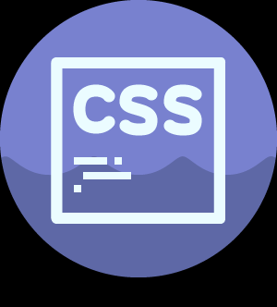
Css overview
As pages get more complex, formatting many elements in a like manner becomes tedious
When trying to give a consistent appearance to all pages in a site, keeping the consistency can be tedious especially when the appearance is to be changed on all pages.
Web developers attempt to keep page content separate from page formatting (not always possible)
For all these reasons (and probably a few more) the W3C has developed Cascading Style Sheets (CSS)
  CSS2.1 is widely used and implemented by browsers
  CSS3 is being finalized
W3C also has a CSS validator
  http://jigsaw.w3.org/css-validator/

Slide 5
Css Tutorial Video
How to link to external style sheets, embed style sheet, definitions in html
Derek Banas -CSS Video Tutorial, part 1
  https://www.youtube.com/watch?v=I-rTKuEhrCM

Slide 6
Css Tutorial Video
How to link to external style sheets, embed style sheet, definitions in html
Derek Banas -CSS Video Tutorial, part 2
  https://www.youtube.com/watch?v=rD_6jBlrIn4

Slide 7
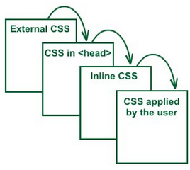
Css levels
CSS allows you to apply styles at three different levels
  Inline.
    What we’ve been doing all along (style=)
    Applies a style to an individual element
  Embedded
    Allows you to define styles that affect all elements on a page
  External
    Allows you to define styles for elements in an external file and then link to that file from multiple pages.

Slide 8
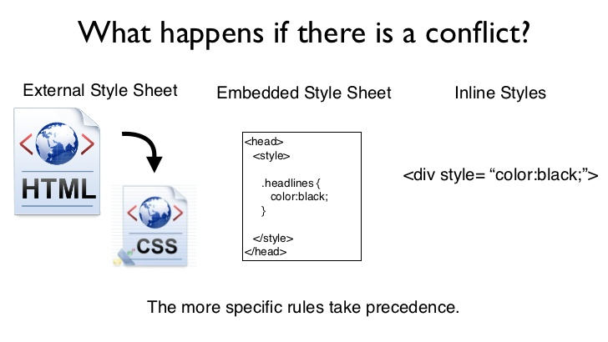
Css levels
Inline styles override embedded styles which override external styles.
All deprecated attributes are overridden by styles.
Inheritance

Slide 9
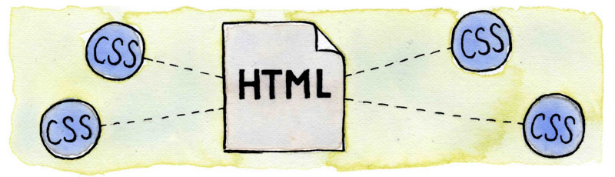
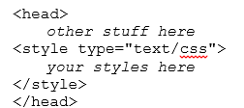
Creating embedded styles
On many pages, you’ll want to change the default appearance of all elements of the same type on the page (see example)
  To do this, you create embedded styles
Embedded styles are defined in the <head> section of your HTML, normally just before the </head>

Slide 10
Defining a style
When defining a style, you first have to designate what type of element you want the style to apply to. This is called the style selector
Then, in {curly brackets} designate the style attributes (separated by semicolons) you want to apply
h3 {font-family: Arial Black;
background-color:lightgrey;}
You can create a style that is applied to more than one selection—simply separate the element types with commas
h2, h3 {font-family: Arial Black;
background-color:lightgrey;}
Style attributes

Slide 12
Applying embedded styles
There’s really nothing to applying embedded styles
When you add the <style> tag to the <head>, any element whose type is designated in the style is automatically changed.
Unless it has an overriding inline style

Slide 13
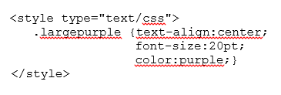
Named, embedded styles
  In some circumstances, you’ll want to create a style that is applied to some elements on the page, but not others.
  Named styles allow you to create a style, assign a name to that combination of style attributes and then apply that style to selective elements.
  Note the style name begins with a period. Otherwise the named embedded style is similar to the regular embedded style
  Note how the style elements are listed on separate lines. This is not required, but makes styles easier to decipher.

Slide 14
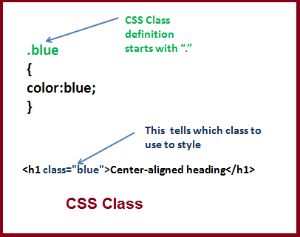
Applying named styles
  To apply a named style to a page element, you use the class="stylename" within the element’s tag.
  <p class="largepurple"> Text Here </p>
  <span class="largepurple"> text here </span>
  NOTE: the period used to define the style IS NOT included when applying the style.
  The style name must be surrounded by quotes
  You can combine (inline) style= and class= in the same tag. If they overlap (both define a color for instance), the inline style will override the embedded style.
  CSS named styles & ID selectors are case sensitive.
The name used in the class element must match the name defined in the style exactly.

Slide 15
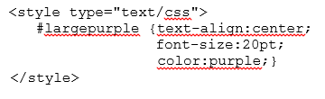
Id selector
  A final type of embedded style is also given a name, but is only applied to the page element whose ID matches the style name.
  Note the only difference between this style definition and the named definition is the style name is prefixed with a # instead of a period.
    Normally, you wouldn’t use both a named style and ID selector with the same name.
  ID selectors can only be applied to one element on a page
  ID selectors are most often used in external style sheets, applying the style to objects with the same name on many pages.
  Use named styles if it is likely the style will be applied to more than one element.

Slide 16
Applying id selector
  Somewhere in the HTML page, define an ID for an element using the ID selector name
<p id="largepurple">
  Only this element (the whole paragraph element) will be formatted using the designated style.
Note the # is not included in the ID application

Slide 17
Add CSS to your project
Download the zipped Unit 3-CSS (start) from onedrive
Place it on your desktop
Unzip
Open up index.html in notepad++

Slide 18
Add CSS to your project
Within your html document….
Create an ID style called picBeethoven
  Vertical-align: text-top;
Create a named style called pageTitle
  Color: teal, Arial Black, letter-spacing .5em
Apply font family of arial black and background color of orange to h3 tags

Slide 19
Add CSS to your project
Within your html document….
Apply a largepurple named style with text-align of center, font size of 24px and color of purple
Apply this to both history paragraphs

Slide 20

Font sizes
Relative sizes
  Percent (relative size)
  Em (1em is 100%)
Absolute sizes
  Px (pixels)
  Point … 12px = 16 pt
  This is a legacy from print media. Sizes in MS Word are based on these

Slide 21
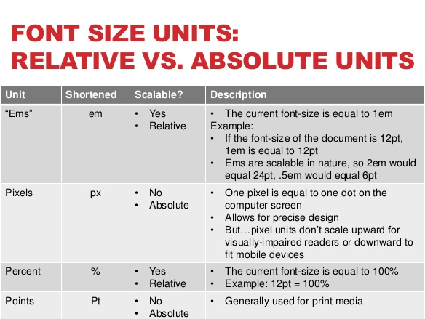

Slide 22
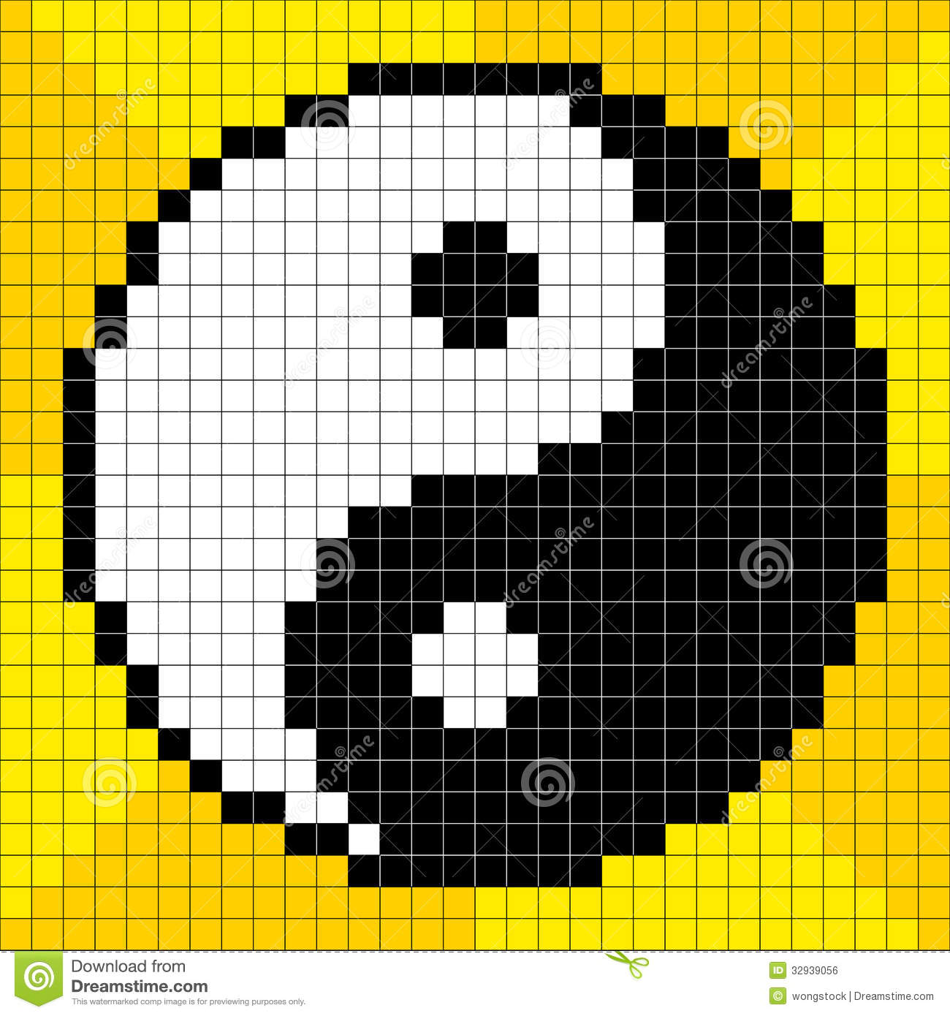
Px elaboration
px is an absolute unit of measurement that also happens to be 1/96 of an in (inch) unit.
Because it is an absolute measurement, it may be used any time you want to define something to be a particular size, rather than being proportional to something else
  Such as the size of the browser window or the font size.

Slide 23

Scaling of absolute units
Absolute units don't scale according to the width of the browser window.
  Thus, if your entire page design uses absolute units such as px rather than %, it won't adapt to the width of the browser.
  This is not inherently good or bad, just a choice that the designer needs to make between adhering to an exact size and being inflexible versus stretching but in the process not adhering to an exact size.
  It would be typical for a site to have a mix of fixed-size and flexible-sized objects.

Slide 24

Use of fixed style elements
Fixed size elements often need to be incorporated into the page - such as advertising banners, logos or icons.
  This ensures you almost always need at least some px-based measurements in a design.
  Images, for example, will (by default) be scaled such that each pixel is 1*px* in size, so if you are designing around an image you'll need px units.
  It is also very useful for precise font sizing, and for border widths

Slide 25
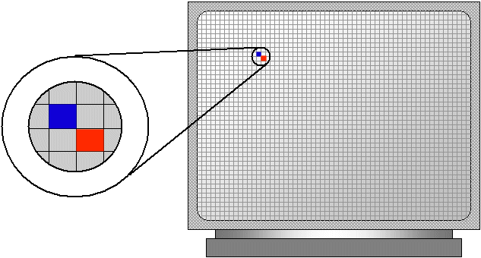
What is a physical px?
All absolute measurements are rigidly related to each other
  1in is always *96px*, just as1in is always *72pt*.
  Note that 1in is almost never actually a physical inch when talking about screen-based media.

Slide 26
What is a physical px?
All absolute measurements assume a nominal screen resolution of 96ppi (pixels per inch) and a nominal viewing distance of a desktop monitor
  on such a screen one px will be equal to one physical pixel on the screen and one in will be equal to 96 physical pixels.
  On screens that differ significantly in either pixel density or viewing distance, or if the user has zoomed the page using the browser's zoom function, px will no longer necessarily relate to physical pixels.

Slide 27

Em units
em is a unit that is relative to the currently chosen font size.
Unless you have overridden font style by setting your font size with an absolute unit (such as px or pt), this will be affected by the choice of fonts in the user's browser or OS if they have made one
it does not make sense to use em as a general unit of length except where you specifically want it to scale as the font size scales.

Slide 28

% unit
% is also a relative unit, in this case relative to either the height or width of a parent element.
They are a good alternative to px units for things like the total width of a design, if your design does not rely on specific pixel sizes to set its size.
Using % units in your design allows your design to adapt to the width of the screen/device, whereas using an absolute unit such as px does not.

Slide 29
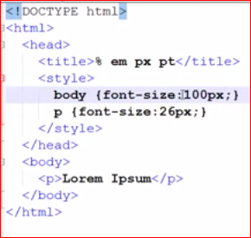
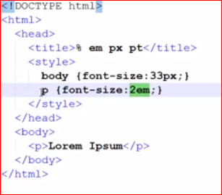
Font sizes
What size will the paragraph font be for these cases?
26px
66px

Slide 30
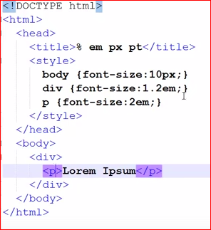
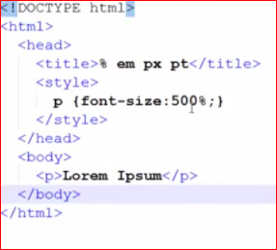
Font sizes
What size will the paragraph font be for these cases?
24px
500% x the base font size

Slide 31
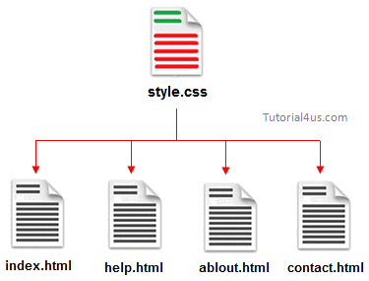
Creating external style sheets
To apply the same styles to multiple pages of a web site (without having to enter them into each page), you need to create an external style sheet.
The style sheet contains style descriptions in the same format as embedded styles except the <style> tag is omitted.
The style sheet must be saved as a text file and is normally given the .css extension.
Style sheets are often stored in their own (css) folder.

Slide 32
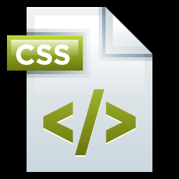
External style sheet comments
Style sheets can (and often do) include comments to thoroughly document the style and to designate the purpose for the style sheet and its author in case the CSS file is separated from its web site folders.
In CSS files, surround comments with /* */
/* Sample CSS Comment */

Slide 33
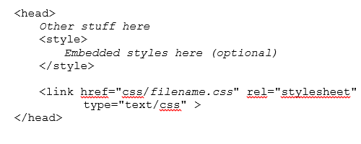
Linking a page to a stylesheet
Once the style sheet is created, every page that is to use it must be linked to the style sheet.

Slide 34
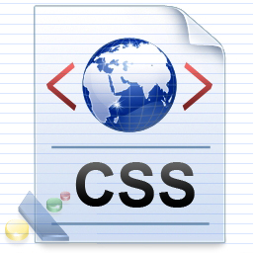
Connecting to stylesheet
One-sided tag
The only thing you should have to change is the name of the CSS file (filename.css)
  Designate the correct path (may need a relative path)
A page can have a combination of external, embedded and inline styles.
A page can also link to multiple style sheets.
  If two style sheets define styles for the same type of element, the style loaded last takes precedent.

Slide 35
Add CSS to your project
Create a folder called css within your project
Create a file titled beethoven.css within this folder
Reference this file in your html document
Move all the prior formatting to an external css document
Add hr {width:80%;}
Add #title {color:maroon;} & change title id

Slide 36
Observe css changes
Beethoven.css
  Change location of notes.gif
  Apply picBeethoven to image and pageTitle to title
  Create a style for image links (a img) to remove the border (for ie)
Index.html
  change li style to ol (ordered list nesting)
  Then change them back

Slide 37
Combining element designators
You can gain even further control over which elements are affected by a style by combining designators
ul li {/* style properties here */}
  When you separate one designator from another with a space, the style is only applied to the elements that are contained in the first element.
  This style only applies to list items that are in unordered lists
You can change as many designators in this manner as you need… footer ul li { }
p.fancyParagraph { }
  This style is only applied to paragraphs designated with the named style (class) fancyParagraph

Slide 39
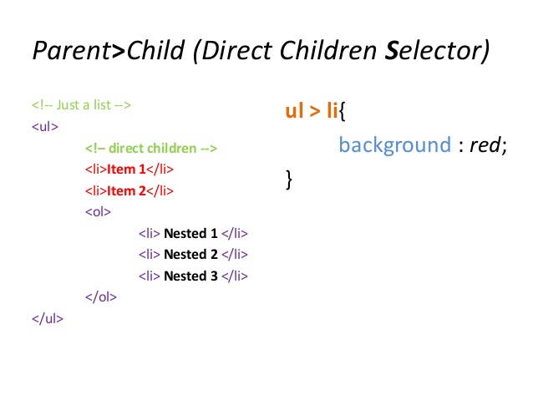
Direct Children Selector
Direct children

Slide 42
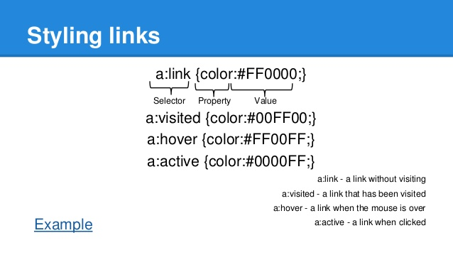
Pseudo class selectors

Slide 43
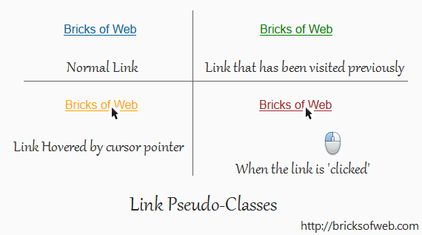
Link pseudo-class look

Slide 45
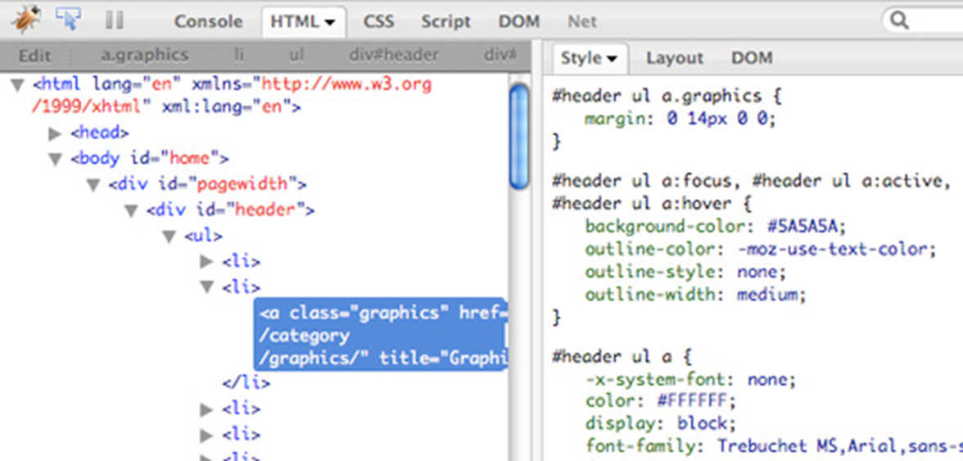

Slide 46
Style propagation
Styles applied to a container element are also applied to the elements within the container (propagated).
For example:
  a font style applied to the body tag will be applied to all the tags within the body (where appropriate)
  a border style applied to a table will apply to all rows and cells within the table
  a bullet style applied to an ordered or unordered list will apply to all list items within the list
Styles applied directly to the elements within the container element override the propagated styles. For example:
if a paragraph element within the body has a font style applied to it, that style will override the body style.

Slide 47
Html size designations
http://www.w3schools.com/cssref/css_units.asp
Relative Sizing Options
  These sizing measurements are relative to their parent container
  % - percent of container (e.g. 80% 125%)
  em - relative to current font size (1em = 100%,
  1.5em = 150%)
  Many purists only use % or em to size elements (no absolute units)
    More accessible – these measurements are in relation to the user’s preferred sizes

Slide 48
Absolute size elements
  There are five (common) ways to designate an absolute units:
      px (pixels)
      pt (points, 72 points = 1 in)
      (usually for font size)
      in (inches)
      mm (millimeters)
      cm (centimeters)
    Remember, the HTML standard requires all measurements (including font size) to include the units
      HTML5 except when designating image height and width (where they should not be included)

Slide 49
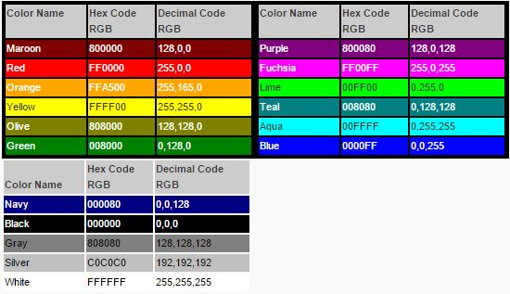
Web colors
Colors are represented as combinations of different red, green, and blue (RGB) values.
  Each color can have a value from 0 to 255
  In total, there are over 16 million different color combinations (256 * 256 * 256)
  Many drawing programs allow you to select a color from a color wheel and will provide the RGB values for that color

Slide 50
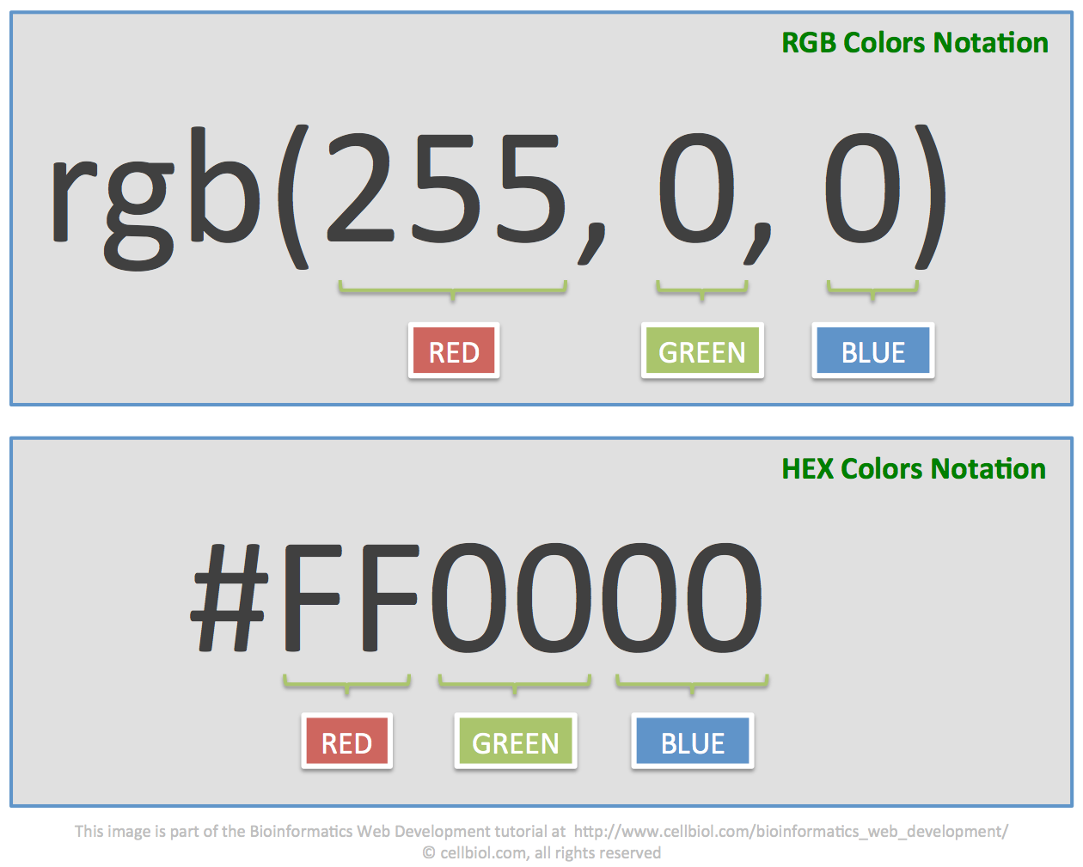
Web colors
In HTML, color can be designated in one of three ways
  As an RGB value: rgb(red, green, blue)
  As a hexadecimal value #2CD088
    # designates a hexadecimal value
    Each color is represented by a 2-digit, hexadecimal number (r, g, b)
    Many drawing programs will also provide the hexadecimal code for a color
  Using named colors.
    The CSS3 standard (and therefore the validator) recognizes 140 named colors.

Slide 51
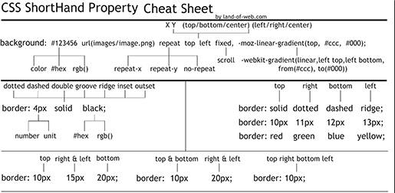
Css property chet sheet

Slide 52
Web color tools
  http://www.w3schools.com/cssref/css_colornames.asp
  http://www.w3schools.com/html/html_colors.asp
  http://www.w3schools.com/tags/ref_colorpicker.asp

Slide 53
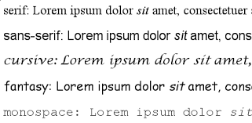
Fonts & font families
You can enhance the appearance of your web page by changing or adding fonts.
CAUTION: If you change the font-family of elements you will override the browser’s font settings. This can cause issues for visually impaired users who have difficulty reading certain fonts (particularly cursive and fantasy fonts)

Slide 54
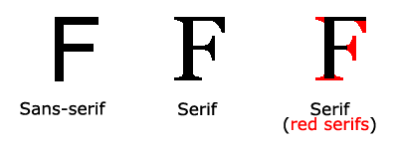
5 families of fonts
Serif
  Used for normal text
  Examples: Times New Roman, Bookman Old Style
  Small lines at the end of some characters
Sans-Serif
  Used for larger titles and headings
  Examples: Arial, Verdana
  “sans” = without

Slide 55
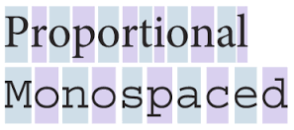
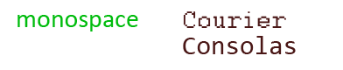
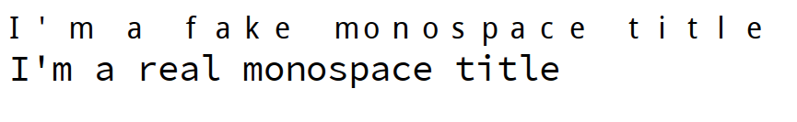
5 families of fonts
Monospace
  Typically used to show computer code or HTML code
  All characters are the same width
  Example: Courier New

Slide 56
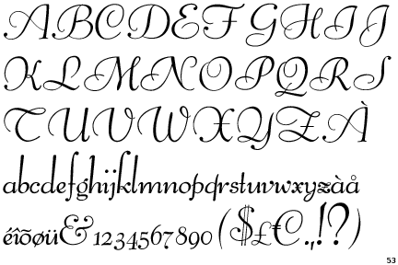
5 families of fonts
Cursive
  Script-like font.
  Example: Script MT

Slide 57
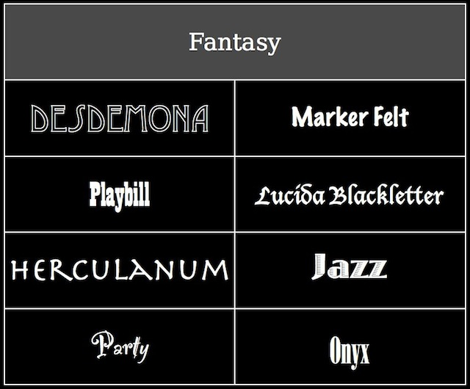
5 families of fonts
Fantasy
  Used for special effects
  Examples: Castellar, Old English
  Caution: these fonts will only appear properly on computer where the font is installed.
    To ensure the font always appears, create an image of the words you want (using a drawing program), save the image and put the image in the web page

Slide 58
Changing element fonts
Use the font-family property to set the font of an element (next slide)
Font names are not case sensitive.
  times new roman == Times New Roman
You may list any number of font names in the font-family property.
  The browser will use the first font that is available on the client computer
After designating specific font names you should always designate the font family
  These will be used if the computer displaying your web page doesn’t have the requested font installed.

Slide 59
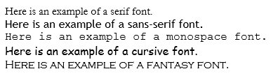
Changing element fonts
Use the font-family property to set the font of an element (next slide)
Font names are not case sensitive.
  times new roman == Times New Roman
You may list any number of font names in the font-family property.
  The browser will use the first font that is available on the client computer
After designating specific font names you should always designate the font family
  These will be used if the computer displaying your web page doesn’t have the requested font installed.

Slide 60
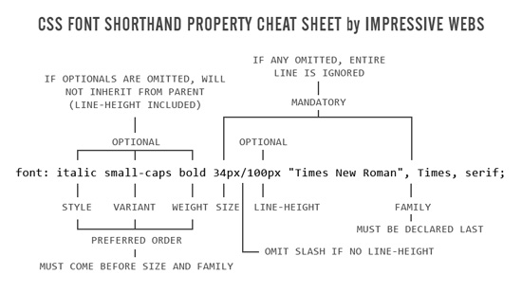

Slide 61

Combining font formatting
Use the font: style attribute
Followed by formatting in the following order:
  font-style value
  font-variant value
  font-weight value
  font-size/line-height
  font-family
Must be in that order, but you can leave any of them out except size and family.

Slide 64
assignment
CSS jigsaw
  Groups of 3
  Assign one box to each person to research
  Get back together to present to your group
  All subject matter experts get together and make one common document
  This document is what I will grade

Slide 65
For the topics assigned to you provide:
  Documentation of what it does
  Examples (provide for all variations)
Meet with the large group for your assigned Box and make up a joint document
Place joint document in OneDrive

Slide 66
Float and clear
To make one element’s content wrap around another, you include a float style property.
  wrap paragraph text around an image
  Can only float right (image on right, text on left)
  or left (image on left, text on right)
  or none
<img src=”myPic.jpg” alt=”My picture” style=”float: right;” />
Occasionally, you’ll want some text to wrap around an image, but you’ll want other text (usually following the first text) to not wrap around the image.
Use a clear style attribute in the element that should not wrap.

Slide 67
Float and Clear Example

Slide 68
float and clear video
Float and clear as 3d object
  https://www.youtube.com/watch?v=xara4Z1b18I
Float and clear summary
  https://www.youtube.com/watch?v=IiJzbXzOdHQ

Slide 69
Float and clear example
Float and Clear example
  Remove the * styling, note the default padding that we are removing with this
  Put blocks in a parent block
    Add block container with the two blocks in it
  Add float:left; to div#block1
  Add width:600px; to div#block1
    You can set the width of both elements if you wish
    Try moving the width of the entire screen. Blue block behaves by wrapping

Slide 70
Float and clear example
Put a margin:left on the second block that is equivalent to the width of the first block
  Put margin-left: 600px; on block2
    This keeps the left of the second block from wrapping around the first block (this is basically a 2 column layout)
    Change both to 200px;
Create a second blockcontainer with div’s including block 3,4,5

Slide 71
Float and clear example
Create a rule to control all the blocks
  Use descendant selector
    div#blockcontainer2 div {width: 300px; float:left}
    Note that this confuses the container a bit…
      add overflow:hidden; to div#blockcontainer2
      Will discuss the overflow later
      The blocks are all side by side now.
    Float all of them to the right
      Div#blockcontainer2 div – add float: right;
        Note what happens- they orientate from right to left

Slide 72
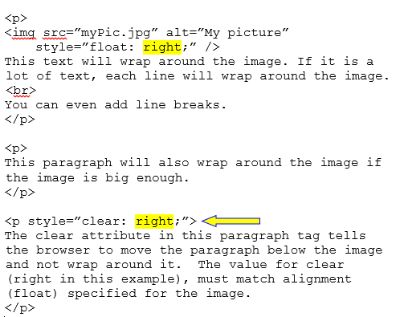
Float and clear example

Slide 73
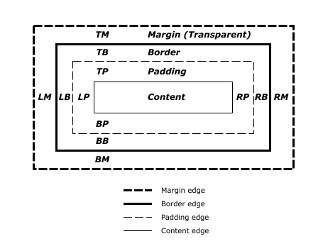
Margins vs padding
Margins designate how much extra space is placed outside an element’s border
Padding designates how much extra space is placed inside the element—how much space separates the element border from its content

Slide 74
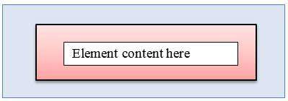
Margins vs padding
  The dark black Box designates the element’s borders (defined by width and height)
  The pink box represents the element’s padding—how far from the border the contents appear
The light blue box represents the element’s margin—how much space is put between the element and other elements (or the window border)

Slide 75
Box Model Example

Slide 76
Margins vs padding
Often times the box model is used to help explain this
  http://www.w3.org/TR/CSS2/box.html
  http://barbaraambach.com/HTMLTutorials/02BoxModel/BoxModel.html

Slide 77
Box model
Make basic document. Add a div and syling for border, height, width, margin
  Add padding
When you add margin & padding, the size of the overall box is changing.
  Total width = 2x 10px for margin + 2x10px for padding + the 300px + 2px border = 342px.
    What would need to be done to make it 300px total?

Slide 78
Box model
Add margin-left, margin-right, margin-top, margin-bottom
  Margin 10px; applies to all sides
  Margin 10px 0; -- applies to top & bottom
  Margin 10px 0 0 0 – top, right, bottom, left
Same thing for padding
Why is this important?
  Layout has left menu area, right area & you need to match them up with your content

Slide 79
Box Model video
https://www.youtube.com/watch?v=EljqgJCtwOU

Slide 80
positioning
By default, elements positioned static
  Always appear in the same place on the page in reference to other elements
Fixed
  Element always stays in the same position in browser
  Floats above the rest of the page as it scrolls
  Similar to fixed backgrounds except these elements are in the foreground
Relative
  Allows shifting from normal position
Absolute
  Other page elements ignore this element when page is rendered
  Scrolls with page though

Slide 81
positioning
When using positions other than static, you should always designate at least one of the following: left, right, top or bottom.
The position property example
  http://www.w3schools.com/css/css_positioning.asp
CSS Positioning Videos
  https://www.youtube.com/playlist?list=PL530CBAED4D59D42F

Slide 82

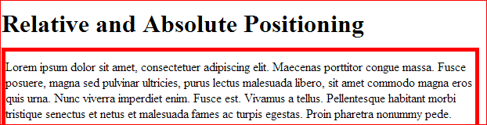
Relative position
Relative position
  Does not impact the rest of the page
  “Right” moves the h1 to the left. “top moves down

Slide 83

Relative positioning
Move paragraph over top of image using relative positioning
  Note that the image itself does not move when the h1 position is changed
  It’s part of the same <p> tag, so why doesn’t it move?

Slide 84

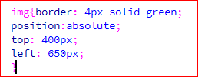
Absolute positioning
tells the browser that whatever is going to be positioned should be removed from the normal flow and of the document and will be placed on an exact location on the page.
  position:absolute; top: 10em... will always be offset 10em from the top.

Slide 85
Absolute positioning
Aligns the element related to it’s parent element (the entire page in this case)
Move the image to the top, then the bottom
  Resize the page and observe what happens
  Image moves accordingly

Slide 86
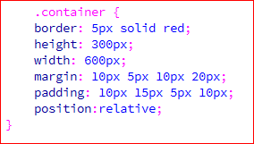
relative positioning
assume that we want the bottom:0px and right:0px to be relative to the container, not the window.
  Add position:relative to the container css to force the image to position relative to the container

Slide 87

Positioning- static
This is the default for every single page element.
Different elements don't have different default values for positioning, they all start out as static.
Static doesn't mean much, it just means that the element will flow into the page as it normally would.
The only reason you would ever set an element to position: static is to forcefully-remove some positioning that got applied to an element outside of your control. This is fairly rare, as positioning doesn't cascade.

Slide 88
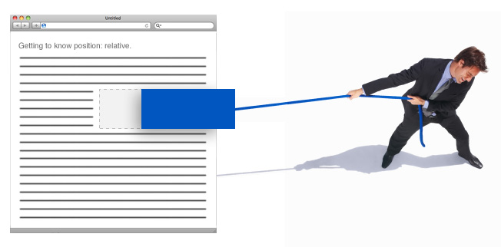
Positioning - relative
This type of positioning is probably the most confusing and misused. What it really means is "relative to itself".
If you set position: relative; on an element but no other positioning attributes (top, left, bottom or right), it will no effect on it's positioning at all, it will be exactly as it would be if you left it as position: static;
  But if you DO give it some other positioning attribute, say, top: 10px;, it will shift it's position 10 pixels DOWN from where it would NORMALLY be.
  The ability to shift an element around based on it's regular position is pretty useful.

Slide 89
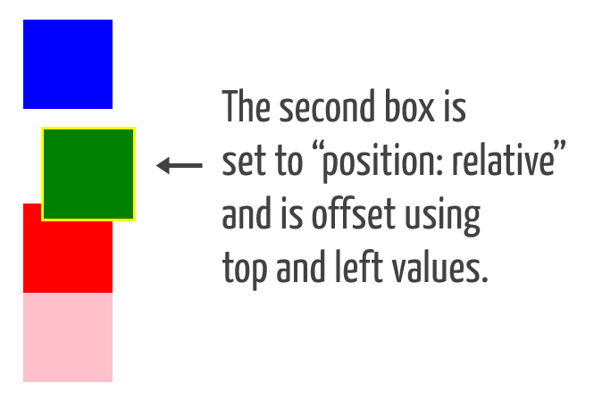
positioning- relative
There are two things that happen when you set position: relative; on an element that you should be aware of.
  One is that it introduces the ability to use z-index on that element, which doesn't really work with statically positioned elements. Even if you don't set a z-index value, this element will now appear on top of any other statically positioned element.
  The other thing that happens is it limits the scope of absolutely positioned child elements.
  Any element that is a child of the relatively positioned element can be absolutely positioned within that block.

Slide 90
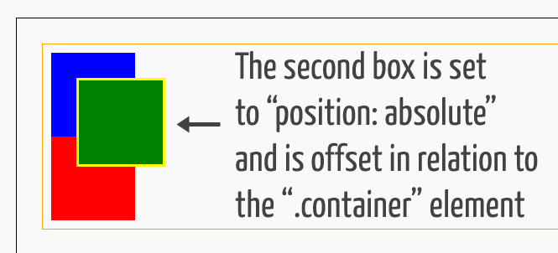
Positioning -absolute
Positioning that allows you to literally place any page element exactly where you want it.
You use the positioning attributes top, left bottom and right to set the location.
These values will be relative to the next parent element with relative (or absolute) positioning. If there is no such parent, it will default all the way back up to the <html> element itself meaning it will be placed relatively to the page itself.

Slide 91
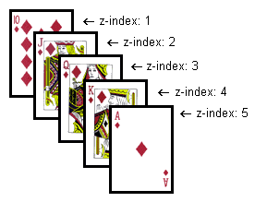
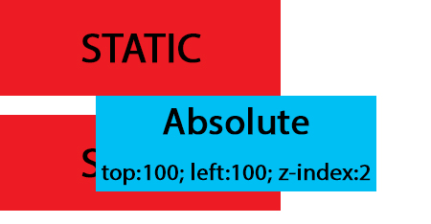
Positioning -absolute
The trade-off, and most important thing to remember, about absolute positioning is that these elements are removed from the flow of elements on the page.
  An element with this type of positioning is not affected by other elements and it doesn't affect other elements. This is a serious thing to consider every time you use absolute positioning. It's overuse or improper use can limit the flexibility of your site.

Slide 92
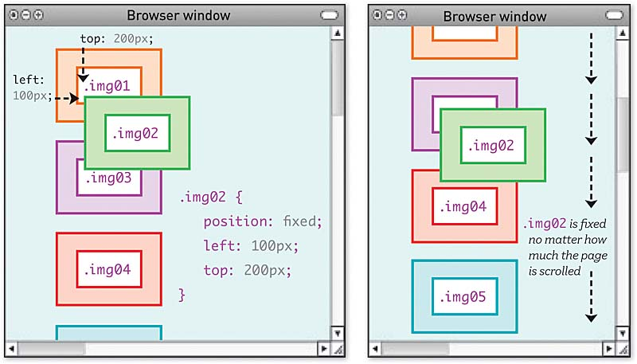
Positioning - fixed
A fixed position element is positioned relative to the viewport, or the browser window itself.
The viewport doesn't change when the window is scrolled, so a fixed positioned element will stay right where it is when the page is scrolled

Slide 93
Transforms
The transform property applies a 2D or 3D transformation to an element.
  Allows you to do the following to any element
    Rotate
    Scale
    Move
    Skew
Very mathematically based
  http://www.useragentman.com/blog/2011/01/07/css3-matrix-transform-for-the-mathematically-challenged/

Slide 94

transforms
Different browsers implement in different ways
http://www.w3schools.com/cssref/css3_pr_transform.asp

Slide 95
transforms
The matrix method allows you to do the following
Understanding 2D transformation matrix
  https://www.youtube.com/watch?v=W4AM1bZfgtw
Practice at w3schools
  http://www.w3schools.com/css/tryit.asp?filename=trycss3_transform_matrix1

Slide 96

transitions
CSS transitions are nothing other than mutating of DOM elements by the use of CSS.
The element's CSS properties will change over a period of time from one to the other.
What properties can be transitioned?
  almost all properties. There are a few exceptions to the rule depending on what browser you are testing on, but in theory, all properties (except of course transition itself) can be transitioned

Slide 97
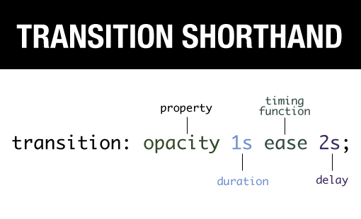
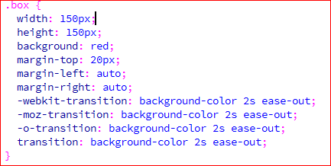
transitions
Syntax – you must account for multiple browser types

Slide 98
transitions
CSS transitions
  https://www.youtube.com/watch?v=eRcAf69IdCk
w3Schools reference
http://www.w3schools.com/cssref/css3_pr_transition.asp

Slide 99


Managing background images
Many types of objects can include background images
  Often, these images are textures, but many web pages use images as well.
  You can find many textures on the web
  Use with caution
    Complex images can make the text hard to read.
<p style=”background-image: url('Wicker Bkgd.jpg');”>

Slide 100
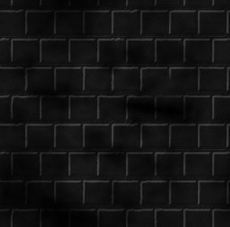

Background images
Note that if your file name (Wicker Bkgd.jpg above) has spaces in it, you’ll have to surround the file name with apostrophes
  I recommend you always include the apostrophes.
  A better idea might be to avoid spaces in your file names, but that’s not always an option.
Background images are repeated automatically (called tiling) to fill the entire object.

Slide 101

Background images
You can also designate how HTML should tile/repeat the image.
  <p style=”background-image: url(‘Wicker Bkgd.jpg’); background-repeat: repeat-x;”>
The background-repeat options include:
    repeat-x (repeat, but only across the page)
    repeat-y (repeat, but only down the page)
    no-repeat (only place one copy on form)
repeat (tile across and down) the default
Note if you designate both a background-color and a background-image, the image will cover the background color.

Slide 102
examples
Apply the Wicker Bkgd.jpg to the <body>
  Note how text is obscured
Try Sand Bkgd.jpg
  Apply to paragraph.
  Apply to list.
Airplane1.gif
Set left margin of body

Slide 103

Location of background image
By default, the background image is placed in the upper left corner of the page and tiled from there.
You can designate the starting location for the image\
style=”background-image:url(‘Wicker Bkgd.jpg’); background-position: 100px 100px;”
  Moves the image 100 pixels across and 100 pixels down
  Any measurement technique can be used (px, in, cm, %)

Slide 104

Location of background image
Background image position is only a factor if the image is not repeated
  If an image is repeated horizontally, you can designate the starting vertical position (down) (only enter 1 position measurement)
  If the image is repeated vertically, you can designate the starting horizontal position (across)
  (only enter 1 position measurement)

Slide 105
Background attachment
By default, the background image moves with the text as the web page scrolls.
Alternatively, you have the background image stay fixed and just have the text scroll.
style=”background-image:url(‘Wicker Bkgd.jpg’); background-attachment:fixed;”
The default is scroll

Slide 106
Assignment
Formatting with CSS

Slide 107
Overflow-y command in css

