Slide 1
Unit 2 – Creating Web Pages
Instructor: Brent Presley

Slide 3
Assignment
Read Chapter 4

Slide 4
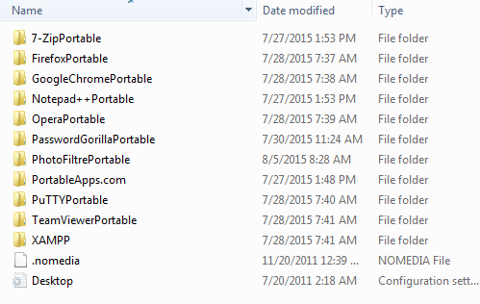
Portable apps flash drive
What should it look like?

Slide 5
using notepadd ++ & xampp
open portable apps
  ensure that xampp is running
create html file in notepad++
  store html file in e:\xampp\htdocs
  file must be stored as a .html file
In browser of choice run:
  localhost/webpagename.html

Slide 6
Update notepad ++ macros
Obtain folder “Notepad ++ customization” from onedrive and execute instructions
  1. Close Notepad++. Can't import with the program running. It will replace what you just copied with what it's using.
  2. Open E:\PortableApps\Notepad++Portable\Data\Config
  3. Copy shortcuts.xml to the folder in step 2.

Slide 7
Html basics
HTML Basics –overview video. Derek Banas
https://www.youtube.com/watch?v=Ggh_y-33Eso

Slide 8

Html basics
Web pages are built using numerous (hundreds or even thousands) of tags.
Tags mark each element of a web page, designating its purpose, formatting, and content
  An element is one component of a web page
  The elements of a web page are combined by a browser to determine the appearance of a page
  All elements must be surrounded by tags

Slide 9
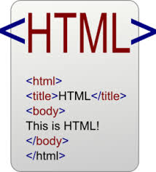
Html basics
Tags are surrounded by angle brackets <tag>
Some tags are two-sided tags
  Always include:
    Opening tag, content, and closing tag
  Opening tag designates what kind of element this is and (optionally) its formatting
  The content is what the element contains (often text)
  Closing tag simply designates the end of the element
    Closing tags always include a slash ( / ) after the opening angle bracket.

Slide 10
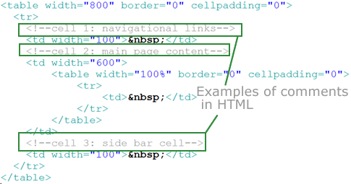

Slide 11
Tag content.

Slide 12
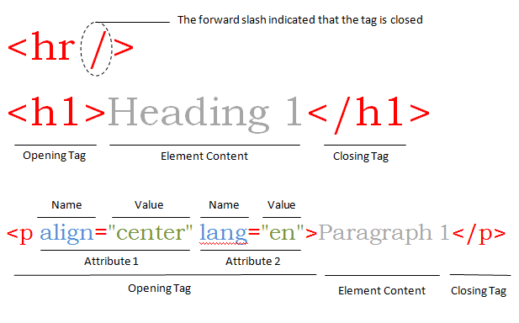
Anatomy of an html tag
Opening tag
Content
Closing tag
Attribute
  Name
  Value

Slide 14

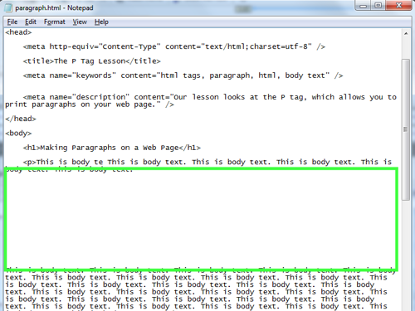

Slide 15
Open my first web page
Open notepad++ portable app
Start xampp
Create new document, run macro to make new html document
  Insert the following tag
    <p> Web principles</p>
Run… in IE, or firefox, etc from the notepad++ menu, or double click document
  You must save the document prior to running the html document

Slide 16
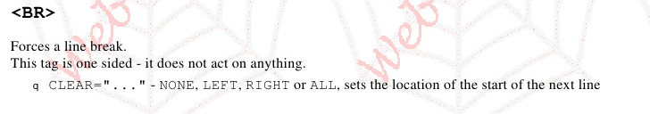
One-sided tags
Used to insert elements that do not have content
  Horizontal lines <hr>
  Line breaks <br>

Slide 17
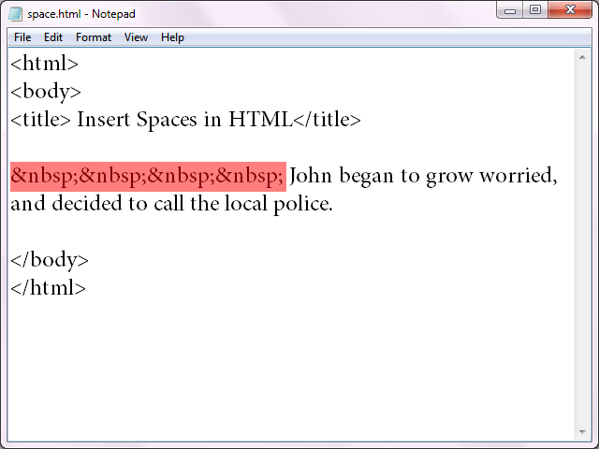
Spacing
You can add blank lines between tags to increase the readability of your HTML.
  These blank lines have no effect on the appearance of the web page in the browser
  Readability will be a factor in the grade you receive for your HTML.
  Too much white space can also detract from HTML readability
Annoyingly (sometimes), HTML also removes extra spaces from the content in your tags.
  All excess white space is removed by HTML

Slide 18
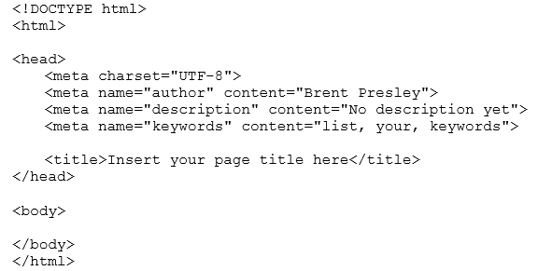
Html page skeleton
Notepad ++ NewHTMLPage macro

Slide 19
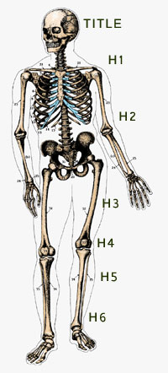
HTML Skeleton details
The DOCTYPE tag tells the browser what type of HTML document this is.
  XHMTL DOCTYPE is much more complex
  HTML 5 only requires the html designation
The <html> opening and closing tags are required by the standard
  ASP or PHP commands may exist outside of these tags
HTML and JavaScript must be inside the tags

Slide 20
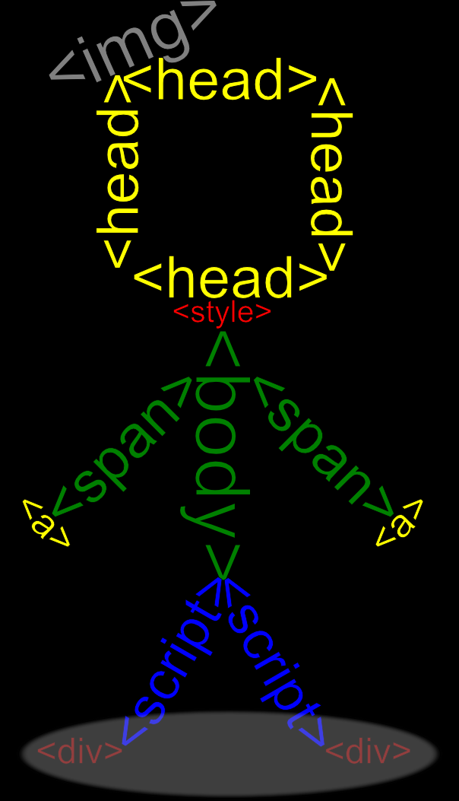
HTML Skeleton details
Each HTML page includes the <head> 2-sided tag that contains information about the web page such as its title or the keywords it contains, among other things.
  UTF-8 designates the character set used in the page
  The content of <title> 2-sided tag is displayed in the browser’s title bar
Each HTML page includes the <body> 2-side tag that contains the content of the web page

Slide 21
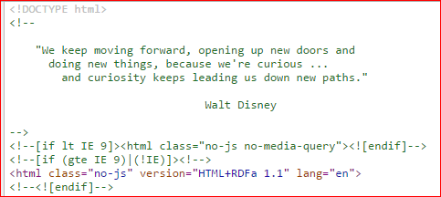
HTML comments
To improve the readability of HTML, developers frequently add comments.
  Used to document the HTML (who wrote it, why, etc).
  Can also be used to explain the purpose of particularly complex or long sections of HTML
  Are ignored by the browser (only visible to developers)
  Comments look like a one-sided tag, but it breaks the rules by not having a slash before the closing bracket.
Comments can be split over multiple lines (HTML ignores white space and it's not displayed on the page)
Disney.com

Slide 22
Comments in your projects
Our course standards will require that each page start with comments that designate:
  Page purpose
    Describe page purpose using complete, grammatically correct sentences.
  Developer's Name
  Course Name (might be Company name in the real world)
  Creation Date
Some organizations require all changes to a page be documented as well (we won't)
Observe: remove <, remove >,
Use 1 comment vs 3 comments

Slide 23
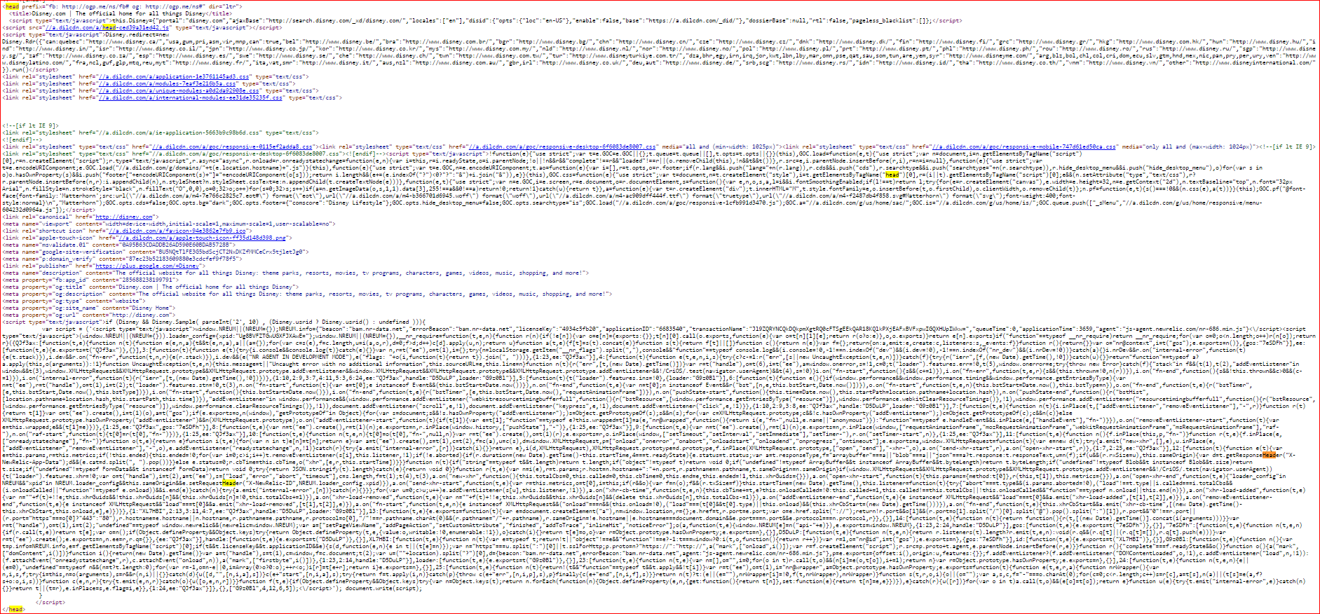
<html> tag
Within the <html> tags, a web page is divided into two parts:
  Page header element
    Contains information about the web page such as its title or the keywords it contains, among other things.
    <head> </head>
    Can be very large
  Page body element
    Contains the elements that define the content to be displayed
    <body> </body>
Disney.com

Slide 24
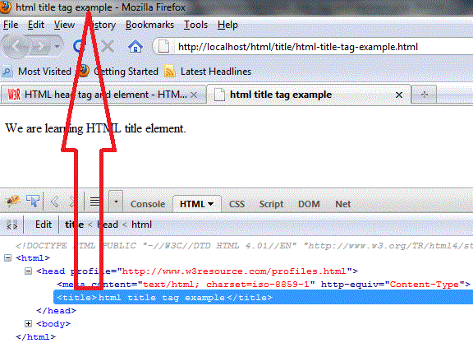
Header element
The header element often starts out with the web page documentation
The next thing all headers should contain is the page title
  This element determines what appears in the browser's title bar
Note the title of the current page
<title>My First Web Page</title>

Slide 25
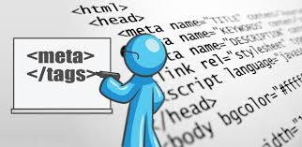
Meta tags
Meta tags are used to document the contents of a web page in a manner that is readable to search engines
  Meta tags appear in the header element and do not impact page appearance
Each meta tag includes a name attribute and a content attribute
  Name must be a word recognized by the search engines that designates what kind of meta tag this is
  Content is the information or data for this meta tag

Slide 26

Meta tags
These are the most likely meta tags, we require all 3 of them
Look at Disney.com for meta tags

Slide 27
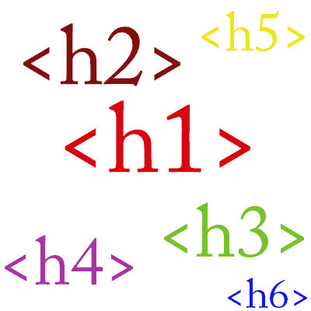
Heading element
Headings allow you to put titles on your web page
<h#>content</h#>
Six predefined heading sizes are available
  Smallest numbers, create the largest font
    Heading 1 24pt
    Heading 2 18pt
    Heading 3 14pt
    Heading 4 12pt
    Heading 5 10pt
    Heading 6 8pt
All heading elements appear boldfaced

Slide 28
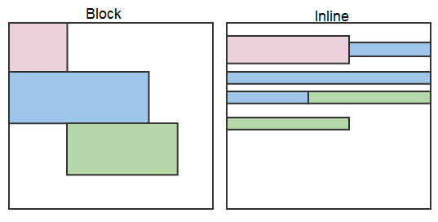
Block vs inline elements
Block level elements always start on a new line and takes up the full width available
  https://developer.mozilla.org/en-US/docs/Web/HTML/Block-level_elements
An inline element does not start on a new line and only takes up as much width as necessary
  https://developer.mozilla.org/en-US/docs/Web/HTML/Inline_elemente

Slide 30
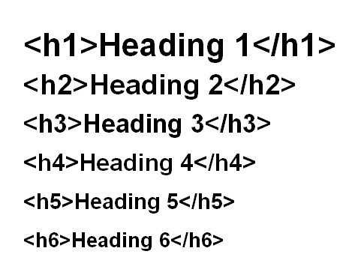

Slide 31
Heading element styles
Many (most) web page elements allow you to designate a style within the opening tag
  Styles are similar to formatting
  They control the appearance of the element
  Styles always start with the keyword style (logically enough), followed by an equal sign ( = ) and then the style surrounded by quotes.
  One element may incorporate many styles
    Include all the styles in one set of quotation marks (after style = )
    Separate each style with a semicolon ( ; )
HTML 5 standards only allow one style= per tag. Include all the styles for that tag between the quotes, separated by (;)

Slide 33
Heading element styles
The most common style applied to heading elements is the alignment style
<h1 style="text-align: center;">
    Note the keyword style is separated from the element name with a space.
    text-align is a style recognized by HTML
    Note the colon and the space
    Instead of center, you could also designate right or left (the default)
The default style is used if the style is not designated

Slide 34
paragraphs
  Paragraph elements are often the most common elements of a web page.
  They surround the text that provides information on a page.
  Features
    Paragraph can be multiple lines long
    Text automatically wraps when hits end of window
    HTML automatically inserts a blank line before the paragraph to separate it from the previous element (paragraphs appear double spaced)
Example:
<p>paragraph text here</p>
Create a paragraph with the course description

Slide 35
Assignment
Unit 1-5 HTML and CSS
  Due after unit 5
HTML Basics
  Due at the end of unit 2

Slide 36
Create this web page, part 1
Create a new web page within notepad ++
Insert the tag <p>Web Principles</p>
Save the file as Sample.html in the My First Web Site folder
After the paragraph tag, add <hr>
Add extra spaces between Web and Principles, observe results
Add six blank lines before the <hr> tag, view the results.
Restore the title, line one blank line before the <hr>
Add comments to the top of the HTML to document the student's name, course name and page purpose. (can be done with one comment or three comments)
Leave the < off: View results. Leave the > off: View the results.
  Good HTML requires > even though it works without.
Add a title to the header: My First Web Page (note title bar change)
Add 6 elements under Web Principles, each a different sized header.

Slide 37
Create this web page, part 2
Center one of the headings and Right-align one of the other headings. View
Resize the window, note how the elements adjust
Remove the heading elements. Convert Web Principles to <h1> (centered)
Access syllabus for this course. Copy the course description to the clipboard. Create a paragraph tag and paste the course description between tags

Slide 38

lists
List elements contain a list of information
  Unordered lists precede each list item with a bullet
  Ordered lists precede each list item with a number or letter
  Definition lists handle lists of terms and their definitions
In unordered and ordered lists, list items are surround by the <li> tag
Ordered list
  Ordered list tag <ol> contains multiple <li> tags
  <ol> tells HTML to automatically insert a number before each item
Unordered list
  Unordered list tag <ul> contains multiple <li> tags
<ul> tells HTML

Slide 39
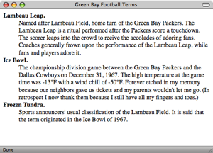
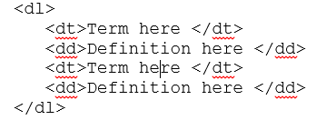
lists
Definition list
Definitions appear below the terms, indented slightly

Slide 42
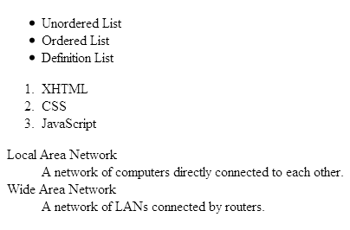
how the lists look in browser
Add a list of each type to your page and note the appearance.

Slide 43

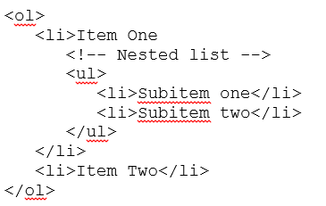
Nested lists
One list can be included inside another
Create a complete <ul> or <ol> inside the <li> tag of the outside list.

Slide 44
Update your web page
After the paragraph, add an ordered list of topics
  Terminology
  Web Concepts
  Web Pages
  Web Sites
After the ordered list, create an unordered list of standards
  <html> required
  <body> required
  Documentation
Add sub items under Web Concepts:
  Web Server
  Browser
  Web User

Slide 45
List-style-type
  Styles can be applied to lists to change their appearance.
  List-style-type
    Designates what precedes the list item in this list
    list-style-type: typehere
      disc (•), circle (), square ()
      decimal (1,2,3)
      decimal-leading-zero (01,02,03)
      lower-roman (i, ii, iii, iv)
      upper-roman (I, II, III, IV)
      lower-alpha (a,b,c)
      upper-alpha (A,B, C)
      none (no marker, just a list)
<ol style="list-style-type: lower-roman;">
Change first list item in the sublist to square
Change entire list to lower-roman

Slide 46
Update page: List-style-image
After the colon, designate url('filename')
  HTML 5 standards require that all file names be surrounded by apostrophes ('filename’)
For now, put the file containing the image in the same folder as the web page file.
Example:
<ul style="list-style-image: url(‘DiamBull.gif');">
Notes:
Change the Standards bullet to diambull.gif
Change subitem bullets to disc. Note need to change list-image-style to none

Slide 47
Update page: List-style-position
Choose from outside (default) or inside
Outside creates a hanging indent. If the text is longer than one line, subsequent lines indent.
Inside doesn't indent subsequent lines of text
Example:
<ul style="list-style-position: inside">

Slide 48
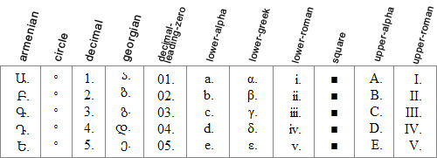
Combining styles
list-style-types
Just use list-style after the =, then list all styles in this order:
  Type, Image, URL
<ul style="list-style: square url('daimbull.gif') inside;">
  This handles the case where the user's browser is text-only (rare).
  The square bullet would also appear if the image file is not found.
  Those browsers will display the square. Graphics browsers display the image.

Slide 49
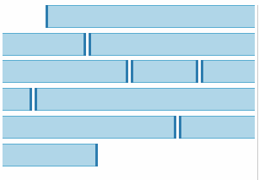
Inline elements
Also known as character formatting elements.
Some formatting should not be applied to an entire element, only certain text within the element
  E.g. Boldface or italics text in a paragraph element.
<b>This is bold.</b>
<i>This is italics.</i>
<b><i>This covers both.</i></b>
  Note the order of the closing tags. HTML standards require in-line elements be turned off in the opposite order they were turned on.
<strong> vs <b> and <em> vs <i> (type of content instead of formatting)
Semantics, not formatting

Slide 50
<b> and <i> tag history
Before HTML5, i and b were indeed deprecated. The reason was that they essentially worked like em and strong, respectively, but with focus on presentation and not on semantics (which is bad).
Indeed, i meant that the text should be in italics (it said something about how the text should be rendered on-screen). On the other hand, em meant that the text was to be emphasised (it said something about the semantics of the text).
There is an important theoretical difference here. If you use em, the user agent (=browser) knows the text should be emphasised, so it can render it in italics if the document is displayed on-screen (or all-caps if formatting is not possible, or maybe even in boldface is the user prefers that), it can pronounce it differently if the document is spoken to the user, etc.
Notice that emphasis really is about semantics. For instance, the phrases
The cat is mine. (=not the dog!)
The cat is mine. (=not yours!)
do not have the same meaning.
The same difference applies to b (boldface font) and strong (strong emphasis).
A general principle of digital writing in general, and of hypertext authoring in particular, is that you should separate content and style. In hypertext authoring, this means that the content should be in the HTML file, and the style should be in a CSS file (or a number of CSS files). A different but related principle is that the document should be rich in semantics (like marking up headers, footers, lists, emphases, addresses, navigational areas, etc.). This has a number of advantages:
It is much easier for computer programs to interpret the document. These programs include browsers, text-to-speech applications, search engines, and digital assistants. (For example, the browser can let you save an address to your address book, if only it can find and interpret it. Also, you might know that Microsoft Word can create and automatically update a TOC for you if you mark up your headings correctly.)
It is much easier to change the style later on. (If you want to change the colour of all your third-level headings in your 860-page document, you can change a single line in the stylesheet. If you had mixed content and presentation, you would have to go through the entire document manually. And you would probably miss a heading or two, making the document look unprofessional.)
You can use different stylesheets depending on the circumstance (is the document being displayed on-screen or printed on paper?). You can even let the end user choose the style herself. (My website offers a number of alternate stylesheets. In IE and FF, you change these using the View menu.)
So, in short, i and b were deprecated because they were HTML tags concerned aboutpresentation, which is totally wrong.

Slide 51
<b> and <i> tag history
In HTML5
In HTML5 i and b are no longer deprecated. Instead, they are given sematic meaning. So they are now actually about semantics, and not about presentation.
As before, you use em to mark up emphasis: "The cat is mine." But you use i for almost all other cases where you would use italics in a printed work. For instance:
You use i to mark up taxonomic designations: "I like R. norvegicus."
You use i to mark up a phrase in a different language compared to the surrounding text: À la carte
You use i to mark up a word when you talk about the word itself: "drink is both a noun and a verb"
It is also a good idea to use the class attribute to specify the precise usage (also Google "microformat" and "microdata"). And, of course, in the second case, you should really use the langattribute to specify the correct language. (Otherwise, for instance, a text-to-speech agent might mispronounce the text.)
A year ago or so, the HTML5 specification also said that cite should be used to mark up names of books, films, operas, paintings, etc.:
What do you think of Nymphomaniac?
Finally, since long ago, dfn is used to mark up the defining instance of a phrase in a text (like a mathematical definition, or the definition of a term):
A group is a set X equipped with a single binary operation * such that...
So the italics in your printed book, which can mean a lot of different things, is represented by four different HTML5 tags, which is really great, because semantics is good, as I tried to convince you about earlier. (For instance, you can ask your browser to make a list of all definitions in the text, so you can make sure you know them all before the exam.)
Turning to strong and b, the HTML5 specification says that strong should be used to mark up an important part of the text, like a warning or some very important-to-catch word in a sentence. On the other hand, b should be used to mark up things that need to be easy to find in the text, like keywords. I also use b as headings in list items (LIs).

Slide 53

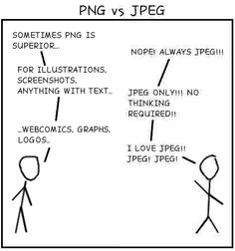
Images
One of the most popular items on web pages is images.
Web images basically come in three flavors
  GIF files (transparent and animated)
  JPG files (best for photos, resize better)
  PNG file (all the above except animated)
  Other image formats (BMP, TIFF) are uncompressed and much too large for web sites
  Drawing programs like Paint.Net can easily convert any format to a web format.
Images are one type of empty element--elements without closing tags.

Slide 54
Images
Use the <img> tag with at least these two attributes:
  src="filename"
    File that contains the image to display
    For now, store the image file in the same folder with the web page
  alt="alternate text"
    Some people turn off the display of web page images to speed page loading
    Page readers used by blind people to browse the web read the alternate text of images.
    This attribute should let them know what the image would display.
    If the image has no content value, you may set the alt string to the empty string, but the validators/standards require an alt tag.
<img src="mygraphic.gif" alt="Picture of ... "
width="100" height="150">

Slide 55

Images
  HTML 5 standards require img tags be embedded in another tag.
    I’ll use paragraph tags (see example for centering an image below) or div tags.
    <div>
    <img src="~~~~~~" alt="~~~~~~" >
    </div>

Slide 57
Title attribute on images
The alt attribute appears if the image is not found and is used by page readers.
  In older browsers, it also used to display in a tooltip, but not anymore
If you want a tooltip to display when the user hovers over your image, use the title attribute:
title="My best friend

Slide 58
Image width/height
Our standards dictate that every image includes width and height attributes.
These are not styles (though they can be), they are attributes.
The value is measured in pixels. Don’t designate px—it is assumed (error if you do). No other measurement type is allowed.
Surround the measurement with quotes
The following is copied from the w3schools web site.
  http://www.w3schools.com/tags/tag_img.asp
  Height is in pixels

Slide 59

image with height/width
Vary image width/height and note result

Slide 60
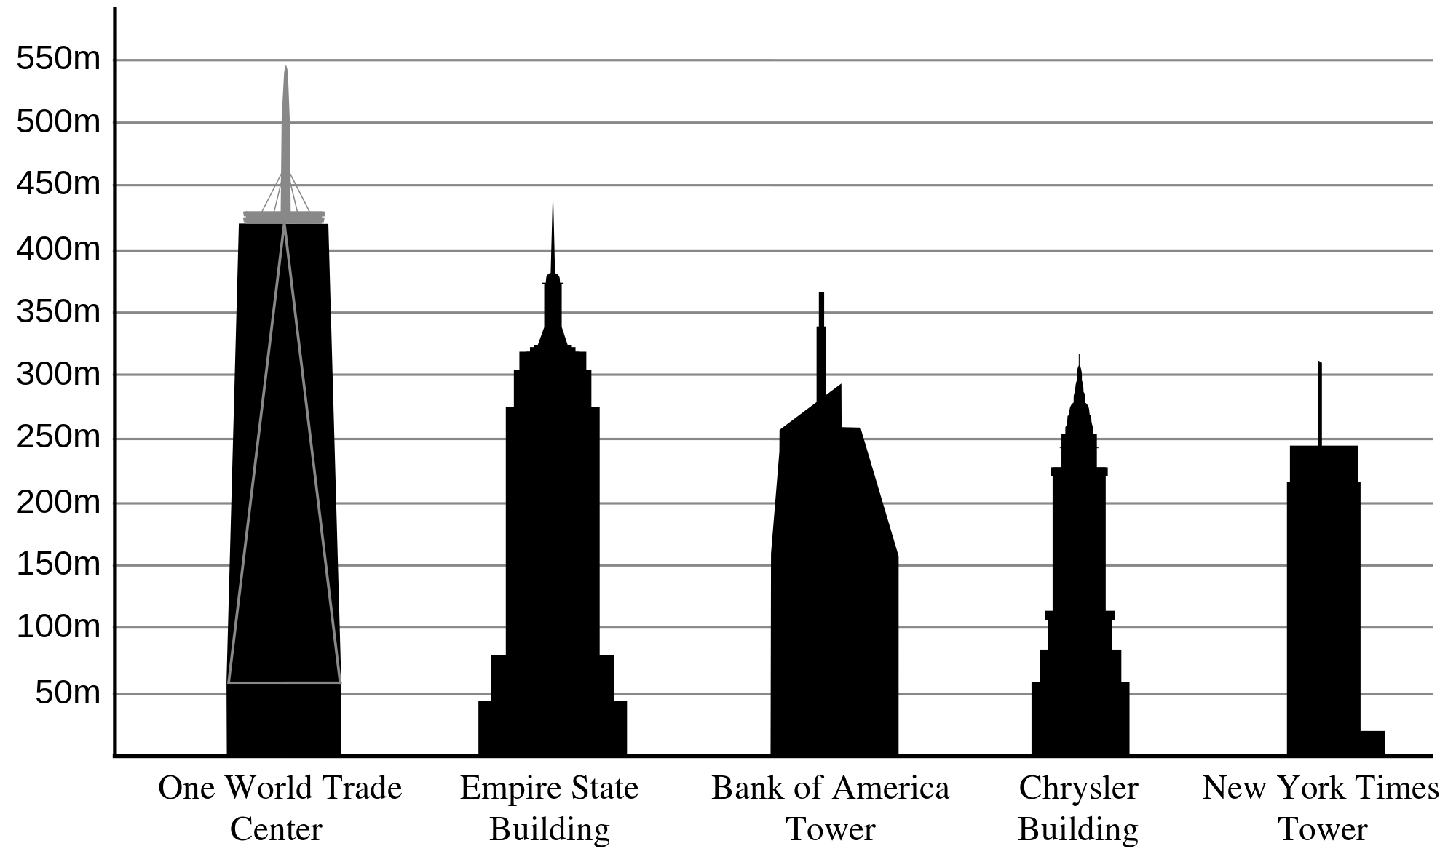
Image height/width
Tip: Always specify both the height and width attributes for images. If height and width are set, the space required for the image is reserved when the page is loaded. However, without these attributes, the browser does not know the size of the image, and cannot reserve the appropriate space to it. The effect will be that the page layout will change during loading (while the images load).

Slide 61
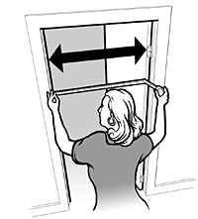
Image height/width
Tip: Downsizing a large image with the height and width attributes forces a user to download the large image (even if it looks small on the page). To avoid this, rescale the image with a program before using it on a page.

Slide 62
Update your page
Boldface the word using in the first sentence
Italicize the word languages
Insert the globe.jpg inside the <h1> tag for Web Principles (right before the W)

Slide 63
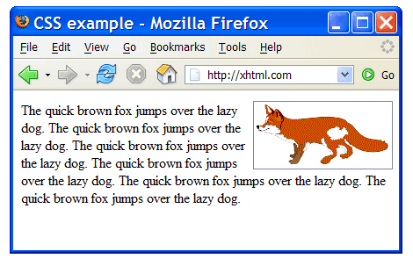
Image styles –horizontal alignment
float: position
  Position can be none, left or right
      When position is set to right, the image floats on the right side of the window and text wraps around it on the left.
      When position is set to none (the default), the image appears where it was placed within the text.
<img src="mygraphic.gif" alt="Some text here" style="float: right;">
    This image will appear on the right side of the page & the text will wrap around it on the left

Slide 64
Image styles –horizontal alignment
float: position
<img src="mygraphic.gif" alt="Some text here" style="float: right;">
    This image will appear on the right side of the page & the text will wrap around it on the left

Slide 65
Image styles –Centering an Image
float: position
    The position style does not include centering—that would imply wrap text on both sides of the image.
    If you want an image to be centered on a page, place it inside a paragraph element and center the paragraph.
<p style="text-align: center;">
< image tag here >
</p>

Slide 66
Update your page
Insert the globe.jpg inside the <h1> tag for Web Principles (right before the W)
  Give it width and height of 100
  Alt property should be “earth”
The globe is in onedrive, web programming…InClass… unit2- first web page
  Download this from onedrive and place images in the root of your project folder

Slide 67
Horizontal line (rule) -deprecated
  As you learned above, the <hr > tag adds a horizontal line (also known as a horizontal rule—that’s where the tag name came from) to the page
    Color is gray, goes from left edge of window to right edge.
  color and background-color styles
    Some browsers use the color style to control a horizontal line, others use the background-color.
      Good idea to set both
    2 million colors available—for now stick to the basics.
      See Formatting notes for color list
    Example:
<hr style="color: red; background-color: red" >
  Note the styles are separated with semicolons

Slide 68
Horizontal line – use css for formatting
  height style
    To make a thicker line, designate its height style
      If you don’t specify units, HTML will use pixels.
    Default height is 2 pixels
    <hr style="height: 4px" >
  width style
    width of the line (length) can be designated as either pixels or percent
    Default is 100%
    <hr style="width: 432px" >
    <hr style="width: 50%" >
  The first example creates a line that is always 432 pixels wide (long)
    The second example creates a line whose width is 50% of the window’s width

Slide 69
Line break
  Another empty element is the line break
  Paragraphs are double spaced. The line break allows you to start a new line within a paragraph or between elements that are not automatically spaced.
  <br>
  If you simply press Enter in a paragraph element, HTML ignores it (white space)
  Example:
<p>
Line1<br>
Line2
</p>

Slide 70
Special characters
  Some characters that are often included on web pages are not available via the keyboard
    ® © ½
  Other characters have special meaning to HTML so you’ll need a technique to display them if you need them
    < > &
  These characters are called special characters
  Chami.com Tips shows an extensive list of the special characters (including the characters themselves)
  See the official list here:Named Character References w3.org

Slide 71
Special characters
Start with a “&” followed by either the character’s number or name, followed by a semicolon
  Names are more self-documenting
  &cent;
  &#162;
  Both result in ¢
Add these to your page, then delete them.
Add 3 special characters to the H1, then delete them.

Slide 73
Special characters
Enter the following line
  My favorite tag is <hr>

Slide 74
Common special characters
    &nbsp; non-breaking space; HTML won’t remove
    &copy; ©
    &reg; ®
    &cent; ¢
    &pound; £
    &yen; ¥
    &euro; €
    &amp; &
    &lt; <
    &gt; >
    &divide; ÷
    &frac12; ½
    &frac14; ¼
    &frac34; ¾

Slide 75
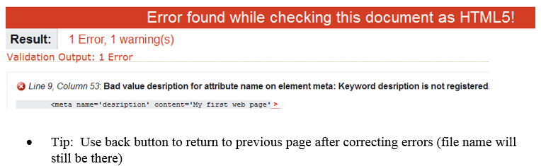
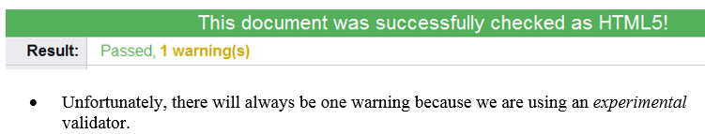
Validating html 5
  http://validator.w3.org
  File upload tab
  Browse: locate your file
  Check

Slide 76
Assignment
HMTL Jigsaw (next slide)

Slide 78
HTML jigsaw
  Groups of 3
  Assign one box to each person to research
  Get back together to present to your group
  All subject matter experts get together and make one common document
  This document is what I will grade

