Slide 1
Unit 13 –JQuery Basics
Instructor: Brent Presley

Slide 3
what is jquery?
jQuery is a library, or set of helpful add-ons, to the JavaScript programming language. It may seem counterintuitive to learn how to use a library before learning the actual language, but there are a few good reasons for this.

Slide 4
what does jquery do?
What jQuery does best is to interact with the DOM (add, modify, remove elements on your page), do AJAX requests, create effects (animations) and so forth
work with modern browser event model
adds sophisticated effects

Slide 5
why is Jquery helpful?
Tested for cross-browser compatibility
Useful for:
  Special effects and animations
  Customizing forms
  DOM manipulation
  jQuery UI (user interface)
  Another library that uses the core jQuery library as
  its core (more jQuery built on jQuery)
Libraries are called plugins

Slide 6
benefits of using jquery
leverages knowledge of css
works with sets of elements
perform multiple operations on a set of elements with one line of code (statement chaining)
hides browser quirks (so you can concentrate on the end result)
is extensible( so you can use 3rd party plugins)

Slide 7
jquery libraries include
* Data validation plugins
* Slide show plugins
* Carousel plugins

Slide 8
getting jquery
open source
can download file www.jquery.com
* Better to simply link it into the pages that need it
Compressed version is very small. Shouldn’t affect page load much.
<script src="http://code.jquery.com/jquery-latest.min.js"></script>

Slide 9
link to it vs download?
> Ensures you’re always including the most recent
version
> Include in header.php? Maybe better to include in
individual views that use it.
> Have to have an Internet connection to test pages, but
that shouldn’t be a big problem.
> See book for how to include latest version offline.

Slide 10
jquery basics
* Debugging: Firebug may report errors in jQuery files, but it’s never the jQuery files it’s the calls you made to jQuery libraries. Check the calls.
* Combines JavaScript IDs with CSS tags to reference page
elements

Slide 11
jquery methods
* $(document).ready(function() { });
> Used in most JavaScript pages
Replaces window.onload—actually more efficient (Murach)
Note document not in quotes—fixed name for the entire document
So commonly used, there’s a short form:
$(function() { } );
* Document.ready is assumed here

Slide 12
jquery selectors and filters
retrieve content from the document so it can be manipulated using other functions
returns array of objects that match the criteria
filter acts on a selector to further refine the results array that the selector returns.
the array is not a set of DOM elements
it is a collection of JQuery objects that have predefined functions included with them

Slide 13
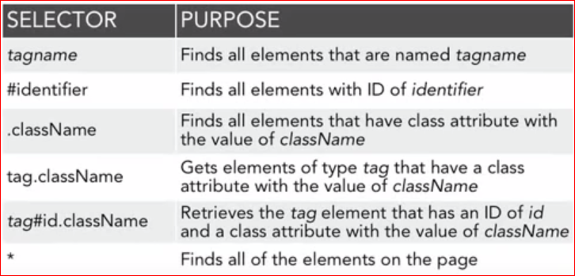
using jquery selectors
css-style selectors and filters are based on css syntax.

Slide 14
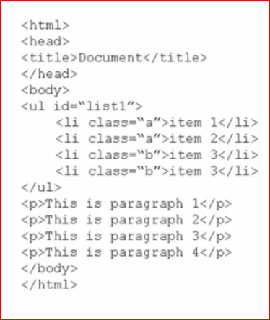
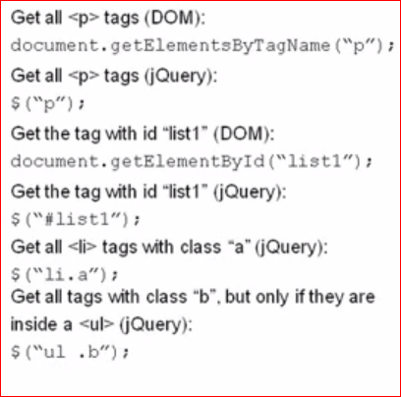
Sample and Comparison

Slide 15
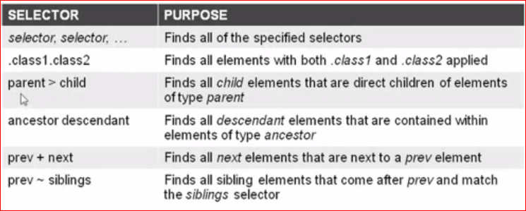
heirarchy and combination selectors
heirarchy and combination selectors allow a bit more advanced selecting

Slide 16
jquery filtering
basic -first, last, etc
content - contains a particular string
visibility - use visibility of each element as test
form - operates on form elements -enabled, checked, etc
child -select elements based on relationship with their parent element
attribute- examines a given attribute

Slide 17
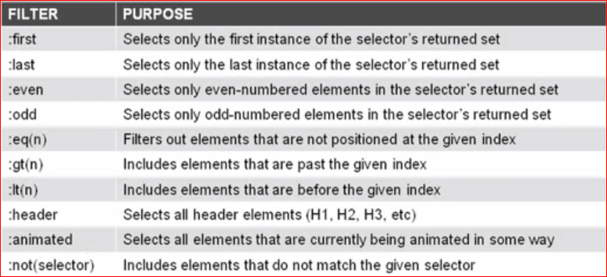
other filter options

Slide 18
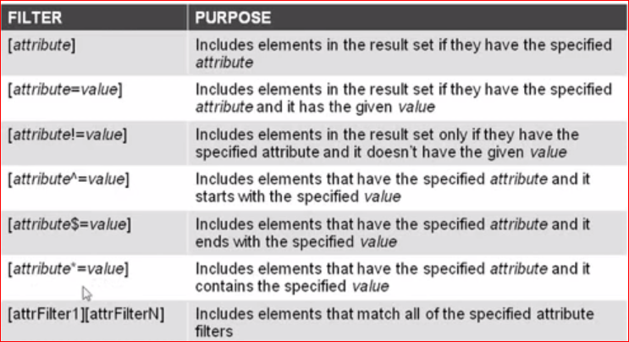
attribute filters

Slide 19
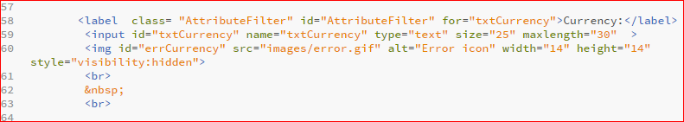
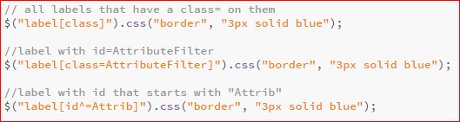
attribute filter examples

Slide 20
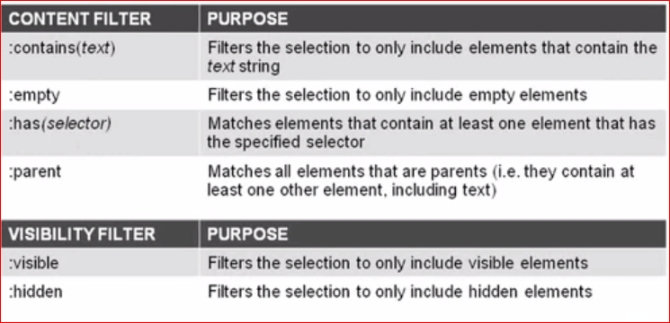
Child Filters

Slide 21
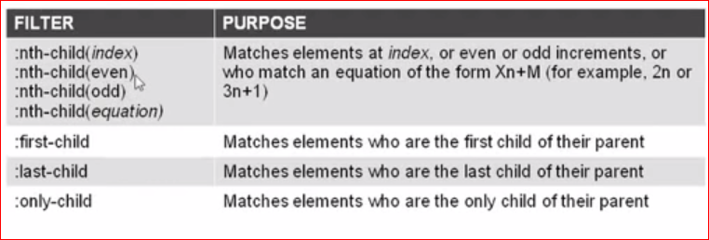
child filters

Slide 22
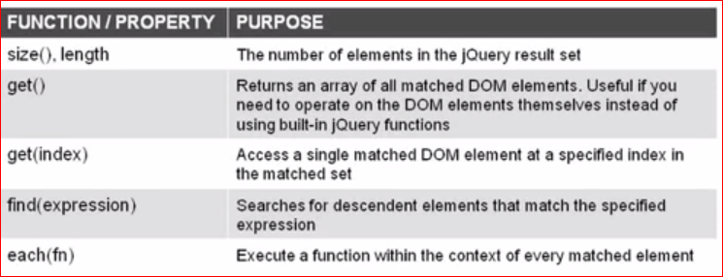
traversing the document information

Slide 23
examples
returns the number of items in the collection of labels
alert of obj type of first label

Slide 24
jquery resources
http://www.tutorialspoint.com/jquery/jquery-basics.htm
https://www.codecademy.com/learn/jquery
https://learn.jquery.com/

Slide 25
jquery methods
* Like JavaScript functions, jQuery methods must be associated with an event
Generic format:
$(selector).event(function() { //code here });
Note that this event handler includes an anonymous function. The function has no name, but is linked to the event.
Similar to anonymous functions in Android.

Slide 26
* $("#btnSubmit").click(function() {
alert("Button clicked! ");
});
Code for the click event of button with this ID
Define btnSubmit click Just show an alert
Like in JavaScript, event handlers for buttons, etc. are usually defined in the ready function

Slide 27
link event handler to function
linking the event handler to another function (other than calling that function)
$(function() { //Ready
$("#btnSubmit").click(function() {
alert("Button clicked! ");
}); //end of click
}); //end of ready
Indentation is critical
  Keep all the { } and ( ) straight

Slide 28
* .show() .hide()
> Show or hide selector
> Easier than using css(‘visibility’)

Slide 29
selectors
* Selectors allow you to designate which page (form) objects to apply code to.
Similar to the $( ) function we wrote in JavaScript to access form elements quickly.
Selectors start with $( ) (like our function)

Slide 30
using css selectors
* Instead of just the name (id) of a page element, jQuery selector allows you to use any CSS selector (in quotes) to designate page elements
One jQuery selector can select many page elements (unlike our $ function that only referenced one)

Slide 31
example
* Examples:
> $("p") applies jQuery code to all paragraphs
> $("#header") applies jQuery code to the page element with ID header
similar to our $ function but note the # is required
$(".title") applies jQuery to all elements with class title

Slide 32
accessing values, attributes, and css
* (selector).val
* (selector).attr(‘attribute’, value)
* (selector).css(‘style’, ‘newvalue’)

Slide 33
javascript easier
* Rename our $ to $$ or el
* No easy jQuery way to clear form

Slide 34

function chaining
one of JQuery's most powerful features is the ability to chain multiple functions
output from the first function is the input to the second...

