Slide 1
Unit 12 JavaScript Arrays
Instructor: Brent Presley

Slide 3
references
http://blog.xkoder.com/2008/07/10/javascript-associative-arrays-demystified/

Slide 4
concepts
arrays are many(sequential) memory locations that are all referenced by the same name
eachitem in the array is an element and is referenced by a 0 based counter
since variables do not have types in JavaScript, JavaScript arrya elements can be of varying types
  some can be string, and others date, and some numeric in the same array
array is a class in JavaScript
JavaScript arrays are dynamic: their size can change as needed.

Slide 5
declaring arrays
var myArray = new Array( );
  Declares a new, empty array (size 0)
  Code must add elements to the array
var myArray = [ ];
  Alternate to above
var myArray = new Array(15);
  Declares a new array with 15 elements (0-14)
  Code may change the size of the array

Slide 6
declaring arrays
var myArray = new Array(5.25, 10.11, 2.75, 9);
  Declares a new array with 4 elements (0-3)
  Initializes the elements of the array with the values designated
  Code may change the size of the array
var myArray = [5.25, 10.11, 2.75, 9];
  Alternate to above

Slide 7
assigning values
myArray[index] = newValue;
  Index can be any value. If the value is beyond the end of the array, the array will automatically resize
Quick way to add an element to the end of the array (and resize)
myArray[myArray.length] = newValue;
  length returns the number of elements in the array

Slide 8
deleting elements
delete myArray[2]
Removes the 3rd element of the array
Size of the array is unaffected
myArray[2] is now undefined

Slide 9
for loops and arrays
For loops and arrays go together like peanut butter and jelly. You rarely have arrays that aren’t processed with for loops
for (var i=0; i<myArray.length; i++)
for (var element in myArray)

Slide 10
Notes regarding looping
Each time through the loop element has a different index value from the loop
Big Note: Skips over elements that are undefined
Big Note: if the array is indexed using integers (not associative array), the loop variable (element in this example) has type String (not integer)

Slide 11
passing arrays to functions
doSomething(myArray);
  Only the array name is included as an argument
  Arrays are passed by reference. Only the address of the array is sent to the function.
  Any changes made to the array by the function are also available outside the function

Slide 12
sorting arrays
The Array class includes a sort method,
arrayName.sort();
Because arrays can contain any kind of value, you also have to let the sort method know how to sort them.
If you do not provide a function name (optional argument to sort), sort sorts the array as strings

Slide 13
sorting
If you want to sort differently, you’ll have to define a comparator function that designates how two items would be sorted.
  Include the function name as a parameter to sort
  arrayName.sort(howToCompare);
  Note only the function name is included, no ( )
  The function must have two parameters
    These parameters are filled in by sort using two elements of the array
  The function must:
    Return a negative number if parameter1 is less than parameter 2
    Return 0 if the parameters are equal
    Return a positive number if parameter1 is greater than parameter 2

Slide 14
reverse sorting
If you want the array sorted in reverse order (descending), after sorting call the reverse method
myArray.reverse();

Slide 15
case insensitive sorting
Sorting is normally done using the ASCII character sequence (little letters come after capital letters).
If you want to sort ignoring case, you’ll have to define a comparator function.

Slide 16
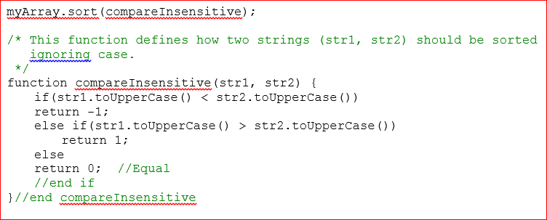
example of a sort

Slide 17
searching arrays
Easiest way to search an array is to use the indexOf method built in to the Array class
index = myArray.indexOf(findMe);
Index will contain the index of findMe in myArray.
If findMe does not exist, indexOf returns -1.
indexOf includes an optional second parameter: start
Designates where in the array to start searching
Great for finding all occurrences in a string

Slide 18
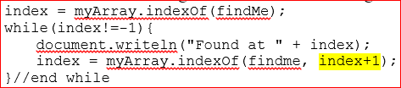
lastindexof
lastIndexOf method also exists—also includes an optional start parameter

Slide 19
binary search
Used to search larger arrays
Arrays must first be sorted
Starts in the middle of the array
Continually divides the array in half until the value has been found or the array can no longer be split.
Extremely fast

Slide 20
associative arrays
Associative arrays use strings instead of numbers as indexes.
PHP uses associative arrays when it receives values posted from a web form.
An associative array basically duplicates the functionality of one record in a database, though it can be used for other purposes.

Slide 21
create an associative array
Define the array: var studentData = [];
Add elements to the array using strings as indexes
studentData["firstName"] = "Fred";
studentData["lastName"] = "Flintstone";
studentData["program"] = "Prog/Analyst"
studentData["GPA"] = 3.25;
You can retrieve the data from the array in the same way, using the string indexes you used when defining it

Slide 22
create array with initial data
Creating array with initial data
var record = {"firstName":"Brent",
"lastName":"Presley",
"age":969 };
Actually creates an object but behaves like an associative array.

Slide 23
multidimensional array
As in all languages, JavaScript allows you declare arrays with more than one dimension—more than one index
JavaScript doesn’t support multidimensional arrays directly, but you can simulate them using arrays of arrays.
Declaring
var myArray = [ [1,2,3] [8,9,10]];
var twoDarray = new Array(2);
twoDarray[0] = [1,2,3];
twoDarray[1] = [8,9,10];

Slide 24
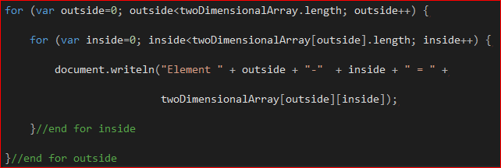
accessing indiv elements
twoDarray[1][2] //Returns 10
Note multidimensional arrays also go well with for loops—nested for loops—one for each dimension

