Slide 1
Unit 11 –Reglar Expressions
Instructor: Brent Presley

Slide 3
Overview
Most languages today support regular expressions
Including HTML5’s pattern attribute
Though not standard, most languages’ implementation of regular expressions are similar

Slide 4
Regular expressions are defined using special control characters.
The control characters are combined to form patterns that are then used to search, replace or validate other strings to see if they match the pattern.

Slide 5
We will focus on using regular expressions to validate user entries.
  They can be used to search and replace inside of strings, but most languages have other functions to do this (though they may not have all the power regular expressions have)

Slide 6
exception character
"\" is the exception character
  used to designate some control group.. ie \d
  used to remove special meaning from control characters
    . normally represents any character is allowed
    \. inserts a period into the pattern- requiring that character to be only a period

Slide 7
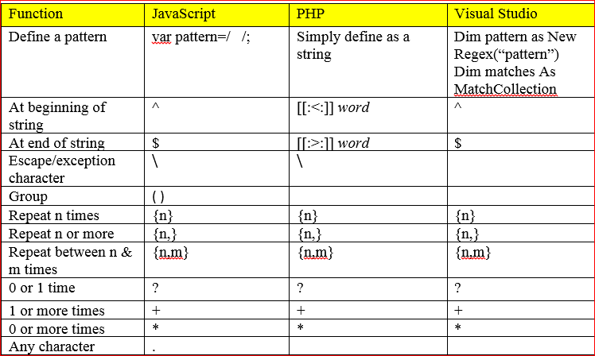
regular expression control characters

Slide 8
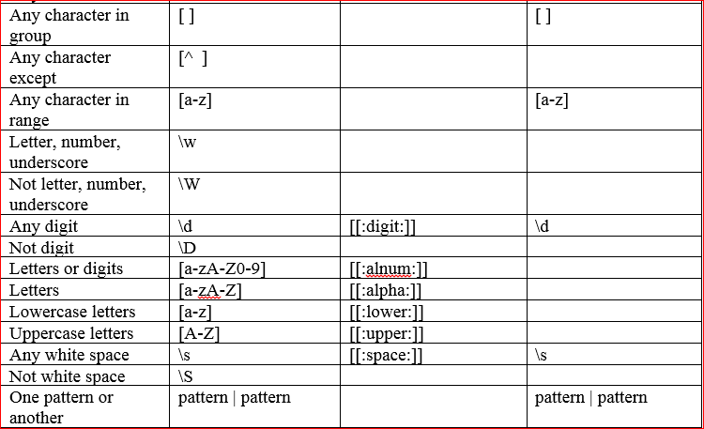
regular expression control characters

Slide 9
syntax
( ) can be used to group control characters
^ and $ are both used in many (many) JavaScript regular expression patterns to ensure the string includes no additional characters.

Slide 10
sample regular expressions
phone 999-999-9999
/^\d{3}-\d{3}-\d{4}$/
Credit Card
/^(\d{4}-){3}\d{4}$/
zip code
/^\d{5}(-\d{4})?$/
start
stop
any digit
repeat 3 times
optional
repeat 0 or 1 times

Slide 11
regex sites
http://www.regxlib.com/
http://www.regular-expressions.info/examples.html

Slide 12
a more complicated example
/^(\(\d{3}\) ?)?\d{3}[-.]\d{4}$/
\( = escapes the special character for "(" meaning that the character at this location must be a (
'space'? = optional space
[-.] = character choice of these
https://regex101.com/

Slide 13
defining regex pattern variable
What does this match?
var pattern = /^.*$/;

Slide 14
what is this one?
[A-Z0-9._%+-]+@[A-Z0-9.-]+\.[A-Z]{2,}

Slide 15
defining regex pattern variable
JavaScript
var pattern = /^.*$/; //matches anything
Visual Studio
using System.Text.RegularExpressions.Regex;
string pattern = @"^.*$";
note that backslashes must be doubled in string pattern literals or you can add @ to the beinning of the string

Slide 16
using regular expressions
if(pattern.test(str))
  will return a boolean
if(str.match(pattern)
  match returns an array of strings that match the pattern. (false if 0 elements)

Slide 17
javascript syntax
define the pattern, then check to see if the pattern matches.

Slide 18
examples
in unit11.js
  ValidateSection
  ValidatePhone
  ValidateCreditCard
  ValidateHexValue

Slide 19
eliminate ^ and $
looks for the pattern anywhere in the string
index = str.search(pattern)
  gives a 0 based index of first occurrence
  returns 1 if not found

Slide 20
returned array
if you do not have /g in the pattern
  finds all occurrences of an expression
  foundArray=str.match(pattern)
  returns an array with 3 elements
  [0]- text that matches the pattern
  [1]- index of matching pattern
  [2] -original string

Slide 21
adding g to the search
foundArray = str.match(gPattern);
Returns an array where each element contains a string that matched the pattern
  Found matches will not overlap
  Search continues after the previous match
Example: if searching for 3 digits, 1234 will match 123, but not 234 (search continues after 3)

Slide 22
replace
Replace text that matches an expression
newString = str.replace(pattern, newText)
Replaces first occurrence of text matching the pattern with newText
Include g at end of pattern to replace all (global)

Slide 23
in credit card
replace any space with a dash

