Slide 1
Unit 10 –JavaScript Validation
Instructor: Brent Presley

Slide 3
link buttons to js function
Ways to link buttons to JS functions
<input type="submit">
<input type="image">
<button> (submit implied)
<button type="submit">
Using <button type="button"> is also an option, but if the user’s browser JavaScript is turned off, no submit action will ever occur.
When creating web forms you should always consider the user whose JavaScript is turned off

Slide 4
linking form button to js
add onclick event to button
add onsubmit to form tag

Slide 5

linking form button to js
add to window.onload event handler
  onsubmit or onclick

Slide 6
other items re: linking
Note the quotes (single or double) around function name.
Note the ( ) after function name if on the button, otherwise no ()
  at one point we are calling the function, where in the onload event handler, we are not calling the function at that time

Slide 7
Intercepting the Normal Processing of a Submit/Reset Button
Normally, when you click a button designated as submit or image, the form action is processed.
If action is the empty string, the form is cleared
You can intercept the normal processing, do some JavaScript processing (validation?) and then continue with the normal processing or cancel the normal processing.
This can also be done for the reset button.

Slide 8
using return in onclick event
In the button tag, add the keyword return before the function name if you wish to potentially cancel the submit.
In the function, determine if the form should be submitted
If the form should be submitted, return true from the function or don’t include a return statement
If the form should NOT be submitted, return false.

Slide 9
additional onclick info
Note the form’s button designates an onclick event (calling buttonClick) preceded by the keyword return
The button could also be defined using the input tag (type submit or image)
The JavaScript function, buttonClick (pick a better name) does whatever processing is needed. At some point, it checks to see if everything is alright and if so, it returns true.
The submit command probably posts the data to some other form, effectively closing this form.
The returned value of true, tells the form to go ahead with the submit process
When the if statement is false, the function returns false, which tells the form to cancel the submit it would have normally done.

Slide 10
onsubmit event on form
This also works if you add an onsubmit event to the form.
<form id="myForm" method="post"
action="whatever"
onsubmit="return buttonClick()">
This technique would execute buttonClick whenever any submit button (type=submit or image) is clicked.
You wouldn’t use this and a button onclick at the same time.

Slide 11
creating event handlers
Personally, I don’t like adding onclick/onsubmit attributes to HTML tags.
Blends HTML and JavaScript, making the JavaScript hard to find. Violates separation of logic
I prefer to link all event handlers in the window.onload event
You should already have this event in your JavaScript if you included JavaScript to correctly clear a Firefox form

Slide 12
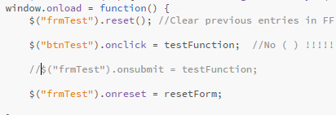
calling functions in onload
The critical point here is to recognize that none of the function names contain (parenthesis)
If you add ( ), the statement tries to call the function instead of linking to it.

Slide 13
button type can affect coding of function
Buttons defined using the <input> tag are always either a submit button or a reset button. They always submit/reset unless the function returns false;
Buttons defined using the <button> tag are also submit/reset buttons unless their type="button". These button buttons don’t do anything unless you link them to JavaScript.
If you want a button button to submit, invoke the form’s submit( ) method
$("frmTest").submit();

Slide 14
update your script
Add function for reset
Instead of clearing text box, place default text.
Return false to prevent clearing of form

Slide 15
my advice...
Use button buttons to invoke JavaScript functions that do things on the form but don’t submit or reset
Use submit or reset types for buttons that should submit or reset even if additional processing is necessary.
If JavaScript is off, submit and reset buttons should still function.

Slide 16
Open index.html.
Note includes unit10.js
Open unit10.js
Discuss window.onload

Slide 17
number type
appears as a numeric up/down
  clicking arrows changes by the step amount
switch txtValue between number and range types and note differences
max and min are set in unit10.js

Slide 18

Date picker validation
set the maximum and minimum date and note the date picker behavior
differences between browsers

Slide 19
required
designates a field as required
  if the field is blank when submitted, HTML displays an error message.
  does not tell you the field is required until the form is actually submitted

Slide 20
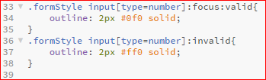
formatting invalid fields using css
observe the number change as we have valid and invalid numbers.
https://dev.opera.com/articles/new-form-features-in-html5/

Slide 21
hide/show error marker
error markers are images displayed next to the fields
create an .onblur event & the function
onblur - occurs when you leave the field

Slide 22

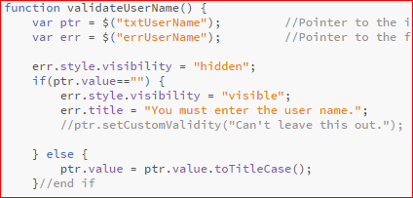
validateusername
will make the err.style visible if there is an error.

Slide 23
disabling/enabling inputs
you can disable a control in the code as well.

Slide 24
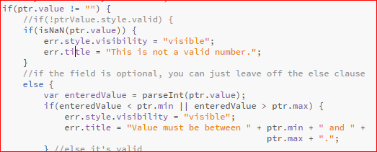
number validation
wire it up in the onload

Slide 25
summary of the number validation prior slide
Create an onblur event handler in window.onload
$("objID").onblur = validateMyField; //No ()
Extract the value from text box
Turn off the error marker
Deal with empty string if appropriate
Check to ensure is numeric (if no keypress)
Parse to a number
Use IF for range checking
If there's an error, change the title, show the marker

Slide 26
validation of dates
The Date class has its idiosyncrasies (2011-11-15 gets converted to 2011-11-14 GMT) which can complicate date range validation.
I’ve discovered the easiest way to compare to dates is to compare the string versions of those dates formatted yyyy-mm-dd

Slide 27
validate date
Import the date entered by the user
Before checking to see if the user’s entry is a valid date (isDate) I first replace all dashes ( - ) and periods ( . ) with / (slash)

Slide 28
validate date
Firefox and Chrome don’t like dates with dashes in these formats: 1-1-2013 or 01-01-2013 however if the dashes are slashes, the dates are acceptable. Replacing the dashes with slashes (behind the scenes) makes the form (JavaScript) more flexible for the user
None of the browsers accept dates with periods (e.g. 11.23.2013) Replacing the periods with slashes again makes the form more flexible

Slide 29
validatedate
If the format is not yyyy-mm-dd (use a regular expression), convert the input to a Date and reformat (import DateFormat.js)
If the format is already correct, don’t mess with it (Date could screw it up)

Slide 30
regular expression for date
remove the dash/slash,or dots globally, and replace them with a slash

