Slide 1
Unit 1 – Web Concepts
Instructor: Brent Presley

Slide 2
Assignment
Read Chapter 1
Complete lab 1 – Installing Portable Apps

Slide 3
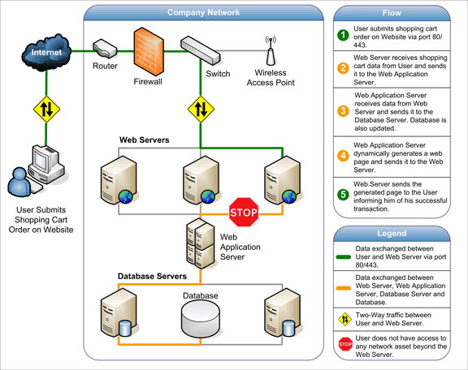

Slide 11
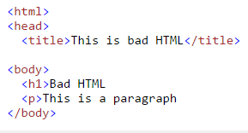
html
Web pages are defined using HTML(Hypertext Markup Language) and now, XHTML Extensible HTML
XHTML was created in 2001 to rein in different HTML standards and to incorporate XML.
XHTML has been incorporated into the newest version of HTML: HTML 5
  We’ll be using HTML 5 in this class. XHTML has been deprecated.
HTML vs XHTML
  Many pages on the internet contain ‘bad’ HTML. The code will work fine in most browsers even though it is not well formed.
  XHTML requires it to be well-formed

Slide 12
html
HTML defines what text is displayed on a page, how it is displayed and what images are displayed on a web page
HTML is pure text (no Word-like formatting)
  Can read these in any text editor because it is just text
HTML can be typed by hand, through Web Development programs
  Microsoft Expression Web
  Dreamweaver
How to view the source code on a page
  right click- view source

Slide 13
Why Learn HTML?
Some web techniques can only be created using HTML
  Inserting JavaScript
HTML developed by other programs frequently needs tweaking
In Web Data Mgt, we’ll be writing programs to create HTML

Slide 14
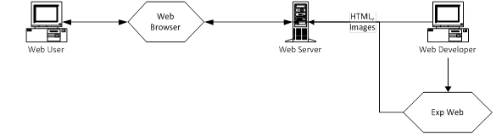
Storing the HTML
Once the HTML has been perfected, it is saved or sent to a web server that stores it in a location that is accessible by the Internet.
An Internet user uses a web browser to request pages from a web server and to display those pages.
A web browser contains the ability to convert the HTML instructions & javascript back into a graphical, functioning web page.
  Internet Explorer, Google Chrome and Mozilla Firefox are the some of the most popular browsers.

Slide 15
Web Site vs. Web Page
A collection of related web pages forms a web.
Each web page is stored in its own file. These files are often organized into a folder.
A web is also referred to as a web site.
The main page of a web (site) should have a special name: index.html or default.html.
  Web browsers recognize this as a starting page when they access a web site

Slide 16
URL
Each individual web page is assigned a URL
Universal Resource Locator
The URL is the web page’s address on the Internet.
All pages have unique URLs
Most URLs start with the letters WWW, but this is no longer the requirement it used to be.
www.mstc.edu
The index.html is implied

Slide 17
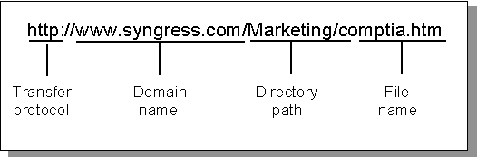
URL components

Slide 18
Web site elements
The starting page for a web site should be named index.html
Web sites normally have an images folder
  This folder contains all the images used by the web site.
  By storing only one copy of each image, the web site can save space, especially if one image is used many times.

Slide 19
Web site elements
Many web sites also have a _private folder
  This folder can store pages, files or images that you don’t want the Internet user to have direct access to.
  This folder might be used to store a database used by the web site.
Web sites are normally organized into folders of web pages, just like a hard disk is organized.
  can also contain files. Word files, Excel files, PowerPoint files, etc can all be displayed by web browsers.
Folder structure on my website. What page pulls up?? Index.html

Slide 20
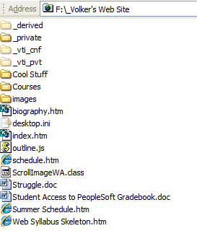
Web Site Elements
index.html
Images folder
_private folder
Other folders
Files
  Html and others
Amazon.com
  Html, css, javascript

Slide 21
Web page elements
Text (formatted, different sizes)
Images (usually stored in a separate folder)
  Web pages can display three different kinds of images:
    jpg. (high quality photos, millions of colors)
    .gif (transparent, animated, 256 colors)
    .png (portable network graphics)
Hyperlinks (links to other web pages/sites)
Tables (used to organize page information)
JavaScript (mini-programs that run within your web page)

Slide 24
Examples of CSS
http://www.creativebloq.com/web-design/examples-css-912710
CSS handles the cool formatting and shading

Slide 27
Javascript examples
http://www.creativebloq.com/web-design/examples-of-javascript-1233964
Javascript is what handles the ‘cool’ elements of a website
  Changing content, interesting effects

Slide 28
Document object model
The Document Object Model (DOM) is a cross-platform and language-independent convention for representing and interacting with objects in HTML, XHTML, and XML documents.[1] The nodes of every document are organized in a tree structure, called the DOM tree. Objects in the DOM tree may be addressed and manipulated by using methods on the objects. The public interface of a DOM is specified in its application programming interface (API).

Slide 29
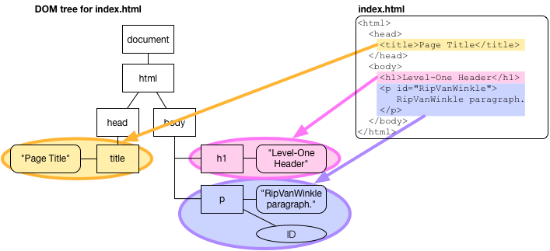
Dom tree for index.html

Slide 30
Nodes

Slide 33
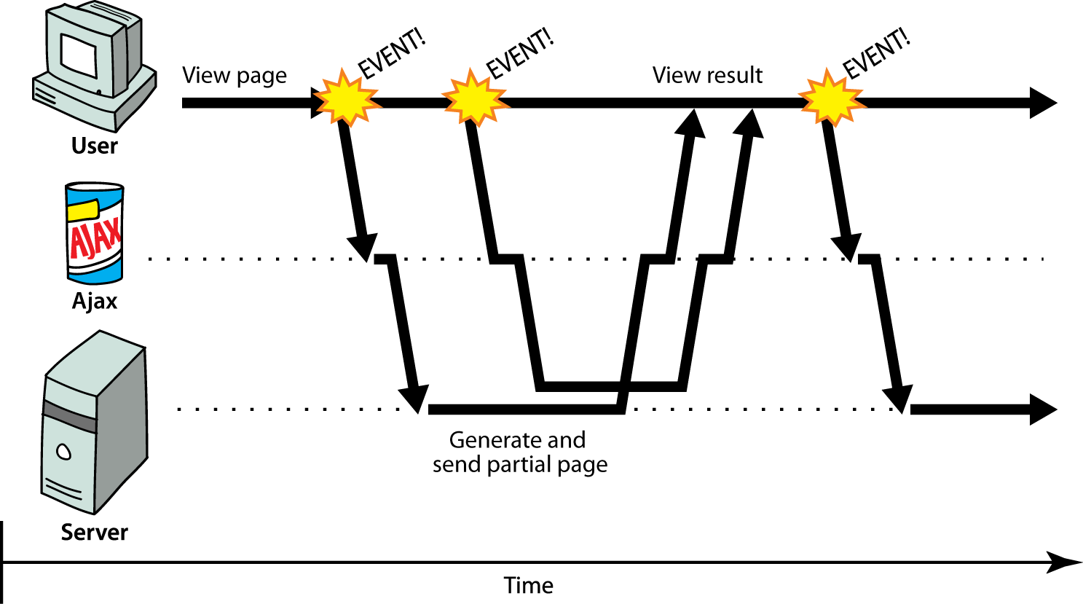


Slide 34
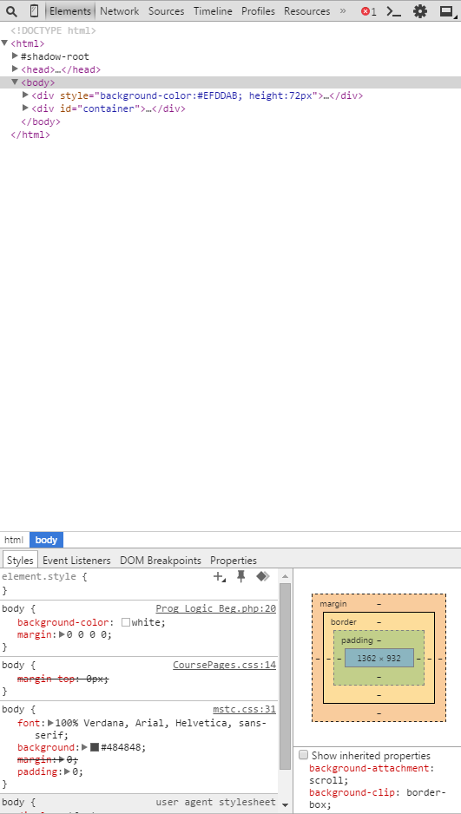
View page source on a page
Right click then “view source”
“inspect element” will also work
Developer tools F12

Slide 35
How the Internet works – summarize what we’ve learned
LearnCode.Academy
https://www.youtube.com/watch?v=e4S8zfLdLgQ

Slide 36
Assignments
In class assignment, work as a group of 3
  View source, or inspect element on 5 pages. Find an example of the following: HTML, CSS, JavaScript.
  Copy/paste them into a document
  Tell me what you think each component that you’ve chosen is doing
  submit the document on onedrive as a group
Individual assignment –
  Unit 1-5 – HTML and CSS (will decide due date later in the semester)

