Slide 1
Unit 4 – Functions and Include Files
Instructor: Brent Presley

Slide 34
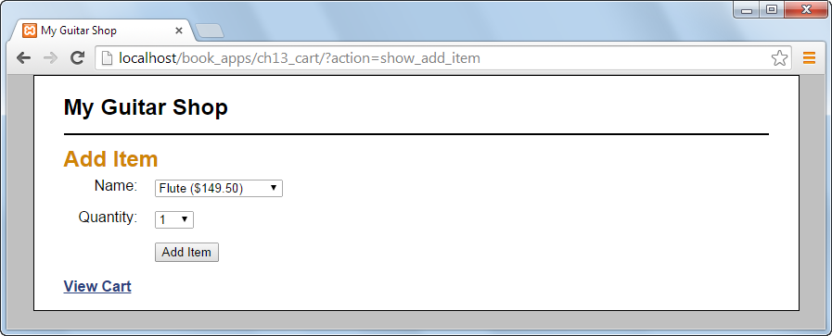

Slide 35
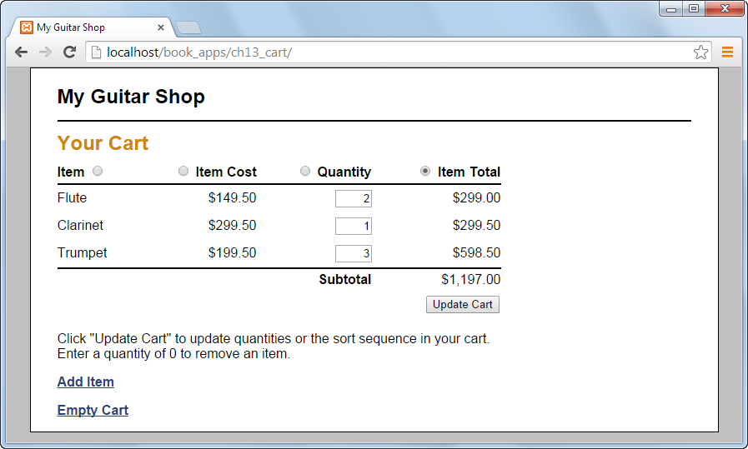

Slide 47
Locations of a function
* Can actually be placed anywhere (inside php tags)
> Even below the </html> tag
* Best stored in external files (libraries, most common)

Slide 48
Function libraries
* PHP functions stored in a separate file (.php extension)
> File must include begin and end php tags
> BIG IMPORTANT NOTE: Do not include any whitespace before the <?php or after the ?>.
* Localhost deals with them OK, but real web
servers get confused by the extra spaces.

Slide 49
Function libraries
* Functions only. No HTML unless created by PHP (echo)
* To include in your web page: require('model/myLibrary.php');
> There is also a require_once statement. Larger web
sites may include libraries where the libraries include
other libraries. A function may only be included
once. If you try to include (require) it again, you’ll
get an error.
> Murach recommends using require unless you run
into trouble.

Slide 50
namespaces
* Occasionally, you’ll need to include two (or more)
libraries that include functions with the same names,
which of course is not allowed.
* Namespaces allow you to accomplish this without making
the function names unique, by defining each function’s
namespace.

Slide 51
Including files
* As mentioned above require( )can be used to include
PHP libraries (don’t include HTML)
* If you want to include external files that contain HTML
and PHP, use the include( ) function.
include('views/errorPage.php');
> This must be included where you want the HTML
injected.

Slide 52
Including files
* In some circumstances (see examples in book) the controller needs to include a copy of itself (maybe with a slightly different display criteria).
* Unfortunately, a page cannot include itself (endless loop)

Slide 53
Including files
* To avoid this, use a header("Location: .") command
> This command actually sends a signal to the browser
to request this same page again.
* The dot (period) represents the home directory
of this web site, where index should be located
* Since we didn’t specify a file name, the default
file (index) is automatically opened
> header("Location: .?action=$newAction");
* This version of the command sets a form
variable (in index) to some value and sends it to
the new version of the form.

Slide 54
Including files
* Often follows a save or delete action that doesn’t cause
additional output on its own, so there’s no button or link
to return to this page and display the main menu
* Use this command to basically link from one case to
another in the controller
> Don’t try to include any other information
(variables). Page is completely reloaded.
* I believe this command should only be used in the cases
files
* Important note: header seems to ignore any SQL
warnings (overwriting them before you can read them).

Slide 55
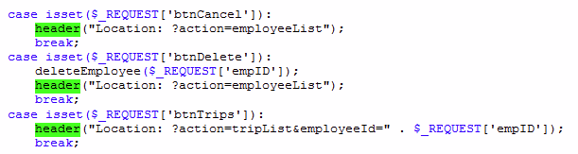
Including files

Slide 56
Including files
* BIG IMPORTANT NOTE
Don’t include blank lines at the beginning or end of
include files. These can cause problems when you
transfer PHP pages to an actual server.
See PHP Journal

Slide 57
Basic function definition
function funcName($parm1, $parm2 ...) {
return $value;
}//end function
* return statement is optional
> Some functions do things, but don’t return a value
* Parameters ($parm1, $parm2, etc) are also optional
* Unlike some languages, you cannot overload function
names (same name, different parameters)

Slide 58
Arrays and functions
* In PHP (unlike most other languages), arrays can be sent
to or returned from functions like any other type of
variable.
> Can be passed as parameter either by value or by
reference
> Can be returned from a function via return statement

Slide 59
Returning multiple variables
* Return statement can only return one variable
* If you need a function to return multiple values, use pass-
by-reference parameters
function funcName(&$parm1, &$parm2)
* Function changes memory location (variable) passed to it
instead of making its own copy
* & instructs PHP to treat parameters as pass by reference
(instead of pass by value)
> & represents the address of the variable
* Inside the function, you don’t include the & in variable
name (only in the parameter)
> Also don’t include in call
* Alternatively, could use global variables

Slide 60
Global variables
* Any variable declared outside a function is considered a
global variable
> All the variables we’ve used so far are global
> They are available in all PHP tags throughout a page,
except in functions
* Any variable declared in a function is local to the
function
* A function may access a global variable. The function
must declare that it is using a global variable
global $varName;

Slide 61
Global variables
> This example assumes the variable $varName is
declared outside the function, but not in another
function (in the global PHP code)

Slide 62
Optional parameters
* Normal parameters are required
* If a parameter is optional, the function call does not need
to include it (though it may)
* To define an optional parameter, you include it in the
parameter list but also assign it a default value
function showAddress($addr, $city, $state='WI')

Slide 63
Optional parameters
* When calling this function, the call must include an
address and city, but the state is optional. If it is not
included, WI is used.
Examples:
showAddress('123 Main St', 'New York', 'NY');
showAddress('933 Michigan Ave', 'Stevens Point');

Slide 64
Optional parameters
* If some parameters are required and others are optional
(like the example above), the optional parameters must
come last in the parameter list
> A required zip code parameter could not be included
after the optional state parameter in the example
above.

Slide 65
Variable parameter lists
* Some functions accept a variable number of parameters
* These parameters differ from optional parameters
> No parameters are listed in the function declaration
> All parameters are optional
> You can force the call to include one parameter, but
including a parameter in the ( )

Slide 66
Variable parameter list
* Inside the function you can list a list of the values sent to
the function:
$parms = func_get_args();
* func_get_args is a built in PHP function
> Creates an array of values sent to the function

