Slide 1
Unit 2 – Sequential Processing
Instructor: Brent Presley

Slide 3

Inserting php into html
To include php in your web pages, you need to surround the php commands with php tags
You cannot include html tags between the php start and end tags
Most pages have many php tags

Slide 4
Inserting html as text
You can insert html in this manner, however
The HTML tags are embedded in the string literal
  They are not HTML tags themselves

Slide 6
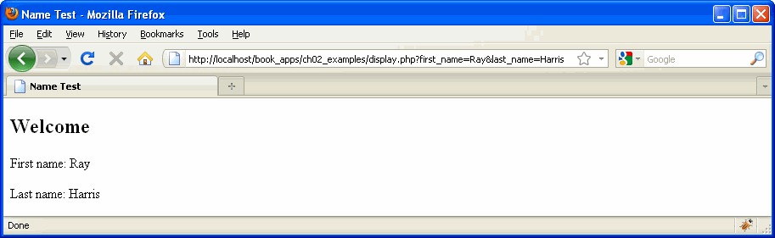

Slide 14
variables
Variables ARE NOT declared in PHP
  You simply type the variable name the first time you need it
  The type of the variable is determined based on the type of data you store in the variable
  Variable types can change
Variable names start with a $ and can contain letters, numbers, underscore

Slide 16
output
In PHP, you output to the HTML that will be sent to the client browser.
Echo
echo 'My name is ' . $name;
    echo command's results are inserted into the HTML
    The command above would insert My name is Brent into the HTML (assuming $name contains “Brent”)
    The stuff to be echoed can be surrounded by parenthesis, but it's not required (I normally don't)

Slide 17
print
print('My name is ' . $name);
  The parentheses aren’t required here either but they're almost always included in the examples I've seen.
print's primary advantage is that it's a function, so it returns a value. In some rare instances, that's necessary (see book page 227)

Slide 20
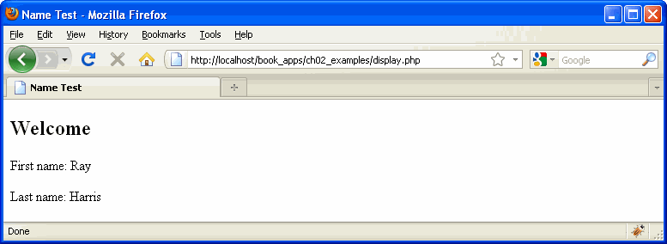

Slide 23
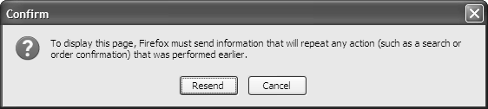

Slide 33
String processing
String literals can be enclosed in either apostrophes or quotes
  Quotes need to be scanned for embedded variables even if there are no embedded variables (slower)
  Remember that HTML can also use either apostrophes or quotes.

Slide 34

Formatting numbers as strings
Formatting numbers as strings
  number_format(value[, places])
  Formats numbers with commas if appropriate
  Rounds to the number of decimal places specified
Decimal places designation is optional. If not included, rounds to 0 decimal places

Slide 35
sprintf
printf(“formatting string”, value[s]);
  Use in place of print or echo (can’t be used inside a string)
  Formatting string can include string literals and placeholders
  Provide one value for each placeholder in formatting string
  http://php.net/manual/en/function.sprintf.php

Slide 36
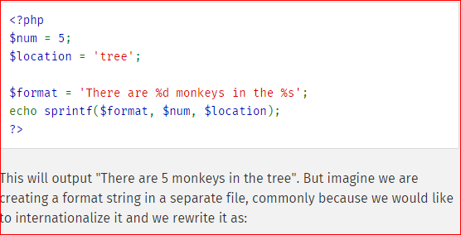
Example of sprintf

Slide 37
Variables in string literals
PHP allows you to embed variables inside string literals
  Usually during output
  echo "My name is $name";
String must be surrounded by quotes in order for variable to be interpreted

Slide 38
Escape characters
Escape characters allow you insert special or non-printing characters into string literals
  \n (new line)
  \'
  (apostrophe in a string surrounded by apostrophes) (even works in strings surround by apostrophes)
  \” (quotes in a string surround by quotes)
NOTE: escape characters only work in string literals surrounded by quotes (not apostrophes)

Slide 39
String functions
There are a lot of string functions, but here are a few of the more useful ones
  Empty($str)
  strlen($str)
  substr($str, $start[, $len])

Slide 40
String functions
str_replace($s1, $new, $s2)
str_replace($array, $new, $s2)
str_ireplace
  Replaces $s1 with $new in $s2
chr(value) creates a single character string given an ASCII numeric value
ord($char) returns the ASCII value of a character
implode and explode are used to convert an array to a string or a string to an array

Slide 42
example
e.g. %5.2f
  Starts with %
  Followed by field width (optional)
  Followed by number decimals (optional)
  Followed by field type
    %d integer
    %f float (number with decimals)
    %s
    Others available (see source above)

Slide 43
example
sprintf("%s is %d years old and makes $%.2f per hour", $empName, $empAge, $empWage);
    %s is replaced by the contents of $empName
    %d is replaced by the contents of $empAge
    %.2f is replaced by the contents of $empWage
    Always displays 2 decimals places
Since width is omitted, number only takes up as much room as it needs

Slide 48
Interesting date item
PHP time stamp is a numeric value in seconds between the time at present and the value at Unix Epoch (January 1 1970 00:00:00 GMT)
Timestamps are old school and will cause problems with dates after 2038 (google 2038 problem in PHP)
  Still used in existing web pages, but new development should use the DateTime class
  There are functions that can convert from timestamp to DateTime

Slide 49
Initial time zone
  Note PHP (in XMAPP) installs with an initial time zone of Europe/Berlin meaning all your times (all dates for a few hours a day) will be off by 5-6 hours. To fix this, you have to modify the php.ini file.
    Navigate to the xampp/php folder on your USB drive
    Open php.ini in Notepad++ or Notepad
    Find (Ctrl-F) zone
    Change Europe/Berlin to America/Chicago
    Save and close
  If you have Apache (XAMPP) running, you’ll have to stop and restart it to get the changes to take effect

Slide 50
Date examples
  $now = new DateTime();
    Instantiate the class and immediate assign current date and time
  $now = new DateTime('2011-01-20 12:00:00');
    Time is optional. If not included, set to 12:00:00 am
  $now = date_create();
    Alias for new DateTime( )
    Can also be used with string parameter
  $now->setTime(22, 30, 0); //10:30 pm
    $now must be instantiated
    -> invokes a class method
  $now->setDate(2011, 1, 20);

Slide 51
dates
$copy = clone $now;
  Creates a new date variable $copy that has the same values as $now
  Can't use (just) = That simply makes two pointers pointing to the same instance
$due->modify('+3 weeks');
  Modifies the date value in $due (must be instantiated)
  See timestamp strtotime function for list of valid modify options.

Slide 52
Date comparison
  NOTE: PHP Dates can be compared using relational operators:
  if($Date1 <= $Date2)
  is legal in PHP (but not in JavaScript)

Slide 53
Dateinterval class
Used for DateTime math
$now->add('P10D');
  Adds 10 days to $now
$now->sub('P10D');
  Subtracts 10 days from $now
$span = $now->diff($anotherDate);
  $span will be defined as a DateInterval
  Determines the interval between $now and $anotherDate

Slide 54
DateIntervals can be assigned to a variable
$myInterval = new DateInterval('P10D');
DateInterval Codes
    P – starts all interval strings
    nY – n years nM – n months
    nW – n weeks nD – n days
    T – beginning of a time interval
    nH – n hours nM – n minutes
    nS – n seconds

Slide 55
Interval codes
One interval can contain many codes
$myInterval = new DateInterval('P2WT10H30M');
    2 weeks, 10 hours, 30 minutes
    Note the “T” that starts the time

Slide 57
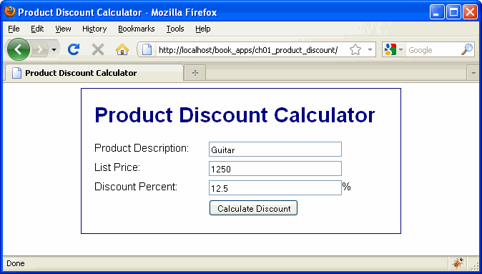

Slide 58
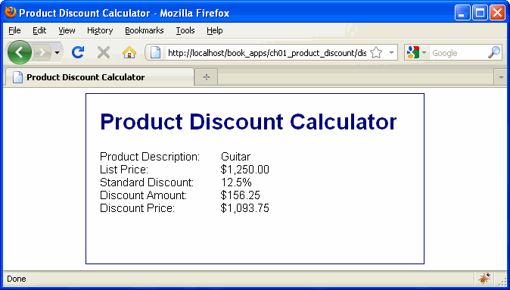

Slide 74
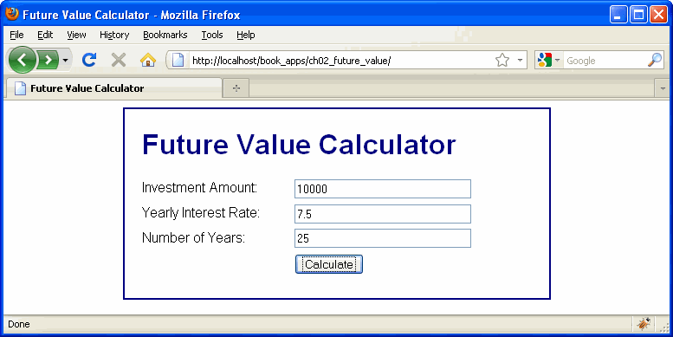

Slide 75
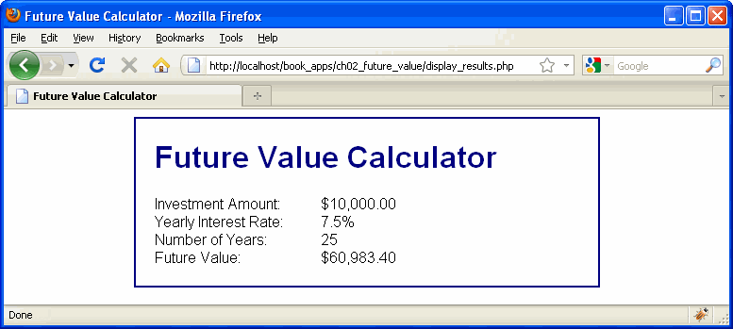

Slide 76
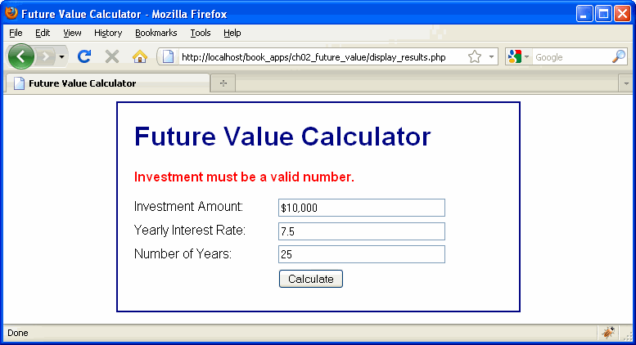

Slide 84
input
  Because PHP runs on a server, it has no mechanism for getting input from a user
  All PHP input comes from an HTML form POST or GET
    Murach recommends using GET when the results page only displays data and using POST when the results page modifies data.

Slide 85
Results page
  The results page has access to the form variables via the super global (always defined) arrays $_POST or $_GET
    Only one or the other array will contain values
    These arrays are associative arrays (remember from JavaScript?). They include key/value pairs
    The keys are the determined by the names of the HTML form objects ( name='school')

Slide 86
Array storage of form elements
  Each form object is automatically converted to an array element EXCEPT:
    Radio buttons (they all share the same name, remember?)
    Check boxes are only assigned $_POST/$_GET array elements if they are checked. They only send their values if they are checked.
  You can use $_POST or $_GET array elements directly in your PHP, but Murach generally transfers values from the array to variables.
  $school = $_GET['school'];

Slide 87
There is also a $_REQUEST super global array that combines $_GET, $_POST, $_COOKIES
  Only one of $_GET, $_POST should contain values
  We won’t be using $_COOKIES for a while (if ever)
  Avoids need to use an If statement to figure out which super global array was filled
I use $_REQUEST often.

Slide 88
Extract function
      extract($_REQUEST);
      This command converts the key/value array pairs into variables with the same name as the key whose values are already set to whatever the value was in the array

Slide 89
example
Assume form has 2 text fields - firstName and lastName
also, user enters Brent and Presley into these text boxes.
$_REQUEST['firstName'] contains ‘Brent'
$_ REQUEST ['lastName'] contains ‘Presley'
extract($_REQUEST); would automatically create a variable $firstName containing ‘Brent' and another variable $lastName containing ‘Presley'
extract creates variables for every value sent from the input form.

Slide 90
PHP includes a handy function: the print_r function
  print_r displays (no echo necessary) all the elements (key/value pairs) of an array
  The results aren’t pretty, but they’re very handy for debugging.
I’ll often insert this command at the very beginning of the receiving page: print_r($_REQUEST); to verify that all my data has been transferred from the input form and to remind me what the input field names are.

Slide 91
Variable scope
  PHP includes a handy function: the print_r function
    print_r displays (no echo necessary) all the elements (key/value pairs) of an array
    The results aren’t pretty, but they’re very handy for debugging.
I’ll often insert this command at the very beginning of the receiving page: print_r($_REQUEST); to verify that all my data has been transferred from the input form and to remind me what the input field names are.

Slide 92
Variable accessibility
However, those variables are NOT accessible inside php functions
  UNLESS, you use a separate line to designate you want access to a global variable
  global $a;
    Provides access to a global variable, $a, inside a function
  Variables declared inside a function have local scope. They are only available to that function.
Super Global variables ($_REQUEST, $_POST and $_GET are examples, there are many others) are available everywhere

Slide 94
