Slide 1
Unit 1 – Web Concepts
Instructor: Brent Presley

Slide 7
review
Previously you learned to create dynamic web pages using JavaScript
  JavaScript was embedded in the page, or stored in an included file
  Once the page loaded, it’s behavior was controlled by JavaScript
Though the pages were dynamic, they lacked on critical component: the ability to store data between sessions.. Why is this important?

Slide 8
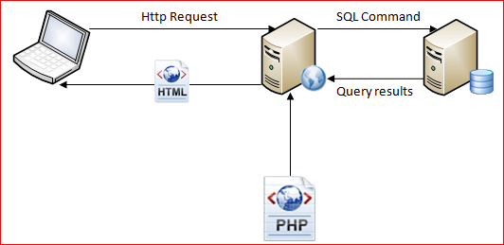
Server-side applications
Web server (server-side) applications allow you to dynamically create web pages before they are sent to the client.
  Code is used to access data
  Code is combined with HTML and data to create web pages

Slide 9
http request for php page
Client (laptop) still sends an HTTP request, but for a PHP page
The web server interprets the PHP commands
  Requests data if needed (probably)
  Uses query results to create the contents of a web page
  Just HTML is returned to the client. If you view the source of the returned page, it contains no PHP.
Page created using PHP may also contain JavaScript that can control the appearance of the form on the client

Slide 10
Example
View source on attendance page
View actual source

Slide 15
      Open source, free web server
      Major component of LAMP (Linux, Apache, MySQL, PHP)
      Microsoft’s web server software.
      Only runs on Windows Server OS
Primarily supports ASP

Slide 16
      Open source, Java-like language. Available for both Apache and IIS
      Uses .net -like interface to develop pages for IIS
    Older, less-used open source language used to develop for Apache
    : multi-use development language that can be used to develop web pages for Apache
open source database software available for all servers and most operating systems
    for-pay database software from Oracle
for-pay database software from IBM
Server: for-pay database software from Microsoft

Slide 20
Php site components
PHP pages (must have .php extension)
HTML pages
  Normally, if one page is a site has the php extension, they are all given the php extension
  PHP pages are simply HTML pages with PHP embedded in them
  They do not have to have PHP in them
  The PHP commands will only be interpreted if the extension is php.
CSS files
JavaScript include files
PHP include files
Images and other support files

Slide 21
Php applications
PHP files, like HTML, CSS and JavaScript files are pure text.
  They can be developed with any text editor, like Notepad or Notepad++
To help debug PHP code, developers often use a PHP development environment
  Eclipse is a free, multi-language IDE that is commonly used
  IDEs can do on-the-fly syntax checking (to some extent), provide intellisense (popups) features
IDEs often include debuggers that allow you step through your code and inspect variables

Slide 22
Php pages
  The real challenge is how to simulate the web and database servers.
    Web development is not done on actual web servers.
    We will use portable versions of the Apache server and MySQL database server that are available for PortableApps through a program called XAMPP
      XAMPP is an abbreviation for (see LAMP above)
      X – cross-platform
      A – Apache
      M – MySQL
      P – PHP
      P – Perl

Slide 23
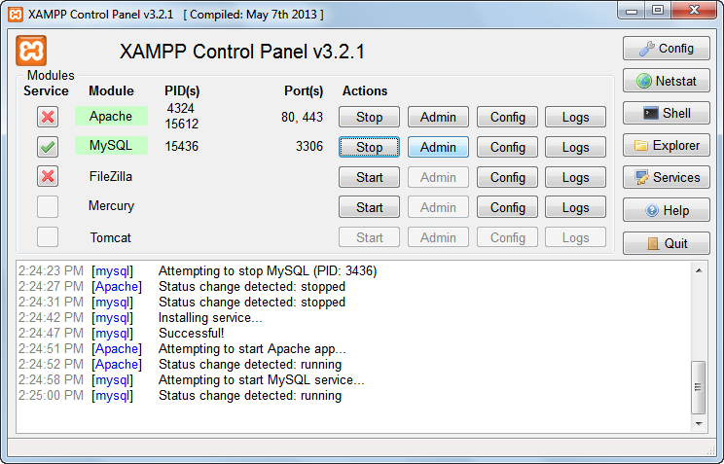

Slide 24
xampp
This program allows you to completely simulate a web server on your USB drive and accurately develop complete web data management applications
There is a version of XAMPP available for Windows that you can permanently install on your computer.
I recommend using the PortableApps version so you can carry your work from home to school.

Slide 25
Assignment install xampp
See separate notes for Installing and Using XAMPP (slide 2 of this presentation)
Note that even though XAMPP is a PortableApps application, it does not install into the PortableApps folder—it installs in the root folder of your USB drive.
DO NOT move this folder! In order for the Apache web server (and all its components) to work, the xampp folder must be located in the root.

Slide 33
Locating your php application
In order for the Apache web server to run your PHP applications, they MUST be stored in the xampp\htdocs folder.
When you attempt to display a PHP page, you will be designating the page is on the local host. Apache translates this to the htdocs folder.
You CAN create subfolders in the htdocs folder and I recommend you do so for each of your PHP projects.

Slide 34
Locating your mysql database
Remember if you plan to use database commands in your PHP, you must also start MySQL in the XAMPP control panel.
Actually, you don’t tell PHP applications or the MySQL Query Browser where to place your databases. The MySQL database server automatically places the databases where it can find them.
Should you need to find your database (to back it up or transfer it to another location), you can find them in: xampp\mysql\data folder.

Slide 35
Launching/viewing/testing a php page
  Be sure your PHP file is in the proper folder (see above)
  To test your PHP page, first open the browser of your choice.
    There is no way I know of to launch a page by double-clicking it
    It’ll launch, but PHP will not be available
  In the address bar enter localhost
Alternatively, you can use 127.0.0.1

Slide 36
Launching/viewing/testing a php page
This will launch the index.php page if there is one. Otherwise, will give you a file structure
Note, like HTML pages, if the file is named index.php, you do not need to include index.php in the file name, just the folder name
  The web server automatically searches for the index file (or default file, php, htm, html extension) if the path ends in a folder name

Slide 37
Launching/viewing/testing a php page
Note: if there is no index.php page in the root folder of localhost, entering localhost will display a directory of folders and files in localhost (htdocs)
  Tip: Delete all the files/folders entered into htdocs by XAMPP.
  Tip: Enter localhost to get the directory, then simply click the folder name of the project you want to launch. If the folder contains an index.php file it will automatically launch.
I have added a Local Host Directory item to the Notepad++ Run menu to give quick access to the localhost directory.

Slide 38
Launch non index.php pages
Be sure your PHP file is in the proper folder
To test your PHP page, first open the browser of your choice.
  In the address bar enter localhost/pagename.php
Replace pagename with the name of your PHP page.
If you want to launch a page that is not in the htdocs folder, simply insert the folder’s path (must be a subfolder of htdocs) between localhost and the PHP file name
Localhost/Brent/pagename.php

Slide 39
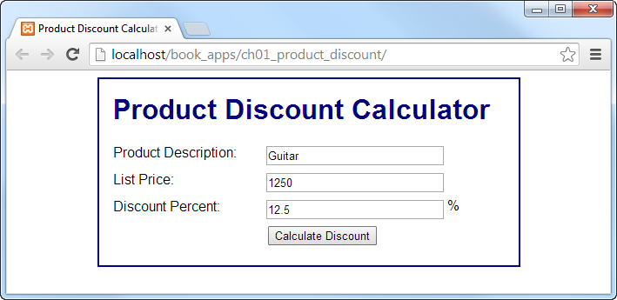

Slide 40
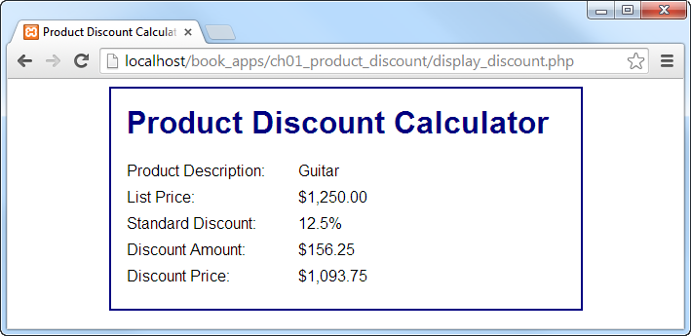

Slide 48
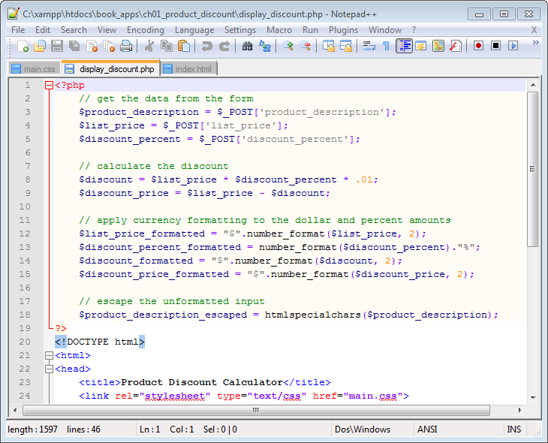

Slide 52
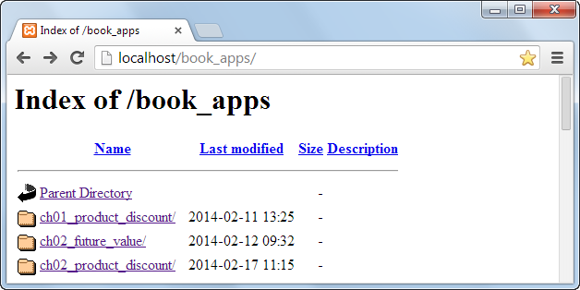

Slide 53
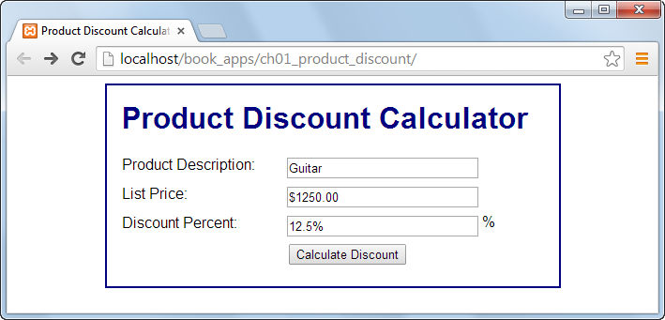

Slide 54
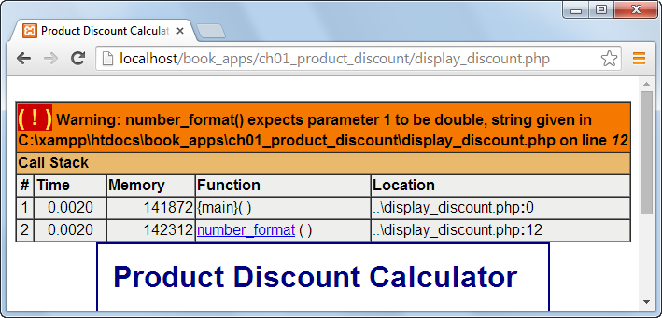

Slide 56
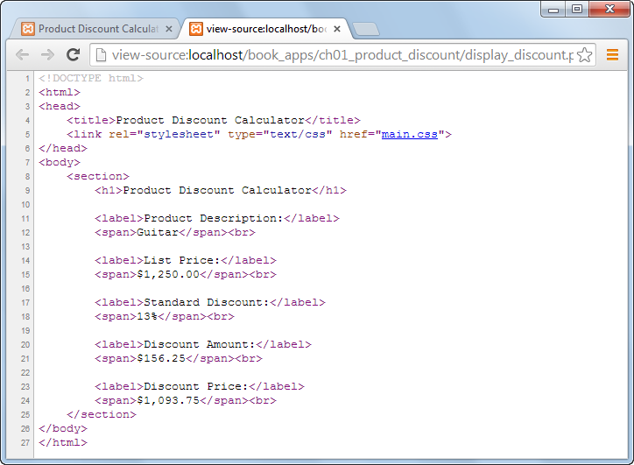

Slide 58
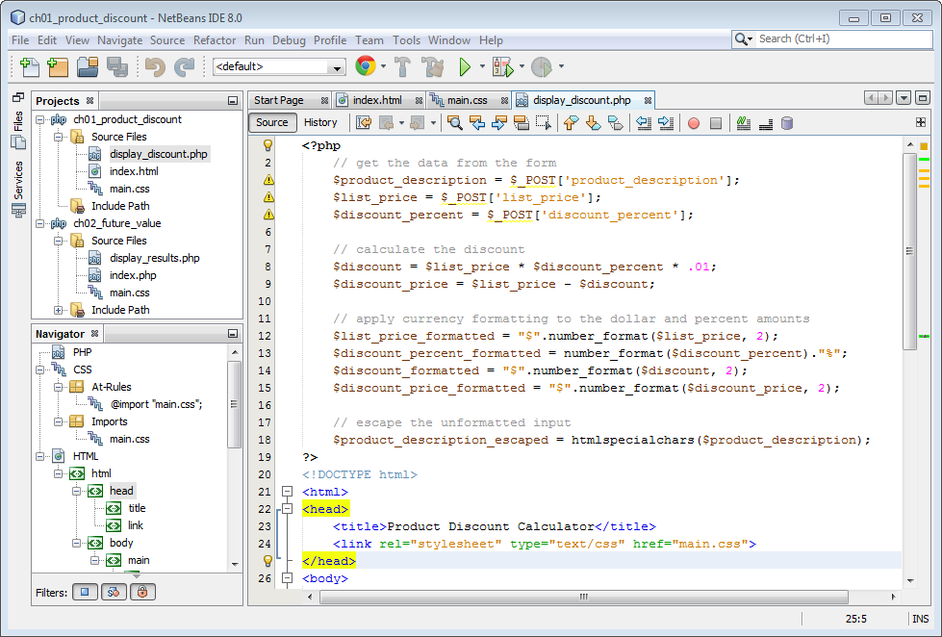

Slide 61
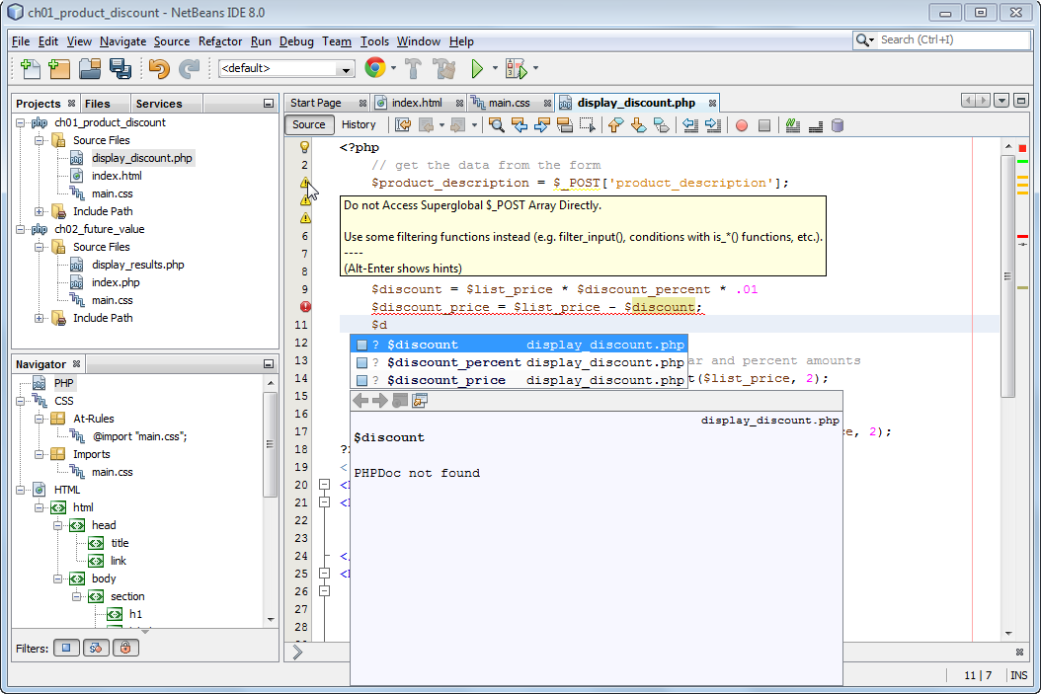
Warning icons
Error icon
Auto-completion list
for names that start
with $d

Slide 63
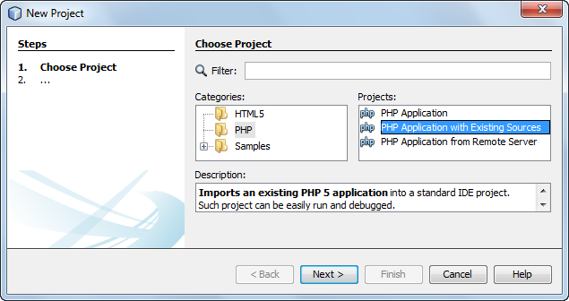

Slide 64
