Slide 1
Unit 6 Repetition Processing
Instructor: Brent Presley

Slide 3
loop types
counter-controlled loops
pre-test loops
post-test loops

Slide 4
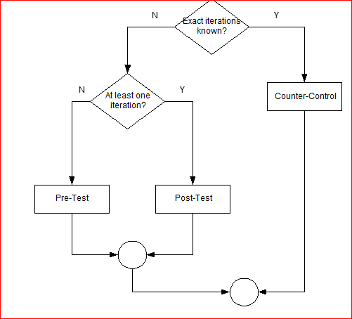
which loop to use?
An iteration is one cycle through the loop.
If you know exactly how many times you need to loop (“display population of all the states”, “display the even numbers from 0 to 100”) you should use a counter-control loop.
If you don’t know the number of iterations, but the code within the loop must execute at least one time, use a post-test loop.
Otherwise, use a pre-test loop

Slide 5
pretest vs post test
The primary difference between a pre-test loop and a post-test loop is where the condition (for continuing the loop) occurs.
In the pre-test loop, the condition comes before the code inside the loop. It is possible, therefore, for the code inside the loop to be skipped entirely if the condition (for continuing the loop) is false at the very beginning.
In a post-test loop, the condition doesn’t appear until after the code inside the loop. The code inside the loop must therefore execute at least once, then the loop condition is checked.

Slide 6
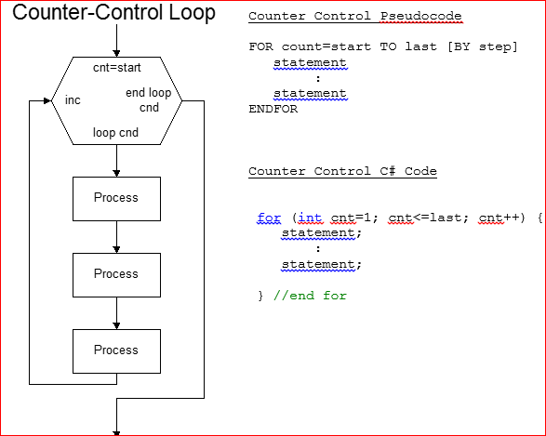

Slide 7
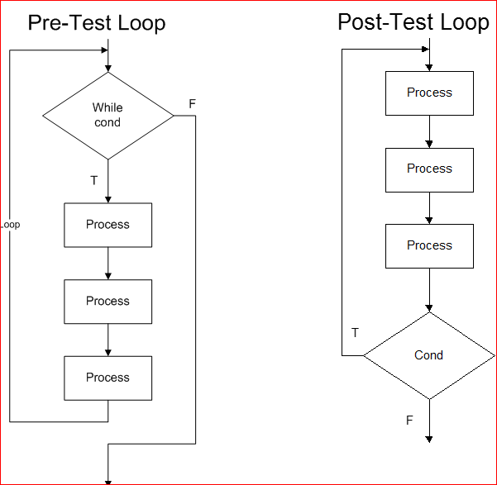

Slide 8
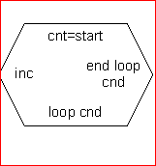
for loop
The most commonly used type of loop in object-oriented programming is the FOR (counter-control) loop
The FOR loop relies heavily on a counter that controls the number of times the loop iterates (hence the name).
The FOR loop includes a new hexagon symbol. Four items are included inside the symbol.
How counter should be changed
When should loop continue
Condition when loop should exit

Slide 9
For loop particulars
FOR loops usually start counting at 0 or 1 but they can start at any value.
For instance, you might want a loop to display the values of your canceled checks. Check numbering usually starts at 101, so you would make this the initial value of the counter in your loop.
FOR loops can also count down as well as up. This provides another example for where the initial value of a loop might not be 1.

Slide 10
for loop hexagon
At the bottom of the symbol (below the initial condition) is text that describes under which conditions the loop should continue.
This is normally described using conditions just like the ones you used in decision processing.
This condition always includes the counter in some way.

Slide 11
for loop
on the right point of the hexagon, you list the condition when the loop should end.
This is always the opposite condition of when the loop should continue (at the bottom of the hexagon)

Slide 12
for loop basics
The For loop is the C# implementation of the counter control loop
Use the For loop to code a loop whose instructions you want processed a precise number of times.
You’ll first need to declare the counter as a variable

Slide 13
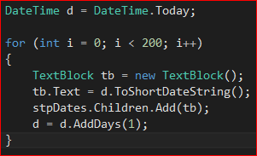
for loop example
this is adding dates to a StackPanel

Slide 14
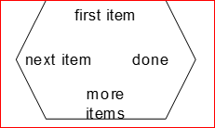
foreach loop
Because the concept of repeat this for each item in the list is so prevalent in modern programming, most programming languages include a foreach or for-in loop.
Used to code a loop whose instructions you want processed for each object in a collection (group) of objects.
Similar to a for loop, but no counter

Slide 15
foreach
The object type of the objectvariable must match the type of objects contained in the collection.
The foreach statement first verifies that the collection contains at least one object. If the collection is empty, the instructions within the loop are skipped.
If the collection contains at least one object, the foreach clause assigns the address of the first object in the collection to the objectvariable and the instructions within the loop are executed.

Slide 16
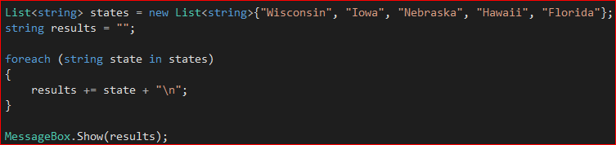
foreach example
Add some states to a list, then iterate through them to print them out in a messagebox

Slide 17
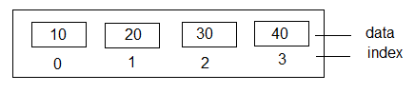
items collections
A collection is a group of one or more objects treated as one unit.
Each item in the collection is assigned an index to indicate the position in the collection. The index value begins at 0 (zero).
Collections can be sorted and you can locate (search for) individual items in the collection.

Slide 18
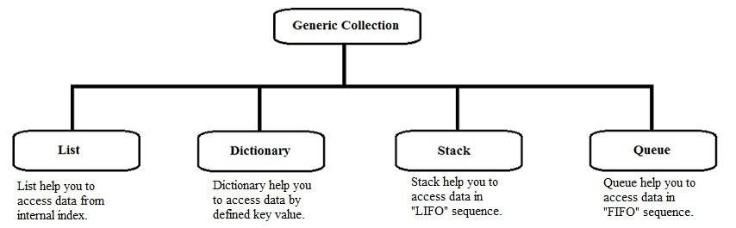
collection types in c#
We will use a list for our examples

Slide 19

collections specific to wpf
The Items property provides access to the collection of items in the ListBox or ComboBox.
Each entry/element in the Items collection corresponds to an entry/element in the ListBox or ComboBox.
Common properties and methods of the Items collection: Count property, Add, Insert, Remove, Clear methods

Slide 20
listbox
The ListBox displays a fixed list of items from which the user can select one or several items.
ListBox names are prefixed with lst
The Items property provides access to the collection of items (entries) in the list.

Slide 21
listbox selectedindex
The SelectedIndex property will contain the index (an integer value) of the item selected. Remember, indexes begin numbering at 0. If no item is selected, the SelectedIndex value is set to -1.
Can deselect all list items by setting
lstBox.SelectedIndex = -1

Slide 22
selecteditem
The SelectedItem property contains the contents of the item selected.
Note: The SelectedItem property has a data type of an object. You must convert this object to a string at run time to access it.

Slide 23
populating/update listbox or combobox
Use the Items property to load entries into the ListBox.
Entries can be loaded into a ListBox at runtime or at design time.
The Add method is used to add an item to the ListBox at runtime.

Slide 24
Code the Add method in the windowLoad event.
Each entry is part of the collection and has an index value associated with it.
Items appear in the list in the order they are added unless the list is sorted.

Slide 25
adding and inserting items
To add entries at design time, you use the Items property.
You add the entries into the Items Collection in the properties.
Each entry is part of the collection and has an index value associated with it.
If the list is relatively fixed (you are not adding/modifying the entries), fill list at design time, otherwise fill list in form Load.
The Insert method will insert an item into the ListBox at the specific location of the index

Slide 26
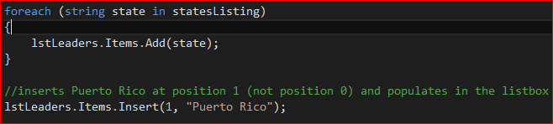
inserting into lisbox

Slide 27

remove items from listbox or combobox
The Remove method will remove the value of the item specified from a ListBox.
Remove a specific item
Remove an item at an index
Remove an item that is currently selected

Slide 28
var statement
Allows you to create a shortcut or alias for long object references. Helps save on typing and makes code (somewhat) easier to read.
Use the var command to link a variable name to an object or an object’s property
From then on (within scope), you can use the var name instead of the object property name

Slide 29
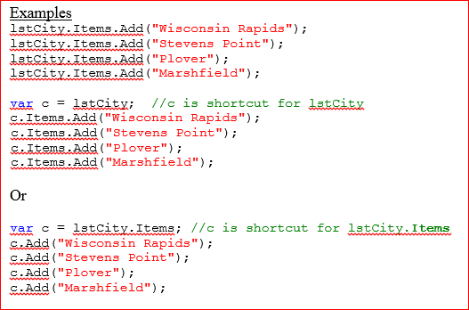
examples

Slide 30
working with listboxes
The SelectionChanged event occurs when the user clicks on (selects) an item in the list.
The SelectedIndex property will contain the integer value of the entry selected.
Use the SelectedItem property to access the value of the entry selected
For the programs in this class, convert the object to a string.
lblResult.Text = listboxName.SelectedItem.ToString();

Slide 31
changing the selected index programatically
You can select any item in the list by setting the SelectedIndex property to the index of the item
listboxName.SelectedIndex = 0;
listboxName.SelectedItem = "Plover";
Selecting a list item in this way also causes the SelectedIndexChanged event to occur as long as the item was not already selected

Slide 32
unselect all items in list
To unselect all items in the list:
listboxName.SelectedIndex = -1;

Slide 33
selection mode
The SelectionMode property allows you to control the number of entries that can be selected at one time.
Setting the property to One indicates only a single item can be selected from the ListBox.
Setting the property to MultiSimple or MultiExtended specifies multiple items can be selected.
MultiSimple: click to select, click to deselect
MultiExtended: Ctrl-Click, Shift-Click
If multiple items are selected, the Text, SelectedItem and SelectedIndex properties all refer to the first item selected.

Slide 34

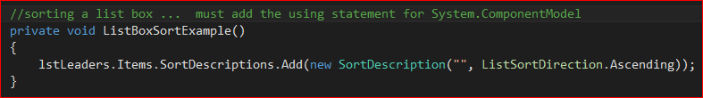
sorting in a wpf collection
you must add a dll to the top of your .cs file.
then sort using this type of code

Slide 35
combo boxes
ComboBoxes display a list of items from which the user can select one item.
The ComboBox displays a dropdown list of items when you click on the arrow.
ComboBox names are prefixed with cmb.

Slide 36
comboboxes
The DropDownStyle property determines whether the textbox portion of the ComboBox control is editable and whether the list portion is always displayed or is displayed when the dropdown arrow is clicked.
Simple mode displays a TextBox and the full list below it (looks like a ListBox).
In this option, the list does not collapse
The user can select an item or enter a value in the textbox portion.
DropDown (default) mode displays the TextBox and a dropdown arrow to access the list.
The user can select an item or enter a value in the TextBox portion
DropDownList mode displays the TextBox with a dropdown arrow.
The user cannot edit the TextBox value; the user must select an item from the list.

Slide 37

selected item
SelectedItem property contains the contents of the item selected
The SelectedItem property has a data type of an object. You must convert this object to a string at run time to access it.
setting the selected item in the view

Slide 38
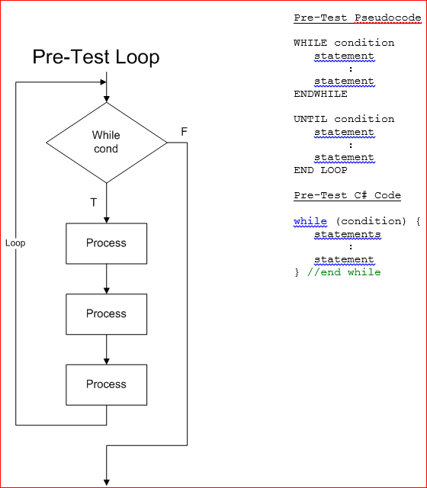
pre-test loops

Slide 39
pre-test loop
In a pre-test loop, the decision on whether the loop should be processed again is made at the top of the loop.
Note the diamond symbol is used to flowchart a loop.
Loop contents are repeated as long as the condition is true.
Is possible for the loop to be skipped entirely if the condition is initially false
Normally, but not always, the loop code appears below the diamond and the loop exits to the side.
Pre-test loop is the loop you'll most likely use when you don't know the number of iterations

Slide 40
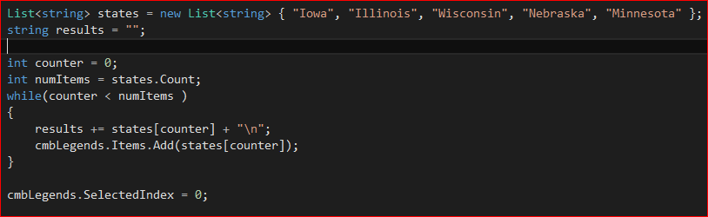
while loop example

Slide 41
post-test loop
The final type of loop is the post-test loop.
Use a post-test loop when, again, you don't know how many iterations the loop will have to go through but, the loop processing should always be done a minimum of one time.

Slide 42
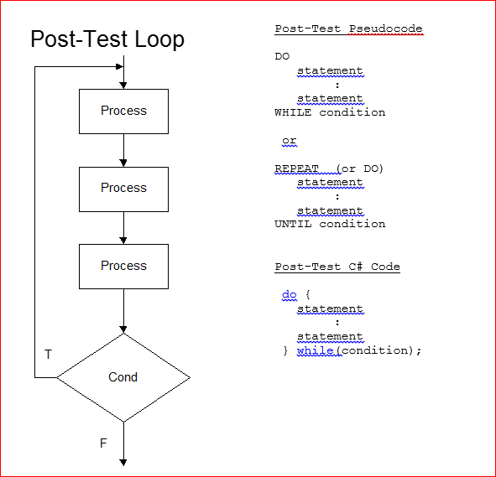
post test loop

Slide 43
post-test loop items
In a post-test loop, the decision on whether the loop should be processed again is made at the bottom of the loop.
Note the diamond symbol is used to flowchart a loop.
Normally, but not always, the loop code appears above the diamond, the loop continues out one side (and back up) and the loop exits to the bottom

Slide 44
post test loop
The do command is simply a placeholder that designates the top of the loop.
Note the while command comes after the end curly bracket
Note the condition is immediately followed by a semicolon.

Slide 45
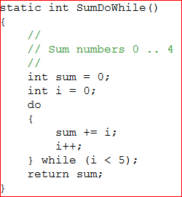
post-test loop example

