Slide 1
Unit 5 Decision Processing
Instructor: Brent Presley

Slide 2
Notes

Slide 3
textbook reading
Page 197-244

Slide 4
introduction to decision programming
So far we have been processing our logic sequentially, one statement after another. This unit introduces decision processing.
Decision processing requires a condition to be evaluated. Whether the condition is true or false determines what statements are executed.
C# (like most languages) has two decision constructs: If statements and Case statements.

Slide 5
intro to decision processing
Decision logic includes situations where:
Something happens if a situation is true but otherwise nothing happens.
One thing or another thing is done based on what the user enters or selects.
Multiple outcomes can occur depending on the user’s input or selection.
CheckBox controls are used to allow the user to make Yes/No or On/Off type inputs.
RadioButton controls are used to make one choice from many possible choices.

Slide 6
if statement construct
Decision logic includes situations where:
Something happens if a situation is true but otherwise nothing happens.
One thing or another thing is done based on what the user enters or selects.
Multiple outcomes can occur depending on the user’s input or selection.
CheckBox controls are used to allow the user to make Yes/No or On/Off type inputs.
RadioButton controls are used to make one choice from many possible choices.

Slide 7
example of if statements
if it is raining outside
  put your rain jacket on
  take your umbrella
endif
take a walk
eat supper
if I have a test tomorrow
  study for test
else
  watch movie
endif
go to bed

Slide 8
constructs in program design flowchart rules
Always 2 paths
Condition must be Yes/No, True/False question
One path may be do nothing
Note: The do nothing path can go straight down the bottom tip of the diamond.
The two divergent paths must always come together
If the same statement occurs in both paths, it probably does not belong in the IF construct (should be above or below)

Slide 9
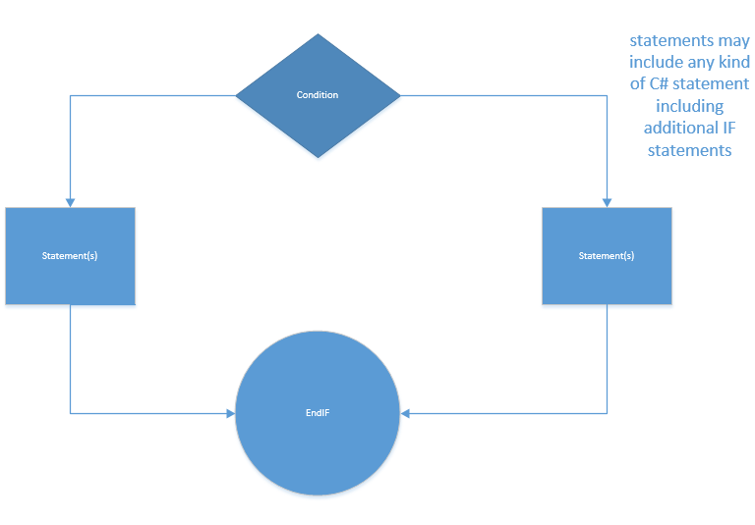
if flowchart example
label on condition can be true/false or yes/no
true
false

Slide 10
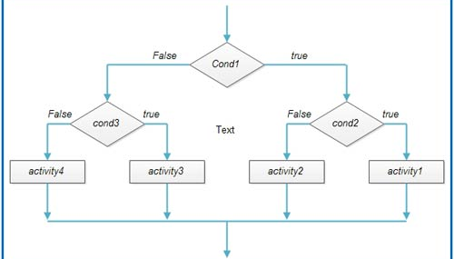
nested if statements flow

Slide 11
visio
demonstrate if statement
demonstrate nested if statements

Slide 12

pseudocode rules
Begin the logic with an If and end it with an End If
Then is optional. (I usually leave it off because C# doesn’t use it)
If there are no statements for the ELSE portion, leave the else off. This is the do nothing situation.
IF condition [THEN]
statements if condition is true
[ELSE
statements if condition is false]
ENDIF

Slide 13

if statement variables
The If … Then statement causes other statements to be executed only if the condition is True.
Pseudocode:
IF it is raining outside
Display “Put on your jacket”
Display “Take umbrella”
END IF
Display “Take a walk”
Do not word the condition so that do nothing is the Yes/True option. If necessary, reword so that No/False is do nothing (see Pseudocode for clearer explanation).

Slide 14
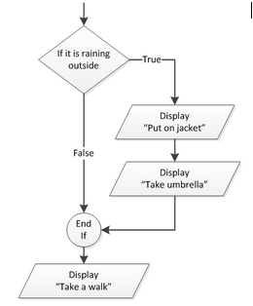
wording if statement
Do not word the condition so that do nothing is the Yes/True option. If necessary, reword so that No/False is do nothing

Slide 15
if statement pseudocode (bad)
//Code with reverse logic (bad example)
IF it is not raining outside
ELSE
Put on jacket
Take umbrella
ENDIF
DISPLAY “Take a walk”

Slide 16
if/else
The If … Then… Else statement executes one group of statements if the condition is true and another group of statements if the condition is false.
The If… Then…Else follows only one of two paths. BUT – the paths meet again at the End If.
Again – If the same statement occurs in both paths, it probably does not belong in the IF construct (should be above or below)

Slide 17
create a flow chart for this (small groups)
Display “Eat supper”
IF I have a test tomorrow
Display “Study for test”
ELSE
Display “Watch movie”
END IF
Display “Go to bed”

Slide 18
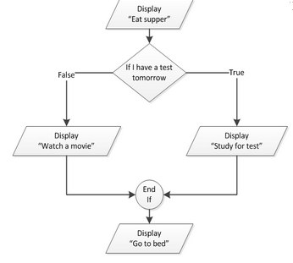
correct solution
display “eat supper”
I have a test tomorrow
Display “Study for test”
ELSE
Display “Watch movie”
END IF
Display “Go to bed”

Slide 19
if … elseif
Your program may have to choose between a number of options.
Like chaining together If… Then…Else statements.
The conditions are checked one after the other until one of them is true
NOTE: often, the same value is checked in each condition. In this example – Color is checked each time.
Use a trailing Else when you need to catch any value that falls through the cracks. It provides a default set of conditions that are executed if no other condition was found to be true. (in this example – Use caution)

Slide 20
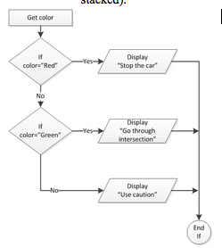
if...elseif example
GET color
IF color = “Red”
Display “Stop the car”
ELSE IF color = “Green”
Display “Go through intersection”
ELSE
Display “Use caution”
END IF

Slide 21
Group assignment
Assume iPhone contains savings account balance.
Draw flowchart to determine if should buy large screen TV or not (given the price).
iPhone also has credit card balance and limit. Modify flowchart to determine if pay cash or charge. (Mix cash and charge?)

Slide 22
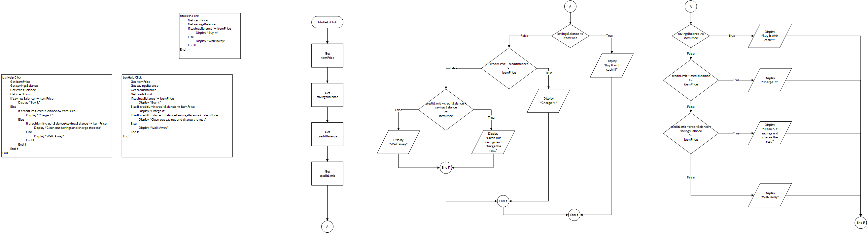
group assignment pseudocode

Slide 23
group assignment flowchart 1

Slide 24
group assignment flowchart 2

Slide 25

nested ifs
If statements within the conditional statements of another If statement. The If within the If can be any type of If (If … Then; If… Then… Else, If… Then… ElseIf)
in pseudocode, each If must have an corresponding End If
Each If does not have to have an Else, but if it does, your If/Else/End If statements must line up in the flowchart and pseudocode.

Slide 26
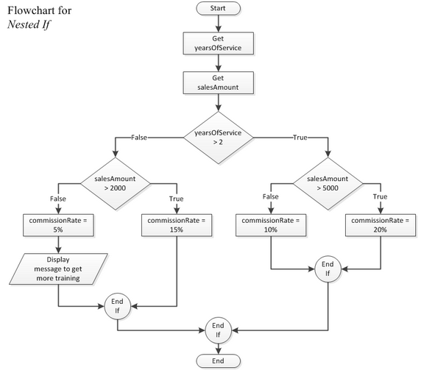
flowchart- nested if
GET salesAmount
If yearsOfService > 2
If salesAmount > 5000
commissionRate = 20%
Else
commissionRate = 10%
End If
Else
If salesAmount > 2000
commissionRate = 15%
Else
commissionRate = 5%
Give Message to request additional training
End If
End If

Slide 27
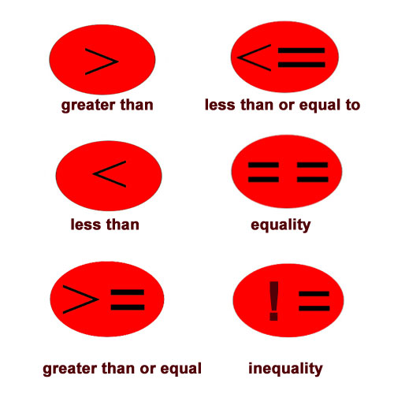
relational operators
During the sequential processing discussion you learned about operators (+, -, *, /, %) that are used for calculations. There are also operators that are used for comparison (in the conditions in the IF statement).
purpose: determines whether a specific relationship exists between two values

Slide 28

relational operators
Relational Operator Meaning
>Greater than
<Less than
==Equal to
!=Not equal to
>= Greater than or equal to
<=Less than or equal to
Relational expressions can only be evaluated as true or false
All operators have the same precedence.
Relational operators come after mathematical operators in the order of precedence

Slide 29
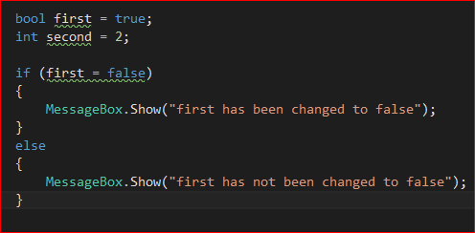
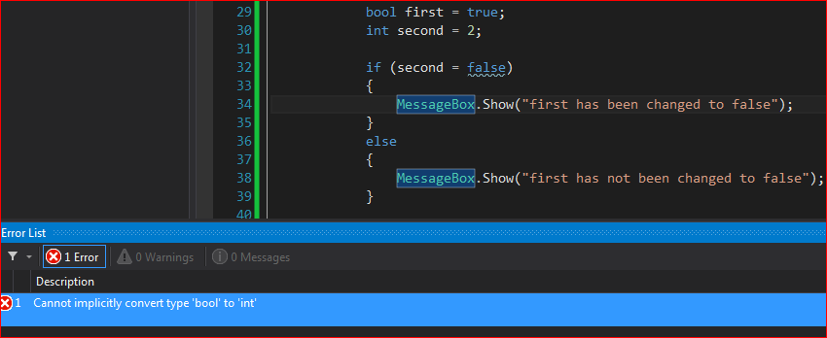
= vs ==
The common logic error made when creating IF statements is to use a single equal sign when checking for equality instead of a double equal sign (==)
C# helps you out. It does not allow you use a single equal sign in a condition (syntax error).
Other curly bracket languages are no so helpful.
Note in pseudocode, you don’t use a double equal sign to check for equality.

Slide 30
relational operators
Relational operators and math operators can be used in the same expression.
When relational operators and math operators are used in the same expression/condition, math operators are evaluated first.
Example 1: amount1 is added to amount2 and then it is compared to 1000
If amount1 + amount2 > 1000
lblMessage = “You get the bonus”
End if

Slide 31
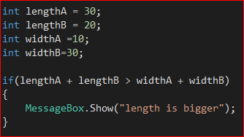
example
Example 2: lengthA is added to lengthB and C# will keep track of the total. Then, widthA is added to widthB and C# will keep track of this total. The totals are compared to determine if the condition is true or false.
If lengthA + lengthB > widthA + widthB
lblMessage = “Length is bigger”
End if

Slide 32

order of operation example
Most programmers prefer to use parentheses to clarify the order of operation. Trying to remember the order of precedence is hard. Be safe and use parentheses to clarify your statement.
If (lengthA + lengthB) > (widthA + widthB)
lblMessage = “Length is bigger”
End if

Slide 33
if statement in c#
if (condition) {
Statement(s) – you can have one or more statements to be
processed when the condition is true
} [else {
Statement(s) – you can have one or more statements to be
processed when the condition is false} ]
} //end if
Note: the code within the square brackets is optional. BUT – there must be a close curly bracket for every open curly bracket

Slide 34
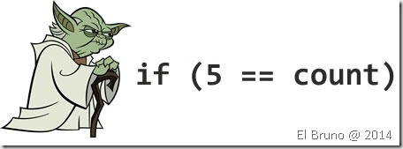
if example for c#
if (btnRaining) {
lblMessage.Content = "Take your jacket";
lblMessage.Content = lblMessage.Text +
" and take an umbrella";
} //end if
if ( saleAmt > 1000 )
commRate = 0.1;
//end if

Slide 35

conditional statements
Note: C# automatically indents conditional statements when you type an If …
{curly} brackets are optional if there is only one statement in the true block of code
I usually add them anyway to save time in maintenance and to stay consistent
You can compare the result of a function call to a value as well (next slide)

Slide 36

conditional stmt
if (int.Parse(txtLengthA.Text) > 100)
{
lblMessage.Text = "Length is too big";
} //end if
if (int.Parse (txtLengthA.Text) >
int.Parse (txtLengthB.Text))
{
lblMessage.Text =
"Length A is bigger than Length B";
} //end if

Slide 37
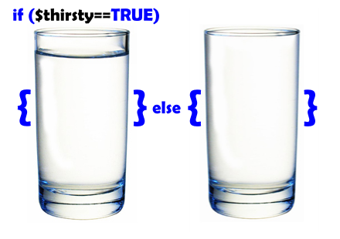
if…else
if ( blnTest ) {
lblMessage.Text = "Study for test";
} else {
lblMessage.Text = "Watch movie";
} //end if
if ( temperature > 72 ) {
lblMessage.Text = "Pool can open today";
} else {
lblMessage.Text = "Pool will be closed today";
} //end if

Slide 38
if…ElseIf
if (txtColor.Text == "Red") { //Note ==
lblMessage.Text = "Stop car";
} else if (txtColor.Text == "Green") {
lblMessage.Text = "Go through intersection";
} else {
lblMessage.Text = "Use caution";
} //end if
//Note only 1 end if for whole construct

Slide 39
assignments
checkpoints 4.1-4.11

Slide 40
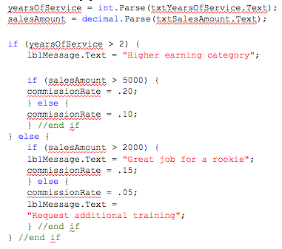
nested if
Note the importance of indentation. If indentation is wrong, meaning of IF statements may be misconstrued.

Slide 41
assignment
complete if assignment practice lab (on onedrive)

Slide 42
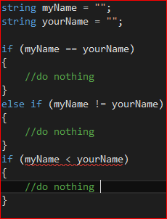
comparing strings
C# relational operators work with strings too but only for equality/inequality. The following are legal.
if(myName == yourName)
if(myName != yourName)
The following is not legal in C# (It is legal in many other languages)
if(myName < yourName)

Slide 43

strings
The only time I ever use this kind of string comparison is when I’m sorting or searching a list of strings. C# includes search and sort methods for lists, so we probably won’t need to do these kinds of string comparisons very often.
If you do need to do this kind of string comparison (other than equality/inequality), you use the Compare method that is included in the String class.

Slide 44
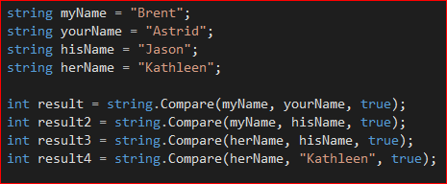
string.compare()
if (String.Compare(str1, str2[, true]) > 0)
compares str1 to str2 and returns a number
The number will be greater than 0 if str1 is after str2
The number will be less than 0 if str1 is before str2
The number will be 0 if the strings are the same
The value of the number is of little use. Typically, you only want to know if it positive or negative.

Slide 45
string.compare()
The third parameter (, true) is optional. Normally, String.Compare does a case-sensitive comparison (uppercase and lowercase letters are considered different)
If you include the third parameter, String.Compare will compare the strings without considering case—a case-insensitive comparison
(“a” considered the same as “A”)

Slide 46

string.compare extra details
String.Compare determines before/after based on the ASCII character sequence.
The ASCII character sequence assigns each character an index (integer value).
ASCII Character Table http://www.asciitable.com/
The “S” in ASCII stands for standards. This sequencing of characters has been the standard since the dawn of the computer age.
Today, the ASCII sequence has been expanded to include foreign characters and is called the Unicode character sequence.
According to Wikipedia, Unicode currently includes over 110,000 different characters and allows room for over 4 billion (32-bits)
The original ASCII characters are still in the same location (0-255)
Unicode characters. http://unicode-table.com/en/#control-character

Slide 47
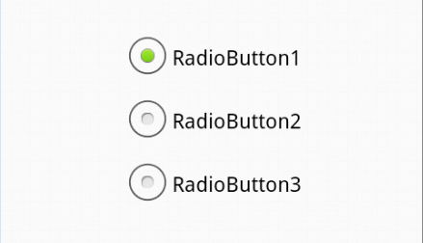
radio buttons
Windows and Visual Studio provide multiple tools to allow users to make selections / decisions
RadioButtons allow users to select one option from a list of choices
When the user selects a RadioButton all other related RadioButtons are automatically deselected
RadioButtons are typically placed in GroupBoxes to designate which RadioButtons are related

Slide 48
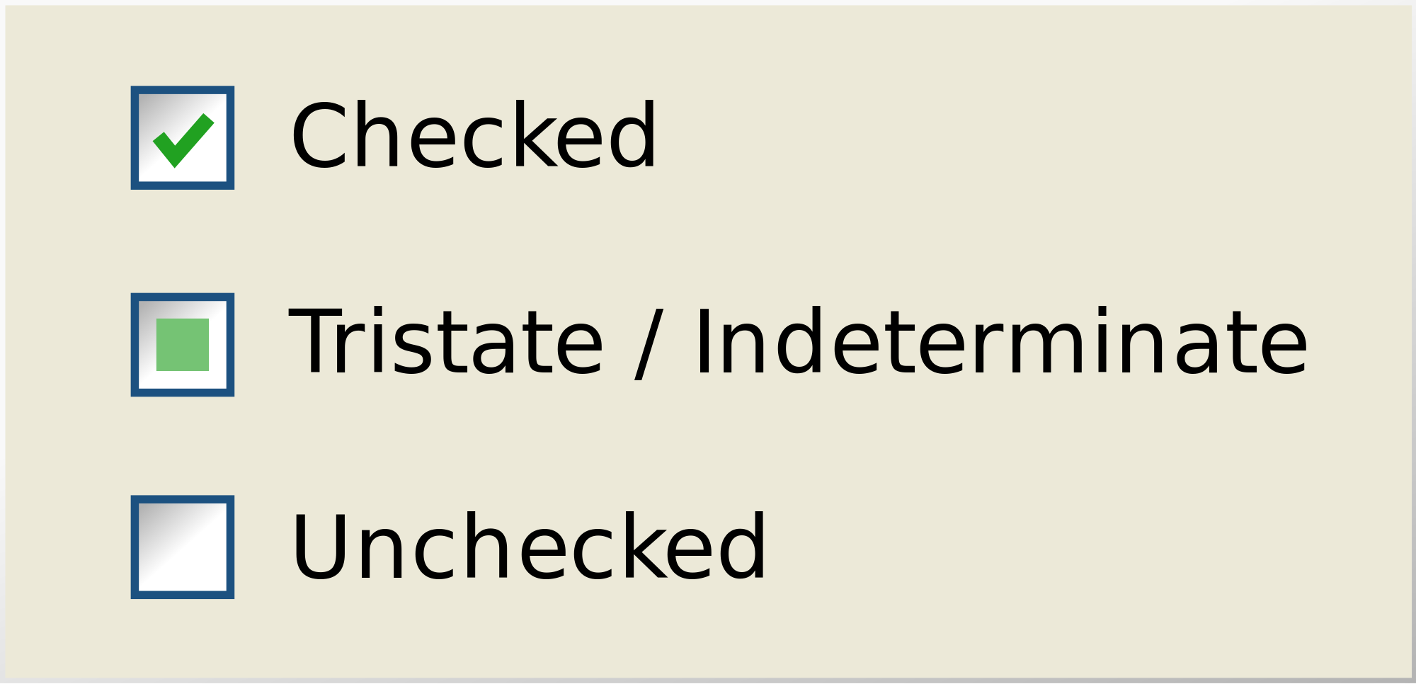
Check boxes
Windows and Visual Studio provide multiple tools to allow users to make selections / decisions
CheckBoxes allow users to select any number of options (including none) from a list of options

Slide 49
group boxes
GroupBoxes allow you to place other controls inside a rectangle to show that they are related
  Sometimes, this is just for appearance sake
  Other times, you might put objects into a group so you can move them together, or show/hide them at run time
With RadioButtons, GroupBoxes let C# know which RadioButtons are related.

Slide 50
group boxes addl items
GroupBox names are prefixed with grp
GroupBoxes often don’t need to be named.
  I only name these controls if my code references them (e.g. making an entire Panel invisible, then visible again)

Slide 51
adding controls to group box
group box can only have one child element
however, a grid can have multiple child elements
therefore,
  <groupbox>
    <grid>
      then put anything you need inside
    </grid>
  </groupbox>

Slide 52
moving controls into groupbox
Moving controls into a GroupBox or Panel
  If the controls already exist (outside the GroupBox) you can move them inside by simply dragging them in. However, you need a grid inside the groupbox first
Caution: if you delete a GroupBox or Panel, all the controls inside the GroupBox/Panel are deleted too

Slide 53
Checkboxes
CheckBoxes allow individual Yes/No, On/Off type selections.
CheckBoxes allow the user to make decisions while the program is running, but unlike RadioButtons, any combination of CheckBoxes can be selected.
CheckBoxes are independent of one another. Because CheckBoxes are not related, they do not have to be placed in a group but sometimes are to improve a form’s appearance.
CheckBox names are prefixed with chk or cbx
Change the Content property of the CheckBox to control what text appears next to the box

Slide 54
checkbox properties
Use the HorizontalContentAlignment and VerticalContentAlignment properties to control where the CheckBox appears in relation to the its text. You may need to make the checkbox wider and taller to observe this
The IsChecked property is true when this CheckBox is selected.
  Note: setting the IsChecked property to true causes the CheckChanged event to occur (see below)
  Note the consistency between CheckBoxes and RadioButtons.

Slide 55
assignments
Group activity: Develop design work for Simple Sub criteria (TOE, pseudo, flowchart)
Share results and develop a common class solution

Slide 56
radio button grouping
wpf will know that radio buttons are grouped together in one of two ways
  1. they are in a stackpanel together
  2. they are in the same GroupName

Slide 57
group box visibility
The visibility property for a groupbox has 3 states
  1- Visible: Display the element.
  2- Hidden: Do not display the element, but reserve space for the element in layout.
  3-Collapsed: Do not display the element, and do not reserve space for it in layout.
  When Visibility is collapsed, the control can't have focus, you can't navigate to the control using the TAB key, etcetera, all of which still can if it would have a height and width of zero.

Slide 58
lab work
Complete RadioButtons/CheckBoxes lab

Slide 59
Update your application(in the lab)
use SimpleSubsOrder program template
Add RadioButtons for Turkey, Ham, Roast Beef and Veggie to the Meat GroupBox
Add Italian and Sourdough to the Bread GroupBox
Add a GroupBox to the form for Add Ons
Add CheckBoxes to the GroupBox for Lettuce, Tomato, Mayo, Cheese

Slide 60
Merging event procedures
  Frequently, multiple objects’ event procedures will be identical or very similar.
  In these cases it is simpler to code and easier to maintain if one event procedure handles all the events. The event procedure is wired to more than one event (in C# terminology).

Slide 61
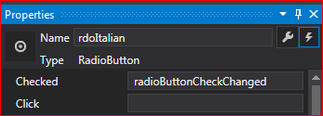

radio button check changed
You can add the same event handler for checking or unchecking a radio button
  xaml
  properties

Slide 62
Check changed event handler
What do you want to do in the event handler?
  determine which radio button is checked, then do something with that information

Slide 63
Coding checkboxes
You can set the checked and unchecked event to the same event handler, CheckChanged.
when the user clicks on the CheckBox (to turn it on or to turn it off)
Often, you won’t code an event for CheckChanged to occur immediately when the user clicks the CheckBox.
  Later in the code (calculation time?) you might include code to determine if the CheckBox is checked
  (e.g. if(chkBold.Checked) )

Slide 64

check boxes
You could also include this type of code in the CheckChanged event if you did need to process the CheckBox immediately (you still have to determine if the box was checked or unchecked)
Because most CheckBoxes do completely different things (change different things), you don’t normally combine the CheckChanged events into one procedure (see RadioButton coding).
I have done this on occasion if each CheckBoxes’ code is short

Slide 65
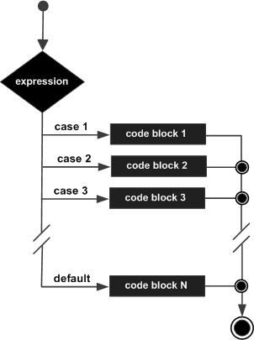
Case statement (switch)
The second decision making construct implemented in most programming languages is the CASE construct. The name comes from the fact that most languages implement this construct using the keyword “case”.
In general, use the following guidelines when deciding whether to implement a decision using a CASE construct, rather than an IF construct.
One, single question
Three or more answers to that single question

Slide 66
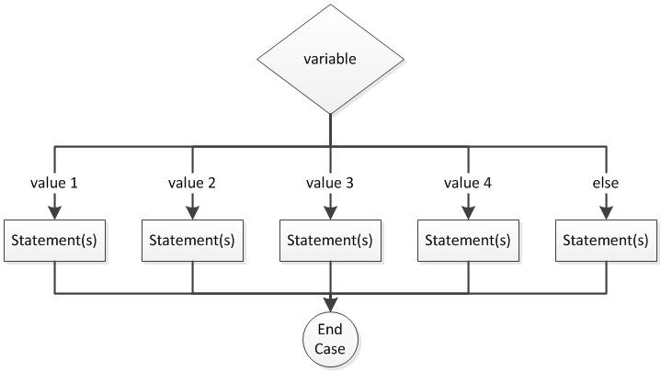
Pseudocode & flow chart
SELECT casevariable
CASE expression1
statements
CASE 1 To 4
statements
CASE 5, 9
statements
CASE > 6
statements
CASE ELSE
statements
END SELECT

Slide 67
Case stmts in c#
switch ( TestExpression ) {
[case expression:
Statement(s) – you can have one or more statements
to be processed when the case matches
break;
case expression :
case expression:
Statement(s) – you can have one or more statements to
be processed when the case matches
break;
default:
Statement(s) – you can have one or more statements to be processed when none of the other Case conditions
match ]
break;
}//end switch

Slide 68
Case statments
Note: the code within the square brackets is optional. BUT – there must be a curly bracket after the switch expression and a closing curly bracket at the very end
Note: case blocks aren’t surrounded by {curly brackets}. The break statements designate the end of each case

Slide 69
test expression of a case statement
The TestExpression is a program variable whose contents are evaluated to determine which case should be processed.
  The TestExpression can only be of type: int, bool or string
Think of each expression is a relational condition value that is compared to the TestExpression
Each case within the switch statement must be followed by an expression and then a colon

Slide 70
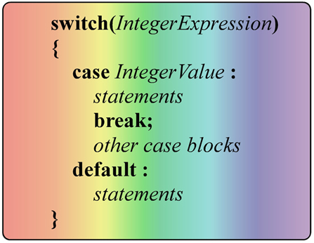
case test expression
C# will process the statements under the first case that meets the criteria of the TestExpression
  It is possible for multiple cases to match the TestExpression, but only the statements under the first case to match will be processed.
  Case order can be important

Slide 71

case stmt
If none of the cases match the TestExpression, the default case statements will be processed
If there is no default and none of the cases match, the Select statement is effectively skipped (nothing happens) and the statements after the end switch will be processed.
In C# (unlike other C-like languages), the break statement at the end of each case (including default) is required.

Slide 72
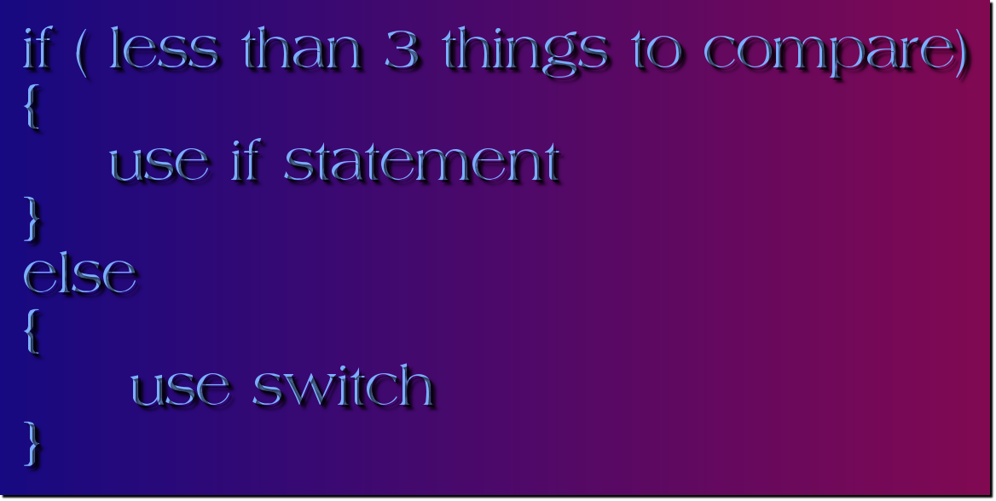
when to use a switch stmt
In general, if your program needs to ask a question with three or more answers, use a switch statement to implement the question.
The data type of the TestExpression and the values in the expressions must match

Slide 73

switch example
  If there is only one statement following a case, you may include it on the same line with the case to save space. Simply follow the case with a colon, then type the statement, followed by break.

Slide 74
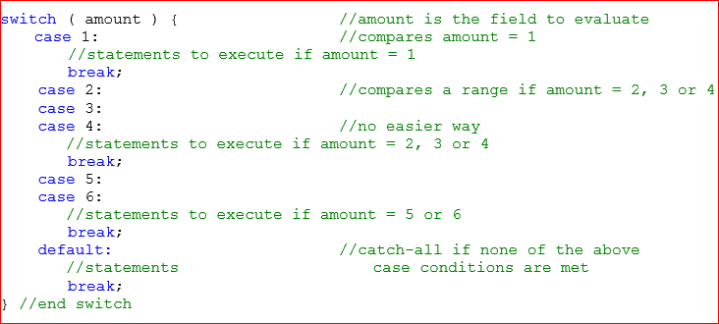
Example w/all case expression list variations

Slide 75

case statement use
  When a procedure handles more than one event, you use a Case statement to determine which object caused the event to occur.
    The procedure’s sender parameter can be used to determine the sending object (object that caused the event).
    Sender is of type object. This type is so generic, you can rarely do processing with it.

Slide 76
wpf windows lifetime event order
http://www.codeproject.com/Articles/403418/Lifetime-events-of-a-WPF-application
Initialized (child controls)
Initialized (window)
Activated (window)
Loaded (window)

Slide 77
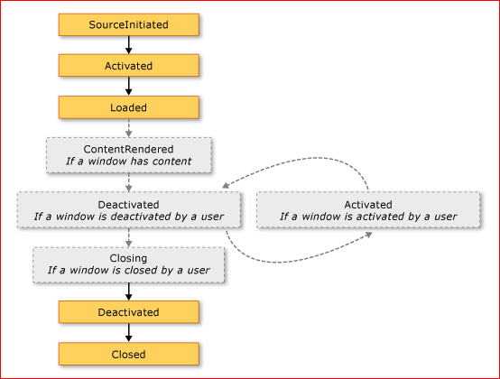
wpf windows lifetime event order
http://www.codeproject.com/Articles/403418/Lifetime-events-of-a-WPF-application

Slide 78
Create an event handler tied to two actions
we need to create a checkedchanged event handler that will fire when the radio button is checked or unchecked.
put same name inside both the Checked and the Unchecked event in the events screen
Do this in your application

Slide 79
Update your application
Add event handler for BreadCheckChanged. Add code to set the cost of the sandwich using If-ElseIf to determine bread/meat cost
Add event handler and add code to determine the add-ons cost using If statements.
Add another check box for soda, and then a Soda Groupbox. (note: no Text available) Copy all four RadioButtons from the Meat GroupBox into the Soda GroupBox (rename, and re-label).
Set the Visible property of the Soda GroupBox to false (Window initialized event handler)
Add code to the Soda CheckBox to appropriately show/hide the Soda GroupBox
add a Calculate Button event handler. Complete the logic to determine the sub cost .. Bread cost + Meat cost + Cost of each add on.
Complete the btnClear: clear all soda RadioButtons
Display the results

Slide 80
Update your application
Replace If-ElseIf with case statement to determine which bread was selected and set Window-level variable.

Slide 81
assignment
Checkpoints 4.20-4.29

Slide 82
checkchanged vs click event
The CheckChanged event also occurs for the RadioButton that automatically deselected (its check status also changed)
  The CheckChanged event for the button unselected occurs first, then the CheckChanged event for the newly checked button.
  In most circumstances this doesn't cause a problem. The selected button code overrides the code in the unselected button code.
If both CheckChanged events occurring does cause a problem, try moving the code to the Click event (which only happens if it's checked, not unchecked.
Note that the checkchanged event occurs, then the click event (demo this)

Slide 83

checkchanged class variable
Often, the CheckChanged event will set a class-level variable to a value that designates which RadioButton was clicked.

Slide 84

changing radio button in code
Changing a RadioButton programmatically
  Sometimes, you want to change or control which RadioButton is selected from within your code (no user click)
    Used to select the default button on form load (has the desired side effect of running the CheckChanged event code also)
    Can also be used when clearing a form to reset the default RadioButton

Slide 85
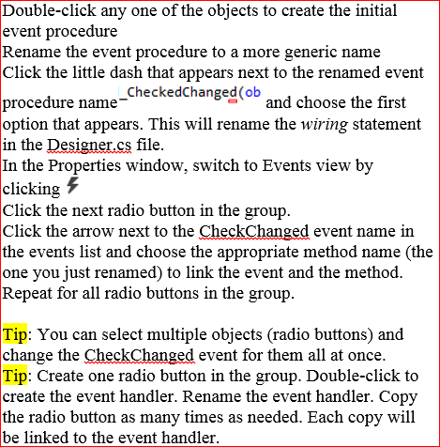
Link one procedure to multiple events

Slide 86
Update your application
Modify the CheckedChanged event, giving it an appropriate name for he group you are working with.
Link all radio buttons in the group to that event

Slide 87
casting the sender
We’ll convert sender to a type we can process
We’ll use a cast statement similar to those we used when doing calculations
In the class example, all the objects handled by the event procedure are RadioButtons, so we’ll tell the procedure to treat (cast) the sender parameter as a RadioButton.

Slide 88

casting the sender
RadioButton rdo = (RadioButton)sender;
or RadioButton rb = sender as RadioButton;
This defines a new variable that points to the sender object and converts it to a RadioButton
We still need to access one of the button’s properties to determine which button is the sender. We’ll use the button’s Name property.

Slide 89

obtain radio button name to use for switch
This command uses the variable rdoName, which is set to the radiobutton's name property. This property is used as the control variable for the switch statement.
Remember, the button’s name is a string, so you must surround the case values with quotes and match the name capitalization exactly.

Slide 90
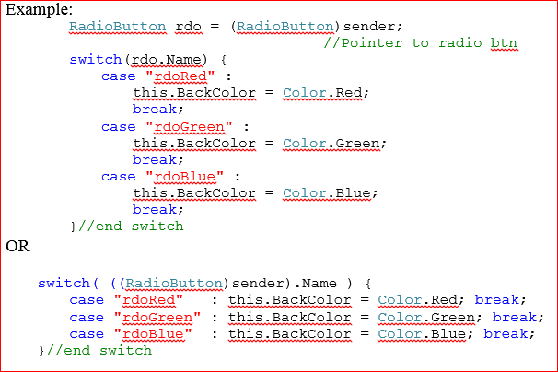
example
example

Slide 91
result of refactoring
Now, the code for all the RadioButtons is consolidated into one module.
  This makes reading the code easier
  Also makes maintenance a lot easier.

Slide 92
sequence of events
Note: because this code is in a common CheckChanged event, two events actually occur when the user clicks a RadioButton
  When the user selects a button, the CheckChanged event for the deselected button occurs first, then the CheckChanged for the button selected.
Because the new button’s code executes last, this has the same effect as using the Click event (for this color example). That may not always be the case. Use Click or CheckChanged appropriately.

Slide 93

use of class level variable
In some circumstances, like our sample program, the program doesn’t respond immediately to a RadioButton click but uses the selection in later processing. This is where I implement the class-level variable technique.

Slide 94
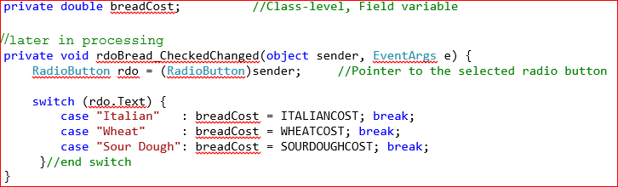
combine checkdchanged with switch
Note I used the same technique as earlier to combine the CheckedChanged events and used a select statement to figure out which button was selected.
In this example though, I saved an appropriate string to a window-level variable. I used the text of each RadioButton (Wheat, Italian, Sour Dough).
  The calculate routine can now look in the selectedBread variable to easily determine which RadioButton was selected.

Slide 95
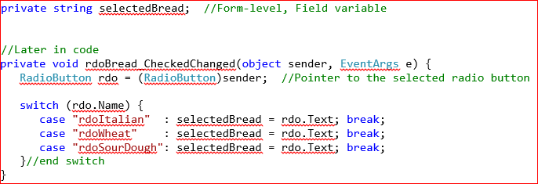
refactoring further
we can improve on this even more
  In this technique, I save the text of the selected radio button in a form-level variable
  This simplified the switch statement a little bit
But, it also allowed me to simplify each of the Case clauses as well. Now, the text of the selected button (represented by rdo) is saved in selectedBread

Slide 96

result
Now each case does exactly the same thing! Similar to IF statements, if the same statement occurs in each case of a switch, you should remove it from the decision and place it above or below the decision. If we remove the selectedBread = rdo.Text statements, there’s no code left in the case statement, so we can remove it as well, leaving only this

Slide 97
delaying the processing
Remember, this technique is only used for delayed processing where we want to store the text of the RadioButton. You’ll have to figure out which of the earlier versions (with case statements etc) to use if you need to process a little differently

Slide 98
Using radio buttons and checkboxes in calculations
  Obviously, you can’t include RadioButtons and CheckBoxes in calculations directly.
  CheckBoxes are easy
    If the status of a CheckBox effects your calculation, check the value of the CheckBox IsChecked property
    Use an If statement to modify your calculations appropriately.
  To simplify RadioButton processing, I recommend a simple programming trick (technique)
    Create a form-level variable for each group of RadioButtons that represents the value of currently selected button.
    Whenever the user selects a different RadioButton (CheckChanged event), store the appropriate value in the form-level variable
Use the form-level variable in your calculations

Slide 99
Compound conditions
  Many times, there is more than one part to a question (condition). For example:
If I get home early and there’s food in the fridge then
I’ll cook supper,
Else
we order pizza
End if
If the roads are too icy or there’s too much snow then
Staying home
Else
I’ll see you there
End if

Slide 100
multi part conditions
These multi-part conditions are called compound conditions. There are basically two kinds of compound conditions: AND conditions and OR conditions. Truth tables are used to show the results of compound conditions. The following are the standard truth tables for AND and OR compound conditions

Slide 101
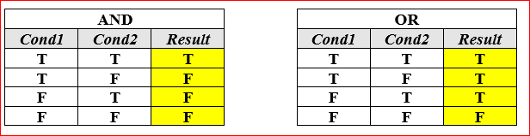
truth tables
  If you examine these truth tables carefully, you’ll see:
    The results of an AND compound condition will only be true if both conditions are true.
    The results of an OR compound condition will be true whenever either (or both) of the two conditions are true.

Slide 102
and vs or
Compound conditions are not restricted to just two conditions; there can be any number of conditions in a compound condition. Because of this, we need to expand the basic premises above:
  The result of a compound condition that uses only AND connectors will only be true if all conditions are true.
The result of a compound condition that uses only OR connectors will be true whenever at least one (or more) of the conditions is true.

Slide 103
example
If I can raise the money and I can find a sitter, I’ll go on the trip.
If I can raise the money and I can find a sitter and I get my car fixed, I’ll go on the trip.
  These are AND compound conditions. Only when all the conditions are true will this person go on the trip. Another way to look at AND compound conditions is: if any one of the conditions is false, the result is false. If any one of the conditions above falls through, the person will not be going on the trip.

Slide 104
compound or conditions
If I can raise the money or students get to go free, I’ll go on the trip.
If I can raise the money or students get to go free or my parents give me the money,
I’ll go on the trip.
  These are OR compound conditions. The student will go on the trip if any one of the conditions is true. Another way to look at OR compound conditions is: only when all the conditions are false will the result be false. If none of the conditions are true, the student will not be going on the trip.

Slide 105
compound and / or
  Things get a little more complicated when compound conditions include a combination of AND and OR.
If I finish my homework and I finish studying for the test or it’s a snow day, I’ll meet you at the bar.

Slide 106
example
  To thoroughly test a program that implements this question (a good program, one that helps you decide whether to go drinking or not) you would need to determine all the possible combinations of conditions and the expected result under each combination. This is where a truth table really comes in handy.

Slide 107
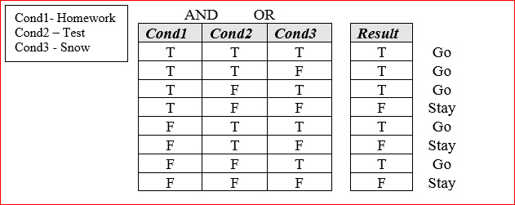
multiple conditions
  Whenever there are multiple conditions, with different connectors (AND, OR), the AND conditions are evaluated first (see order of precedence)—the result of the first condition pair is combined with the third condition, the result of that combined with the fourth condition, and so on. If you check the results in this truth table, the answers look OK.

Slide 108
multiple conditions
  The point is, you must check all the possible combinations of compound conditions, particularly when different condition connectors are used.
  Remember, you can override the order of precedence in programs using parenthesis, forcing the program to evaluate the second pair of conditions first. Use parenthesis to clarify your conditions and ensure they are evaluated properly.

Slide 109
complexity & conditions
  This example shows the complexity of having three conditions. There are 16 possibilities when there are four conditions, 32 when there are 5 conditions and so on.
    Imagine the time required to test all the possibilities. Then multiply that by the number of IF constructs in your program.
    As programs get large, testing all possible combinations is nearly impossible. This is why many of today’s major applications still have bugs in them.

Slide 110
2^n conditions
  If you ever have to build your own truth table:
    Every additional condition increases the number of possibilities by a factor of 2
    If true=1 and false=0, the truth table rows (combination of conditions) count in binary (from bottom to top). F F F = 0 F F T = 1 F T F = 2, etc.
    NOTE: the binary nature of truth tables.

Slide 111
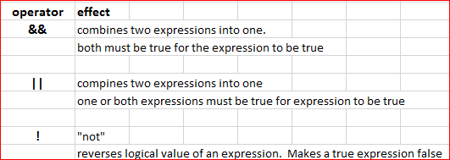
C# logical operators

Slide 112
Short circuit evaluation
  Logical expressions will short-circuit if the result of the whole expression is known after evaluating the first part of the expression.
  Short-circuit evaluation is the default behavior for C#.

Slide 113
&&
  With && (and)
    When using &&, both conditions on either side of the And must be true for the expression to be true.
    If the first condition is false, there would be no reason to evaluate the second condition. The entire expression must be false.
    Tip:
      With &&, always place the condition least likely occur first. When the condition is false, C# short circuits the second part of the condition, saving time, making your program more efficient.
      Or, for efficiency, place conditions that make a function or method call as the second condition. That way it will only be executed if the first condition is true. Calls to functions or methods are time consuming.

Slide 114
||
  With || (or)
    When using ||, either of the conditions on each side of the Or needs to be true for the expression to be true.
    If the first condition is true, there would be no reason to evaluate the second condition. The entire expression must be true.
    Tip: put the condition most likely to be true or the condition that is not a function or method call as the first condition.

Slide 115
update
Complete the code for the Compound Conditions in class example.

Slide 116
Adding tool tips
  ToolTips appear whenever the user hovers over an object for a brief period of time.
    They provide an easy way to show the user a little more information (Help).
  Add a ToolTip control to your project from the toolbox (double-click)
  Because the ToolTip object doesn’t appear on the form (the tips do, but not the object), the ToolTip object appears in the Component Tray below the Form window
  Because this object has been added to the project, every other control (that supports ToolTips) now has a ToolTip property.
  Simply add the text you want to appear to each object’s ToolTip property.
  Alternatively, you can add or modify tooltips at runtime
toolTip1.SetToolTip(objectName, "tooltip");

Slide 117
update
Complete ToolTips lab.
In Simple Subs, add ToolTips to all RadioButtons and CheckBoxes that displays their current cost
CENTSYMBOL = chr(162)

Slide 118
Random numbers
You can generate random numbers in C#.
  C# uses formulas to generate pseudo-random numbers
Create a variable of type Random
  Random rand = new Random();
Note: the variable that holds the random number is usually a class-level variable
Random.Next method returns the next integer in the series generated by the random number generator. If you pass no values/arguments, the returned integer will be between 0 and 2,147,483,647
nbr = rand.Next(); //int nbr;

Slide 119
What is a random number?
A deterministic device will always produce the same output when given the same starting conditions and inputs - that is what it means to be deterministic. "Truly random number" is more of a philosophical viewpoint, as what does it mean to be random is the crux of the philosophical navel gazing (folks aren't even certain if atomic decay is random or follows some pattern we just can't figure out yet). A cryptographically secure random number generator is going to take some external source of entropy to make the device non-deterministic

Slide 120
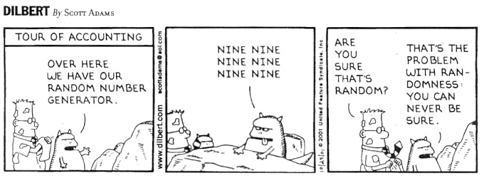

Slide 121
random
You can provide an upper limit to the generated numbers. The following statement will generate a value between 0 and 50:
nbr = rand.Next(1,50);
(Next generates numbers up to but not including the number in parenthesis)
You can have the range start at a number other than zero. Add or subtract a value to shift the numbers range up or downn
nbr = rand.Next(50 + 1) + 50;
This will generate a number between 50 and 100

Slide 122
random
NextDouble method returns a random floating point number between 0.0 and 1.0 (not including 1.0)

Slide 123
random
  If you want a number within a larger range, multiply the method by a scaling factor
dblNbr = rand.NextDouble() * 100.0;
This will generate a number between 0 and 100.0
(not including 100)

Slide 124
random
  If you want the number to start with a value other than zero, add/subtract from the value after you have multiplied by the scaling factor:
dblNbr = (rand.NextDouble() * 100.0) - 50.0;
This will generate a number between -50.0 and +50.0

Slide 125
random
  To simplify generating random numbers, I have written a utility procedure called GetRandom.
    To use it, you first have to import Tools.cs into your project.
      ProjectAdd Existing Item
      Locate a copy of Tools.cs
      Should appear in Solution Explorer
      Tools.cs includes other utilities we’ll use in Programming Logic – Intermediate
Once you’ve imported Tools.cs, all you have to do is call GetRandom.
myNumber = vTools.GetRandom(15, 75);

Slide 126
Import and browse through VolkerTools.cs
Use GetRandom to display two random dice rolls in Craps project.
Provide students with completed Craps project

Slide 127
    All the statements discussed on the previous page (Random, .Next, .NextDouble) are no longer needed. They are embedded in VolkerTools.cs
    This version of GetRandom returns a random integer. If you need to generate a random double value, you’ll have to modify this utility.

Slide 128
getrandom in c# tools class
    Note that GetRandom requires two parameters (the numbers in parenthesis).
      The first number is the smallest random number you want generated
      The second number is the largest random number you wanted generated
      Instead of literals (15, 75), you can use variables
      Basically, GetRandom generates a random integer between the two values you provide (inclusive)
      Both the minimum and maximum number are required.

Slide 129
Toupper and tolower
  ToUpper and ToLower methods work with string variables or expressions.
  General format:
StringExpression.ToUpper();
StringExpression can be any string variable or string expression.
  ToUpper returns the uppercase equivalent of the string.
  ToLower returns the lowercase equivalent of the string.

Slide 130
    Convert a string variable to uppercase and store the value in a variable.
destination = tripDestination.ToUpper();

Slide 131
    Convert a TextBox value to lowercase and store the value in a variable.
lastName = txtLastName.Text.ToLower();

Slide 132
    Compare a TextBox value to a literal
if(txtResult.Text.ToUpper() == "STOP") {
lblMessage.Text = "All processing done";
}//end if

Slide 133
  NOTE: ToUpper and ToLower methods do not modify the original value of the string; they just return the upper/lowercase equivalent. The field keeps its original value.
Use ToUpper and ToLower when you need to do string comparisons. C# is case sensitive which means the uppercase letters are not considered the same value as the lowercase values. Example: “A” is not the same ASCII value as “a”.

Slide 134
flags
  Flags are Boolean (True/False) variables that signal when some condition exists in a program.
  Flags are set in one part of a program and checked in another part of a program.
  Flags are set to true when the condition exists. Flags are set to false when the condition does not exist.
  Tip: Make sure you reset your flags in your program – in the beginning of the processing where the flag is set. If you do not, you can cause logic errors and erroneous results in the program.

Slide 135
if ( blnErrorExists ) {
//Do not process information
//Set error message
}
    Note there is no reason to include == true in the condition. The flag is already Boolean.
  Tip: To make flags easy to recognize, add either a bln or an is prefix to the variable name and name them so they read well in an If statement condition.
if ( blnErrorExists ) {
if ( isRetired ) {

Slide 136
assignment
Checkpoints 4.12-4.17
Page 225
Checkpoints 4.18-4.19
Page 226

