Slide 1
Welcome to MSTC
Instructor: Brent Presley

Slide 2
Overview
MSTC Network Login
MyMSTC
MSTC Email
Computer Needs
Software Needs
Network Storage
Course Website & Syllabus

Slide 3
Introduction
Brent
Education
  Bachelor of Science (Computer Information Systems, Mathematics, Economics).
  MBA,
  Masters Degree in Programming –in progress
Previously at Skyward, LifeQuest, Sentry
1 daughter who is 9 years old

Slide 4
Introduction
Brent
Education
  Bachelor of Science (Computer Information Systems, Mathematics, Economics).
  MBA,
  Masters Degree in Programming –in progress
Previously at Skyward, LifeQuest, Sentry
1 daughter who is 9 years old
I have a Tardis in my basement (next slide)

Slide 5
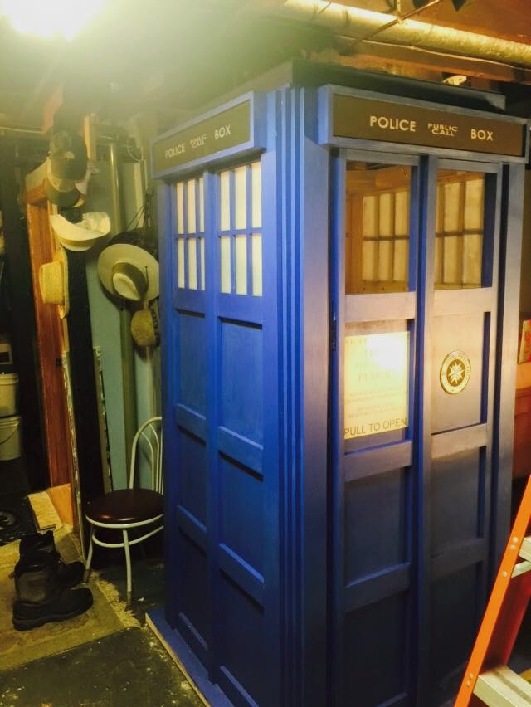
Tardis

Slide 6
Introductions
Name
Program you are in. Degrees you have already obtained (if applicable)
Computer knowledge level (1-10)
Current job & non-student activities
Family
1 interesting thing about you that will make people remember you

Slide 7
Program Success orientation
(PSO)
Friday, August 28
12 pm to 3 pm
Community Engagement Room
Strategies to ensure your success in IT programs
Extra Credit for attendance
Lunch

Slide 8
Course big picture
Why do you think the material in this course is important?

Slide 9
First day activity
pair the students in groups of two and give each person a sheet of paper. The rules are that only one student is allowed to talk, and the other needs to follow the directions they are given EXACTLY. I then sit the students back to back so that they cannot see each other. The student who is allowed to talk creates a paper airplane and talks through the process, while the student who is not allowed to talk follows along. It is fun to see if they come out with the same airplane at the end of the session.
After the paper airplanes are built, I engage students in a discussion about the process, asking them questions such as: "Does the order in which you gave the directions matter?", "What was the most difficult thing about not being able to talk?" and "Would it have been helpful to get feedback during the process about how you were progressing so far?" (Hint - this is a subtle reminder about writing programs in pieces and compiling as you go along rather than trying to do it all at once.) I then refer back to this activity throughout the year as a common experience in which I can frame other parts of the code - compile - run - refactor process

Slide 10
First day activity
Worst class I’ve ever had
  What the teacher did
  What the students did
Best class I’ve ever had
  What the teacher did
  What the students did

Slide 11
Mac Lab
Isolated from MSTC network
Wireless Internet: APPLE-LABs
User: sp-imac1 Password: @&FR_0S
Windows access via VMWare virtual machine (next class)

Slide 12
Mac Lab
Isolated from MSTC network
Wireless Internet: APPLE-LABs
User: sp-imac1 Password: @&FR_0S
Personal user accounts next class
Windows access via VMWare virtual machine (next class)

Slide 13
Set up profile on the mac
Instructor and/or assistant will log you in as an administrator
Then create your own profile
  Use a password you can remember easily
Set up the mouse in the ‘traditional’ manner if you wish

Slide 14
Transfer Virtual Machine
Transfer virtual machine from the admin account to your account. This will take a while to complete
  Save it on your desktop
  May wish to save it to a flash drive
  Always shut down the vm at the end of class

Slide 15
MSTC Network Login
Username
  ######## (student ID)
Password
  First 2 letters of first name (1st letter caps)
  First 2 letters of last name (1st letter caps)
  Last 4 of social security number
  Change it (Alt-Ctrl-Del)

Slide 16
User Profiles
iMac user profile is maintained on current computer
VMWare Windows profile is maintained on current computer
MSTC labs use DeepFreeze
  Profiles reset every day (2 am ?)
Store files on USB or in the cloud

Slide 17
MyMSTC
Different username and password
  Username=Student ID (can customize)
  Password self-selected
    Use Need to create a password?
Access to
  Schedule
  Transcripts
  Registration options

Slide 18
MSTC Email
24-7 access via Internet
lastname####@mymstc.edu
  last 4 digits of student ID
Only accessible via browser
Other student addresses available in address book
Don’t use for SPAM

Slide 19
MSTC Email
Off-campus access
https://outlook.com/mstc.edu
  Or through MyCampus
  Authentication required
    Network user name and password

Slide 20
Online Grades
Current semester
  Blackboard
  Also used to view assignment due dates
Past semesters
  Access via MyMSTC
  Final grades only
  Academics, other academics, Assignments
  Select the (semester) class

Slide 21
Computer at Home
School computers only available M-F
Suggested configuration
  2-3 GHz processor
  3-4 GB or more of RAM
  320 GB + hard drive
  Internet connection
  USB drive

Slide 22
Software available (if needed)
Provided by MSTC
  Operating Systems
    Windows 7 (32- and 64-bit)
    Windows 8 (32- and 64-bit)
    Windows 10
  IDE
    Visual Studio 2013 or 2015
  Others
    Office 2013 (via Email, Settings) – put one on your VM
    VMWare (thru Net Fund)
      http://e5.onthehub.com/WebStore/ProductsByMajorVersionList.aspx?ws=073f1066-723a-de11-b696-0030485a8df0&vsro=8
Downloadable via Microsoft Dreamspart
  https://mstc-dreamspark.onthehub.com/WebStore/ProductsByMajorVersionList.aspx

Slide 23
Other Computer Resources
Room 218: Software Development Mac Lab
Room 323: Networking Lab
  Note: User name/password are different than Mac Lab and MSTC network
  Rooms 110, 112, 411, 412(Windows Labs)
Learning Commons
Other campuses

Slide 24
Network STorage
H: Drive
  Your personal space
  Limited storage

Slide 25
Cloud Storage
H: drive NOT available off campus
Cloud storage is more portable
OneDrive
Inclass files:
Account: mstcpresley@hotmail.com
Password: student2015
Your OneDrive via Email (click OneDrive)
1TB SkyDrive with Office 2013
Make a document, send this information to me on onedrive. Name the file with your name. Bookmark site.

Slide 26
Printing in the Lab
$25 lifetime printing budget
  Not per semester
5¢ per page
Can refill your budget (front desk)
Form available for refund

Slide 27
C.A.S.S.
Campus Activities and Student Senate
  Manage student activities and funds
  Good leadership opportunity for resume’
  Good to have an IT representative

Slide 28
Course Website & Syllabus
http://instructor.mstc.edu/instructor/bpresley/
  Will use blackboard more extensively than in the past

