Slide 1
Welcome to MSTC
Instructor: Brent Presley

Slide 2
Overview
MSTC Network Login
MyMSTC
MSTC Email
Computer Needs
Software Needs
Network Storage
Course Website & Syllabus

Slide 3
Introduction
Brent
Education
  Bachelor of Science (Computer Information Systems, Mathematics, Economics).
  MBA,
  Masters Degree in Programming –in progress
Previously at Skyward, LifeQuest, Sentry
1 daughter who is 9 years old
I have a Tardis in my basement (next slide)

Slide 4
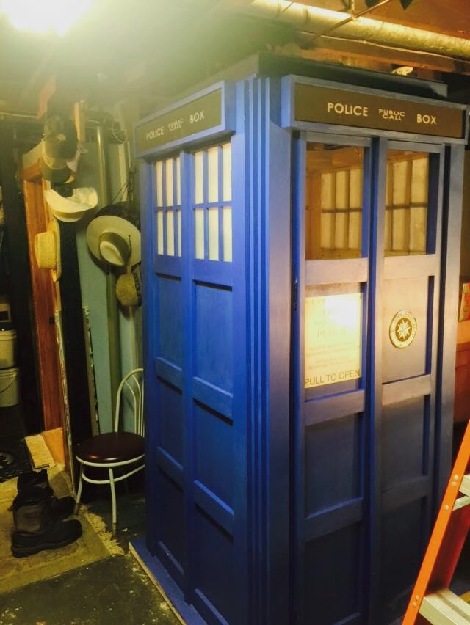
Tardis

Slide 5
Introductions
Name
Program you are in. Degrees you have already obtained (if applicable)
Computer knowledge level (1-10)
Current job
Family
1 interesting thing about you that will make people remember you

Slide 6
Program Success orientation
(PSO)
Friday, August 28
12 pm to 3 pm
Community Engagement Room
Strategies to ensure your success in IT programs
Extra Credit for attendance
Lunch

Slide 7
Mac Lab
Isolated from MSTC network
Wireless Internet: APPLE-LABs
User: sp-imac1 Password: @&FR_0S
Personal user accounts next class
Windows access via VMWare virtual machine (next class)

Slide 8
Set up profile on the mac
Instructor and/or assistant will log you in as an administrator
Then create your own profile
  Use a password you can remember easily
Set up the mouse in the ‘traditional’ manner if you wish

Slide 9
Transfer Virtual Machine
Transfer virtual machine from the admin account to your account. This will take a while to complete
  Save it on your desktop
  May wish to save it to a flash drive
  Always shut down the vm at the end of class

Slide 10
MSTC Network Login
Username
  ######## (student ID)
Password
  First 2 letters of first name (1st letter caps)
  First 2 letters of last name (1st letter caps)
  Last 4 of social security number
  Change it (Alt-Ctrl-Del)

Slide 11
User Profiles
iMac user profile is maintained on current computer
VMWare Windows profile is maintained on current computer
MSTC labs use DeepFreeze
  Profiles reset every day (2 am ?)
Store files on USB or in the cloud

Slide 12
MyMSTC
Different username and password
  Username=Student ID (can customize)
  Password self-selected
    Use Need to create a password?
Access to
  Schedule
  Transcripts
  Registration options

Slide 13
MSTC Email
24-7 access via Internet
lastname####@my.mymstc.edu
  last 4 digits of student ID
Only accessible via browser
Other student addresses available in address book
Don’t use for SPAM

Slide 14
MSTC Email
Off-campus access
https://outlook.com/mstc.edu
  Or through MyCampus
  Authentication required
    Network user name and password

Slide 15
Online Grades
Current semester
  Blackboard
  Also used to view assignment due dates
Past semesters
  Access via MyMSTC
  Final grades only
  Academics, other academics, Assignments
  Select the (semester) class

Slide 16
Computer at Home
School computers only available M-F
Suggested configuration
  2-3 GHz processor
  3-4 GB or more of RAM
  320 GB + hard drive
  Internet connection
  USB drive

Slide 17
Software available (if needed)
Provided by MSTC
  Operating Systems
    Windows 7 (32- and 64-bit)
    Windows 8 (32- and 64-bit)
  Programming Languages
    Visual Studio 2013 (available if needed)
  Others
    Office 2013 (via Email, Settings) – put one on your VM
    VMWare (thru Net Fund)
      http://e5.onthehub.com/WebStore/ProductsByMajorVersionList.aspx?ws=073f1066-723a-de11-b696-0030485a8df0&vsro=8
Downloadable via Microsoft Dreamspart
  https://mstc-dreamspark.onthehub.com/WebStore/ProductsByMajorVersionList.aspx

Slide 18
Other Computer Resources
Room 218: Software Development Mac Lab
Room 323: Networking Lab
  Note: User name/password are different than Mac Lab and MSTC network
  Rooms 110, 112, 411, 412(Windows Labs)
Learning Commons
Other campuses

Slide 19
Network STorage
H: Drive
  Your personal space
  Limited storage

Slide 20
Cloud Storage
H: drive NOT available off campus
Cloud storage is more portable
OneDrive
Inclass files:
Account: mstcpresley@hotmail.com
Password: student2015
Your OneDrive via Email (click OneDrive)
1TB SkyDrive with Office 2013

Slide 21
Printing in the Lab
$25 lifetime printing budget
  Not per semester
5¢ per page
Can refill your budget (front desk)
Form available for refund

Slide 22
C.A.S.S.
Campus Activities and Student Senate
  Manage student activities and funds
  Good leadership opportunity for resume’
  Good to have an IT representative

Slide 23
Course Website & Syllabus
http://instructor.mstc.edu/instructor/bpresley/

